Slide 1
Rare Tumors: Retinoblastoma, Hepatoblastoma, and Germ Cell Tumors
Carlos Rodriguez-Galindo, MD

Slide 2
No conflicts of interest

Slide 3
This talk will follow the topical structure suggested by the ABP:

Slide 4
Retinoblastoma
Hepatoblastoma
Germ Cell Tumors

Slide 5
Retinoblastoma
Hepatoblastoma
Germ Cell Tumors

Slide 6
Retinoblastoma Two Clinical Forms
Basic Science and Pathophysiology
Non-hereditary, unilateral or unifocal
75% of patients
Mutation of both alleles in a somatic cell
Median time to diagnosis: 29-30 months
Hereditary, bilateral, multifocal
25% of patients
Germline mutation of RB1
25% cases: Inherited from a carrier parent
75% cases: “de novo” mutation early in embryogenesis
Median time to diagnosis: 14-16 months

Slide 7
Retinoblastoma Biology
Basic Science and Pathophysiology
Biallelic inactivation of RB1
First hit is germline in heritable form and somatic in sporadic non-heritable form
Additional events required for transformation
P53 pathway: MDM2 and MDM4 amplification
Epigenetics
BCOR mutations
SYK upregulation
Wild type RB1 (1.5%): MYCN amplification
Associated with worse outcome

Slide 8
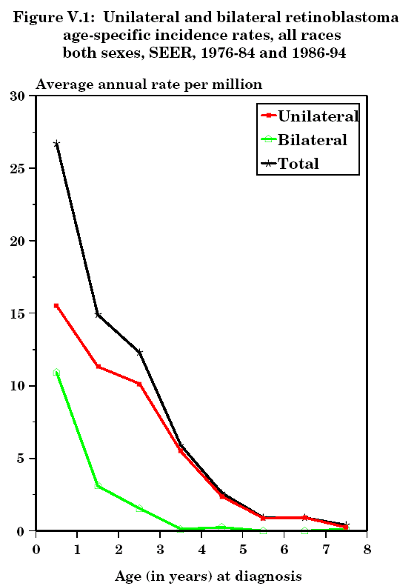
Retinoblastoma
Epidemiology and Risk Assessment
Annual Incidence
3.7 cases per million children < 15 y
US: 300 new cases/year
~3% of all pediatric cancers
11% of cancers < 1 yr
Age at presentation
63% < 2 years
95% < 5 years
Laterality is age dependent
< 1 yr: 42% BL – 58% UL
1-2 yr: 21% BL – 79% UL
> 2 yr: 9% BL – 91% UL
Ries LAG, Smith MA, Gurney JG, Linet M, Tamra T, Young JL, Bunin GR (eds).
Cancer Incidence and Survival among Children and Adolescents: United States SEER Program 1975-1995, National Cancer Institute, SEER Program. NIH Pub.No.99-4649. Bethesda,MD,1999.

Slide 9
Genetics and Genetic Counseling Heritable Retinoblastoma
Epidemiology and Risk Assessment
The First Hit: Germline Mutation
3-5% recognized by cytogenetics
13q- syndrome: RB + Mental Retardation + Dysmorphic features
95% submicroscopic
15-25% detectable by Southern Blot
75-80% point mutations
Paternal allele
Exposure to welding fumes, XR, metal industry
The Second Hit: Somatic
Occurs spontaneously at a rate of 1:1000
75%+ is often chromosomal in nature
More sensitive to environmental factors
XRT → > 2,000 x

Slide 10
Genetics and Genetic Counseling Heritable Retinoblastoma
Epidemiology and Risk Assessment
Facts to remember
Germline mutation → >90% penetrance for RB
Autosomal dominant pattern
All patients with bilateral RB have a RB1 germline mutation
25% inherited, 75% ‘de novo’
BUT:
15% of patients with unilateral RB carry a mutation
15% of patients with germline mutation develop unilateral RB
Mosaics for RB1 mutation exist
Mutation occurs in late embryogenesis
Variable tissue expression
10% of patients with sporadic bilateral RB

Slide 11
Genetics and Genetic Counseling Heritable Retinoblastoma
Epidemiology and Risk Assessment
Genetic counseling and proposal for genetic testing is indicated in all patients with retinoblastoma and their families
Mutations are distributed throughout the 27 exons of the RB1 gene
No single mutational “hotspot”
A single genetic test is unlikely to detect all germline RB gene mutations
Sequencing + FISH + QM-PCR + Methylation + MLPA
Current methods: 90-95% sensitivity
Specific mutation of the proband is needed to screen relatives
All offspring and newborn siblings MUST be screened at birth and every 4 weeks until genetic testing is complete
Babies with positive testing (RB1 mutation) require dilated eye exams every 4 weeks due to high penetrance of mutation

Slide 12
Retinoblastoma Clinical Presentation
Diagnosis
Intraocular
Leukocoria 65-75%
Strabismus 10-15%
Nystagmus 5-10%
Advanced Intraocular
Buphthalmos
Glaucoma
Periorbital cellulitis
Extraocular
Proptosis + LN
Metastases

Slide 13
Retinoblastoma Evaluation
Diagnosis
Examination under anesthesia
Direct visualization of the tumor(s)
Evaluation of corneal diameters and intraocular pressure
Imaging:
Ocular US
MRI orbits and brain
Evaluation of optic nerve prior to enucleation
Evaluation of CNS (Trilateral RB)
Bone scan, BM and CSF
Only if advanced disease: high-risk histology after enucleation, or extraocular retinoblastoma
Genetic counseling

Slide 14
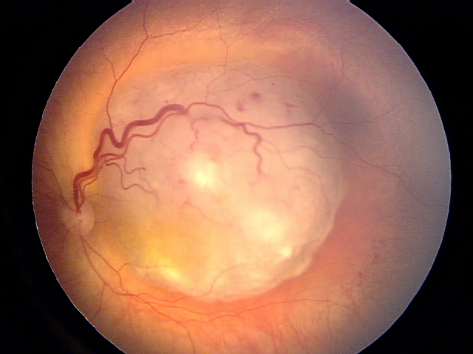
Retinoblastoma
Diagnosis
Subretinal Fluid
Dilated Vessels
Exophytic
Ca++
Luteal Pigment

Slide 15
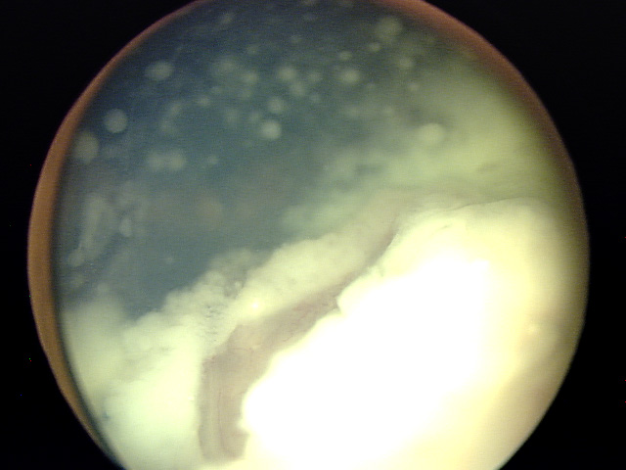
Retinoblastoma
Diagnosis
Endophytic
Vitreous seeds

Slide 16
Retinoblastoma Differential Diagnosis
Diagnosis
Congenital Cataracts
Coats’ Disease
Persistent Fetal Vasculature (PFV)
Retinitis:
Toxocara
Toxoplasma
Medulloepithelioma
Astrocytic Hamartoma
Choroidal Osteoma
See supplemental slides

Slide 17
Diagnosis
Retinoblastoma “Staging”
Eye → Classification (groups)
Patient → Staging

Slide 18
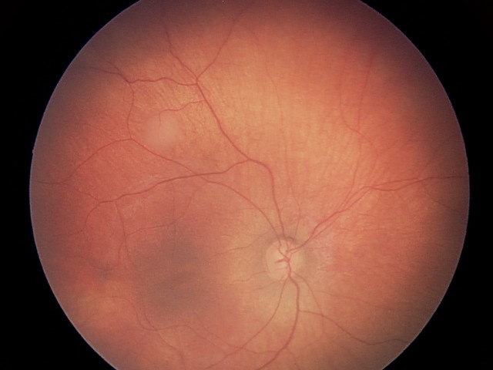
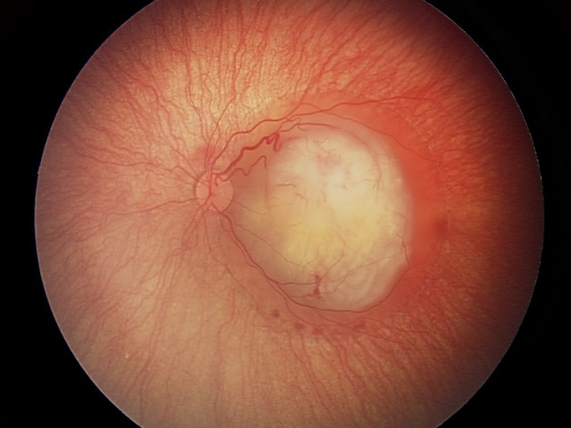
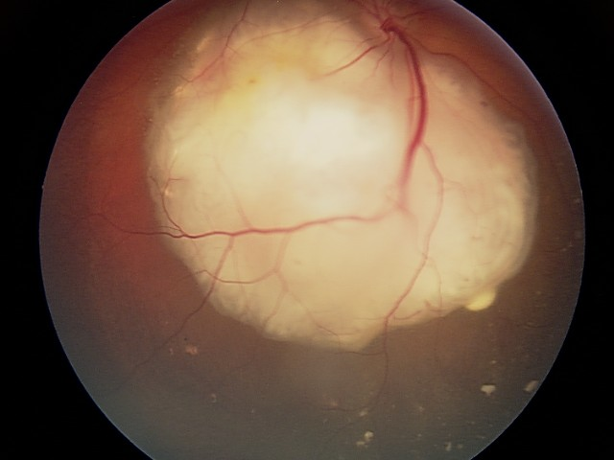
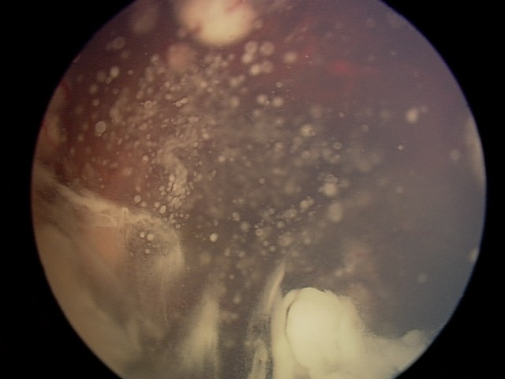
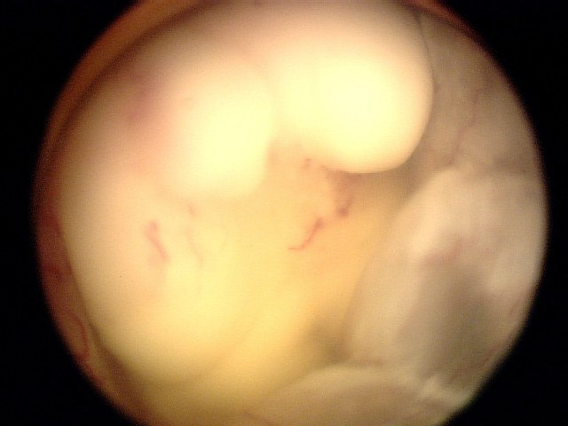
International Retinoblastoma Classification System
Diagnosis
Developed in the 2000’s
Based on ocular salvage using modern conservative approaches
Tumor size and tumor burden
Tumor location (in relationship to foveola and optic disc)
Subretinal fluid and seeding
Vitreous seeding
A
B
Group | Defining Features
Group A Small tumors away from foveola and disc | Tumors < 3 mm and Located at least 3 mm from foveola and 1.5 mm from the optic disc
Group B All remaining tumors confined to the retina | All other tumors confined to retina not in Group A Subretinal fluid < 3 mm from the base of tumor
Group C Local subretinal fluid or seeding | Local subretinal fluid alone > 3 to < 6 mm from tumor Vitreous seeding or subretinal seeding < 3 mm from the tumor
Group D Diffuse subretinal fluid or seeding | Subretinal fluid alone > 6 mm from tumor Vitreous seeding or subretinal seeding > 3 mm from tumor
Group E Presence of poor prognosis features | More than 2/3 globe filled with tumor Tumor in anterior segment or ciliary body Iris neovascularization, neovascular glaucoma Tumor necrosis, phthisis bulbi
C
D
E

Slide 19
International Retinoblastoma Staging System
Diagnosis
Stage | Definition
0 | Patients treated conservatively Refer to RB Group (Classification)
I | Eye enucleated, completely resected histologically
II | Eye enucleated, microscopic residual tumor Trans-scleral invasion Positive cut-end of o.n.
III | Regional extension a) Overt orbital disease b) Preauricular or cervical LNs
IV | Metastatic disease a) Hematogenous metastasis b) CNS extension 1. Pre-chiasmatic 2. CNS mass 3. Leptomeningeal and CSF disease
Key Concepts:
Intraocular disease
Without extraretinal extension
With extraretinal extension
Risk histological factors
Extraocular disease
Orbital
Extraorbital
CNS
Extra-CNS

Slide 20
Retinoblastoma Treatment
Management and Treatment
Multidisciplinary Team
Pediatric Oncologist
Ophthalmologist
Radiation Oncologist
Infrastructure
Supportive care
Priorities in Treatment
Cure
Eye Salvage
Vision Preservation
(+ Avoid or Delay RT)

Slide 21
Retinoblastoma Treatment
Management and Treatment
Priorities in Treatment
Cure
Eye Salvage
Vision Preservation
(+ Avoid or Delay RT)
Must be individualized
Stage, group
Laterality
Major concepts
Ocular preservation vs. enucleation
Risk-adapted therapies
Intraocular vs. orbital vs. extraorbital
Two different scenarios: UL and BL
Avoid or delay RT for ocular salvage
Important impact on orbital growth
Risk of second malignancies (heritable RB)

Slide 22
Retinoblastoma Treatment
Management and Treatment
Treatment of intraocular retinoblastoma
Ocular salvage vs. enucleation
Treatment of unilateral retinoblastoma
Treatment of bilateral retinoblastoma
Treatment of extraocular retinoblastoma
Treatment of orbital disease
Treatment of metastatic disease

Slide 23
Retinoblastoma Treatment
Management and Treatment
Treatment of intraocular retinoblastoma
Ocular salvage vs. enucleation
Treatment of unilateral retinoblastoma
Treatment of bilateral retinoblastoma
Treatment of extraocular retinoblastoma
Treatment of orbital disease
Treatment of metastatic disease

Slide 24
Retinoblastoma Treatment
Management and Treatment
Treatment of intraocular retinoblastoma
Ocular salvage vs. enucleation
Treatment of unilateral retinoblastoma
Treatment of bilateral retinoblastoma
Treatment of extraocular retinoblastoma
Treatment of orbital disease
Treatment of metastatic disease

Slide 25
Treatment of Retinoblastoma Ocular Salvage vs. Enucleation
Management and Treatment
Priorities in Treatment
Cure
Eye Salvage
Vision Preservation
(+ Avoid or Delay RT)
A B C D E
Enucleation
Ocular Salvage
Intra-arterial Chemotherapy
Systemic Chemotherapy
Focal Treatments
(Radiation Therapy)

Slide 26
Ocular Salvage vs. Enucleation Key Concepts in Ocular Salvage
Management and Treatment
Chemoreduction
Focal Treatments
Systemic
Standard: VCR + CBP + ETO
Early stage (Group B): VCR + CBP
Intra-arterial
Single-agent melphalan
Combination CBP/TPT/MEL
(more effective for advanced or refractory)
< 4 DD
Cryotherapy (anterior)
Thermotherapy (posterior)
Photocoagulation (posterior)
4-10 DD
Brachytherapy

Slide 27
Ocular Salvage vs. Enucleation Key Concepts in Ocular Salvage
Management and Treatment
Chemoreduction
PC
Radiotherapy
(45 Gy)
TTT
Progression
Focal Treatments
CT
Enucleation
BT
Systemic
VCR
ETO
CBP
Intra-arterial
MEL
Focal Treatments
…
PC: Photocoagulation; TTT: Transpupillary thermotherapy
CT: Cryotherapy; BT: Brachytherapy

Slide 28
Ocular Salvage vs. Enucleation Key Concepts in Enucleation
Management and Treatment
Upfront treatment of advanced disease
Always indicated in Group E eyes
Alternative to ocular salvage depending on laterality
Unilateral > Bilateral
Treatment after failure of ocular salvage
Surgery: Expert surgeon
Removal of long section of optic nerve (~ 10 mm)
Placement of orbital implant
Histopathological exam

Slide 29
Risk-Adapted Therapy after Enucleation
Management and Treatment
Extra-Retinal Disease = High Risk Histology (20-25%)
Massive choroidal replacement (> 3mm)
Ciliary body infiltration
Iris infiltration
Scleral invasion
Anterior chamber seeding
Optic nerve:
Post-laminar involvement
Pre-laminar involvement + choroidal involvement
(Consensus Criteria from ARET0332 study)

Slide 30
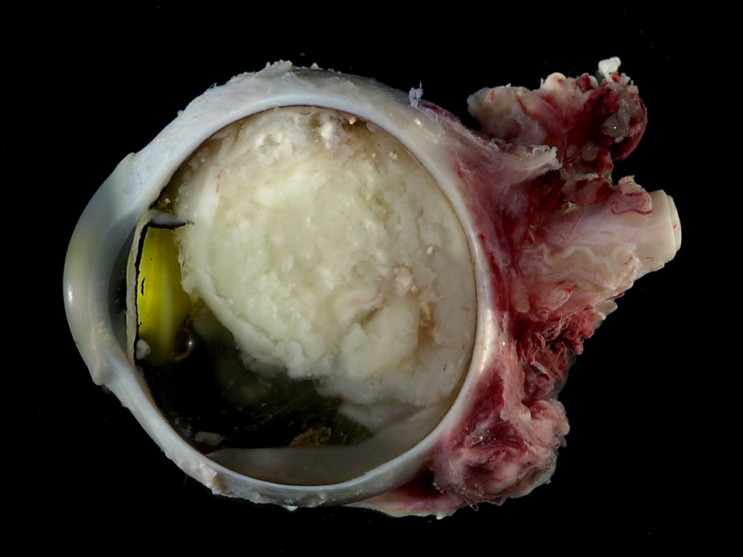
Management and Treatment
No high-risk histology
(intra-retinal)
High-risk histology
(extra-retinal)
Metastatic Workup
(Bone Scan, BM, CSF)
Observation
Examination of orbital socket
Examination of contralateral eye
Imaging not typically required
Outcome: > 90% survival
NEG
POS
Adjuvant Chemotherapy
VCR/ETO/CBP x 6
(VCR/CYC/DOX)
Outcome: > 90% survival
Treatment for
Metastatic Disease

Slide 31
Retinoblastoma Treatment
Management and Treatment
Treatment of intraocular retinoblastoma
Ocular salvage vs. enucleation
Treatment of unilateral retinoblastoma
Treatment of bilateral retinoblastoma
Treatment of extraocular retinoblastoma
Treatment of orbital disease
Treatment of metastatic disease

Slide 32
Treatment of Unilateral Retinoblastoma
Management and Treatment
Usually presents with advanced intraocular disease
Leukocoria → tumor affects 2/3^{rds} of the eye globe
Upfront enucleation and risk-adapted adjuvant therapy has been considered standard of care
No risk pathology (75-80%): Enucleation only
Risk pathology (20-25%): Enucleation + Adjuvant chemotherapy
Ocular salvage treatments indicated for early intraocular disease (A, B, C, some D)
Intra-arterial or systemic chemotherapy + focal treatments
Ocular salvage rates with I-A chemotherapy: > 75%
Ocular salvage not indicated for advanced intraocular disease (E, some D)

Slide 33
Treatment of Unilateral Retinoblastoma
Group A
Group B, C
Group D
Group E
Focal Treatments
Systemic or
I-A Chemotherapy
+
Focal Treatments
Consider IA
chemotherapy
Enucleation
Pathology
Progression
Progression
Progression
No risk
Risk
Systemic or IA chemotherapy
Brachytherapy
Consider
Brachytherapy
Chemotherapy
+ EBRT if extraocular disease
Observation
Enucleation
Enucleation
Histological risk-based adjuvant chemotherapy

Slide 34
Retinoblastoma Treatment
Management and Treatment
Treatment of intraocular retinoblastoma
Ocular salvage vs. enucleation
Treatment of unilateral retinoblastoma
Treatment of bilateral retinoblastoma
Treatment of extraocular retinoblastoma
Treatment of orbital disease
Treatment of metastatic disease

Slide 35
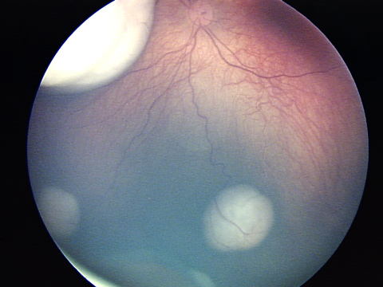
Bilateral Retinoblastoma Key Concepts to Consider
Management and Treatment
Multifocal disease
Dynamic process
Tumors develop until 4-5 years of age
Treatment decisions must include (for each eye)
Tumor burden (‘Group’)
Potential for vision
Status of contralateral eye
Risk factors for ocular salvage:
Tumor size
Vitreous seeding
Retinal detachment/seeds

Slide 36
Treatment of Bilateral Retinoblastoma
Management and Treatment
Usually more conservative approach than for unilateral RB
Upfront intra-arterial or systemic chemotherapy + intensive focal treatments (+/- radiation therapy)
Avoid or delay enucleation and radiation therapy when possible
BUT: Surgery IS curative and radiation therapy IS the single most effective conservative treatment in retinoblastoma
Side effects of irradiation: bone growth delay and second malignancies
Timing of enucleation and irradiation also depends on status of contralateral eye
Outcome
Ocular salvage rates: 65-75%
Survival: >90%

Slide 37
Management and Treatment
Treatment of Bilateral Retinoblastoma
Group A
both eyes
Group B
worse eye
Group C, D
worse eye
Group E
worse eye
Focal Treatments
2 or 3-drug systemic chemotherapy or
I-A chemotherapy
+
Focal Treatments
3-drug systemic
chemotherapy or
I-A chemotherapy
+
Focal Treatments
Enucleate group E eye
Treatment based on
Pathology
Group of remaining eye
Progression
Progression
Progression
Chemotherapy
Brachytherapy
EBRT*
Intravitreal chemotherapy
Enucleation
*EBRT – External-beam radiation therapy
Histological risk-based adjuvant chemotherapy

Slide 38
Retinoblastoma Treatment
Management and Treatment
Treatment of intraocular retinoblastoma
Ocular salvage vs. enucleation
Treatment of unilateral retinoblastoma
Treatment of bilateral retinoblastoma
Treatment of extraocular retinoblastoma
Treatment of orbital disease
Treatment of metastatic disease

Slide 39
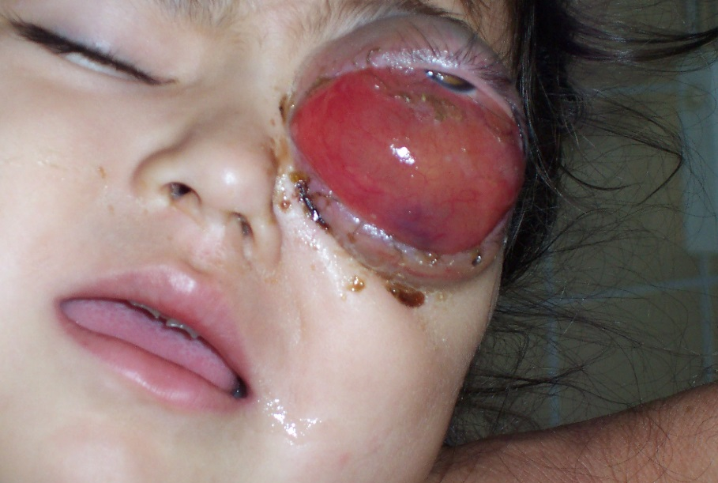
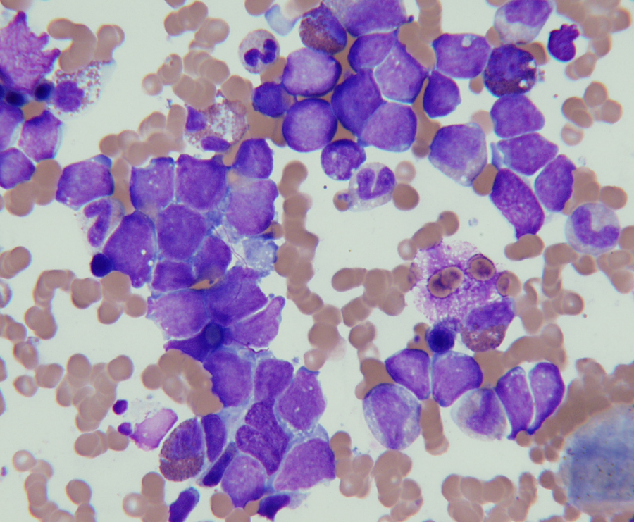
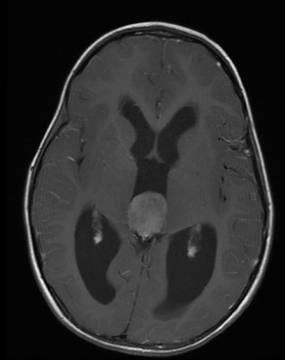
Extraocular Retinoblastoma
Management and Treatment
Orbital Retinoblastoma
Trans-scleral involvement
+ cut end optic nerve
Orbital disease (± LN)
Extra-Orbital (metastatic)
CNS
Extra-CNS

Slide 40
Orbital Retinoblastoma
Management and Treatment
Rare occurrence in the US, usually associated with late diagnosis or recurrence post enucleation
Presentation
Isolated: 60-70%
Preauricular/Cervical LN: 10-20%
Distant metastases: 30-40%
Treatment
Platinum-based regimen
Enucleation (exenteration not required)
Radiation therapy (45-50 Gy)
Outcome
Survival 70-80%

Slide 41
Extraorbital (Metastatic) Retinoblastoma
Management and Treatment
< 5% in US (more frequent in low-income countries)
Metastatic sites
Bone
Bone marrow
Liver
CNS
Extra-CNS disease curable with cisplatin-based chemotherapy + auto HSCT + RT (survival > 50%)
CNS disease → dismal prognosis

Slide 42
Long Term Effects
Management and Treatment
Chemotherapy
Hearing loss
Therapy-related AML (BUT, survivors of heritable RB do not have an added risk beyond chemotherapy exposure)
Cardiotoxicity
Radiation
Facial deformity
Second malignant neoplasms
Ocular
Decreased vision (tumor, treatment)
Retinal vasculopathy (tumor, RT, I-A chemo)
Xerophthalmia (RT)
Second malignant neoplasms

Slide 43
Second Malignancies in Retinoblastoma Survivors
Management and Treatment
Cumulative incidence 36% at 50 years*
Most are radiation-induced:
RT exposure almost doubles the risk (20% to 40%)
60-70% of second malignancies are in the head and neck area
Dose-effect
Age-effect (higher risk for < 1 yo)
Malignancies:
Osteosarcoma (25-40%): Most common inside and outside irradiated field
Soft tissue sarcomas (10-15%): Inside > outside irradiated field (leiomyosarcoma > fibrosarcoma > MFH > STS NOS > RMS)
Melanoma and other skin cancers (15-20%)
Lung cancer and other common cancers of adulthood
*Kleinerman, R. A. et al. J Clin Oncol; 23:2272-2279 2005

Slide 44
Trilateral Retinoblastoma
Management and Treatment
Bilateral RBL + asynchronous midline intracranial tumors
Pineoblastomas
3-9% of bilateral RBL
Median interval B-RBL to T-RBL: 35 m.
Very poor prognosis
Lower vertebrates: Pineal gland is a photoreceptive organ
Role of screening (MRI every 6 months until 5 years of age): Unclear impact on outcome
Caution: 50-60% of patients with bilateral RB develop pineal cysts
BUT frequency of occurrence and size of pineal gland is not different from normal patients

Slide 45
Retinoblastoma
Hepatoblastoma
Germ Cell Tumors

Slide 46
Pediatric Liver Tumors
Epidemiology and Risk Factors
Rare: ~ 1.1% of malignancies
100-150 cases/year in US
0.5-1.5/10⁶ children
Affect infants and young children
Median age 19 months
80% younger than 15 yrs
HBL: Third most common intra-abdominal neoplasm
Incidence is highest during infancy (11.2 per million children)
66% hepatic malignancies < 20 yrs
91% < 5 years
HCC: Liver malignancy of adolescents
Accounts for > 95% of liver malignancies in > 15 year olds
More frequent than hepatoblastoma in Asia and Africa (hepatitis B infection endemic)

Slide 47
Pediatric Liver Tumors
Epidemiology and Risk Factors
Age | Benign | Malignant
Infancy (0-1 y) | Hemangioendothelioma Mesenchymal hamartoma Teratoma | Hepatoblastoma (SCU) Rhabdoid tumor Yolk sac tumor LCH M7 AML Disseminated NB
Early childhood (1-3 y) | Hemangioendothelioma Mesenchymal hamartoma | Hepatoblastoma Rhabdomyosarcoma Inflammatory myofibroblastic tumor
Later childhood (3-10 y) | Perivascular epithelioid cell tumors (PE-comas) | Hepatocellular carcinoma Embryonal sarcoma Angiosarcoma Cholangiocarcinoma Endocrine (gastrin) carcinoma
Adolescence (10-16 y) | Adenoma Focal nodular hyperplasia Biliary cystadenoma | Fibrolamellar HCC Hodgkin lymphoma Leiomyosarcoma
Adapted from Finegold MJ et al. Arch Path Lab Med 2007; 131:520-9

Slide 48
Hepatoblastoma Biology
Basic Science and Pathophysiology
Activation of WNT pathway
Activating mutations in CTNNB1 (or APC) in > 90% of cases
Upregulation of Wnt signaling pathway genes
DKK1
APCDD1, AXIN2, CCND1
NFE2L2 (NRF2) mutation (5%)
Associated with worse prognosis
Other alterations
Mutations in epigenetic modifiers (MLL2, ARID1a)
Variable expression of Lin-28, AFP, Notch

Slide 49
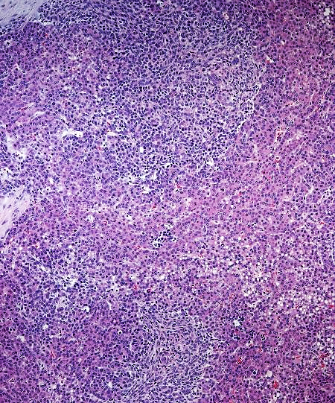
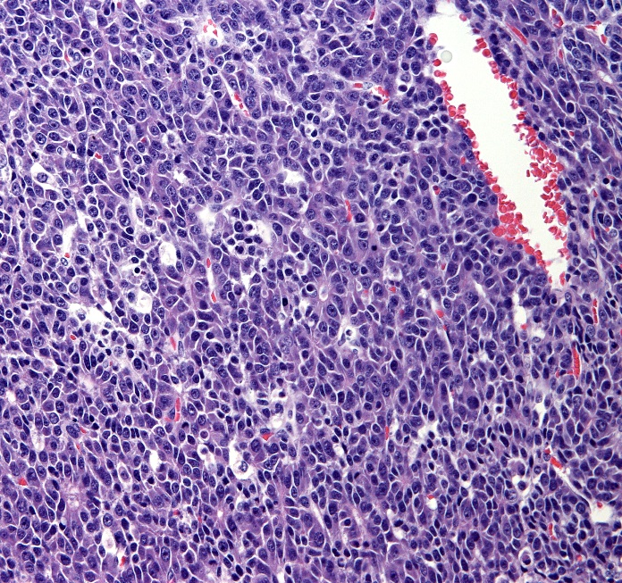
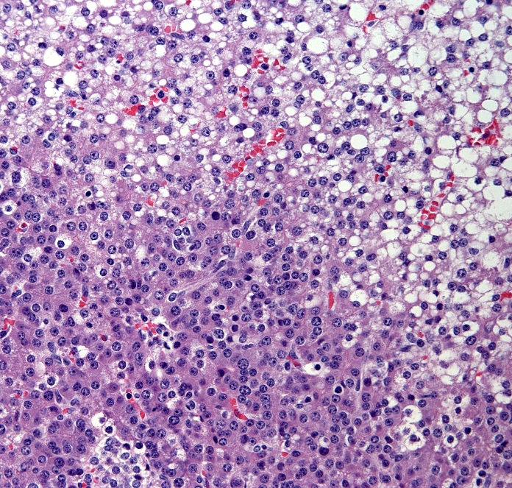
Hepatoblastoma
Basic Science and Pathophysiology
HB arise from a precursor to the mature hepatocyte
Undifferentiated small cells
Embryonal epithelial cells
(= liver at 6-8 weeks of gestation)
Well-differentiated fetal hepatocytes
(= normal fetal liver)
Embryonal Component
Fetal Component

Slide 50
Hepatoblastoma Risk Factors
Epidemiology and Risk Factors
Risk Factors | Hepatoblastoma | Hepatocellular Carcinoma
Congenital Abnormalities | Familial polyposis Gardner Syndrome Beckwith-Wiedemann Sdr. Hemihypertrophy Glycogen storage diseases | Hereditary Tyrosenemia Biliary cirrhosis Glycogen storage diseases α-1 antitrypsin deficiency Hemochromatosis
Environment Factors | Fetal alcohol syndrome Prematurity and low birth weight Oral Contraceptives Oral Gonadotropins Parental exposure to metal, petroleum products, paint | Hepatitis B & C Alcohol consumption Anabolic steroids Aflatoxin Carcinogens (pesticides, vinyl chloride, Thorotrast)

Slide 51
Hepatoblastoma Risk Factors
Epidemiology and Risk Factors
Beckwith-Wiedemann Syndrome
Complex multigenic disorder – growth regulatory genes on 11p15.5
Incidence: 1/10,000 live births
Overgrowth, abdominal wall defects, macroglossia, GU malformations, organomegaly, hyperinsulinemic hypoglycemia, and others.
Malignancy risk: 8-10% during first decade of life
Wilms tumor (43%)
Hepatoblastoma (20%)
Adrenocortical tumors (7%)
Others: Neuroblastoma, rhabdomyosarcoma, pancreatoblatoma, leukemia
Hemihypertrophy
Incidence 1/86,000 live births
Isolated or associated with BWS or Klippel-Trenaunay-Weber or McCune-Albright Sdr.
Malignancy risk: 5% (WT, HB, ACT)

Slide 52
Hepatoblastoma Risk Factors
Epidemiology and Risk Factors
Prematurity and low birth weight
Disproportionate # of cases with BW < 2500 grams
RR 15.64 for BW <1000g
RR 2.53 for BW 1000-1499g
RR 1.21 for BW 1500-2499g
Familial Adenomatous Polyposis and Gardner syndrome:
Germline APC mutations
FAP: Gastric tumors, desmoids, congenital hypertrophy of retinal pigment epithelium
Gardner syndrome: Osteomas
Estimation: 5-10% cases of HB have FAP syndrome → Importance of family history
APC testing recommended in sporadic HB
Lifetime risk of HB for children of FAP families:
1/250 compared to 1/100,000 in general population
RR of developing HB = 800

Slide 53
Hepatoblastoma Clinical Presentation
Diagnosis
Asymptomatic abdominal mass
Weight loss, anorexia, emesis, and abdominal pain (advanced disease)
Elevated alpha-fetoprotein (> 90% of cases)
Distant metastases ~ 20% of cases - mostly to lung
Intraperitoneal, lymph node, brain, and local tumor thrombus
Thrombocytosis (common):
HB cells secrete IL-1B: induces fibroblasts/endothelial cells to produce IL-6 → hepatocyte growth factor secretion and thrombopoeitin secretion
Hypertension (rare): Renin-secreting tumors
Precocious puberty (rare): Secretion of h-BHCG

Slide 54
Hepatoblastoma Differential Diagnosis
Diagnosis
Biliary rhabdomyosarcoma:
Jaundice
Hemangioendothelioma:
Congestive heart failure
Kaposiform HE: Kassabach-Merritt phenomenon
Hemangiomas and Hemangioendotheliomas:
Hypothyroidism (due to production of iodothyronine deiodinase)

Slide 55
Hepatoblastoma Evaluation
Diagnosis
Diagnostic imaging:
Ultrasound/Doppler:
Helps evaluate cystic versus solid masses
Patency and involvement of vascular system
CT scan CAP and MRI: define hepatic and extrahepatic tumor extent, vascular supply, and operability
Laboratory work-up:
Alfa Fetoprotein: most valuable test
Elevated in 80-90% of patients, useful for monitoring
Biologic half-life: 5-7 days
Pathology:
Biopsy: multiple histologic types are present and intermingled (multiple passes recommended if trucut biopsy)

Slide 56
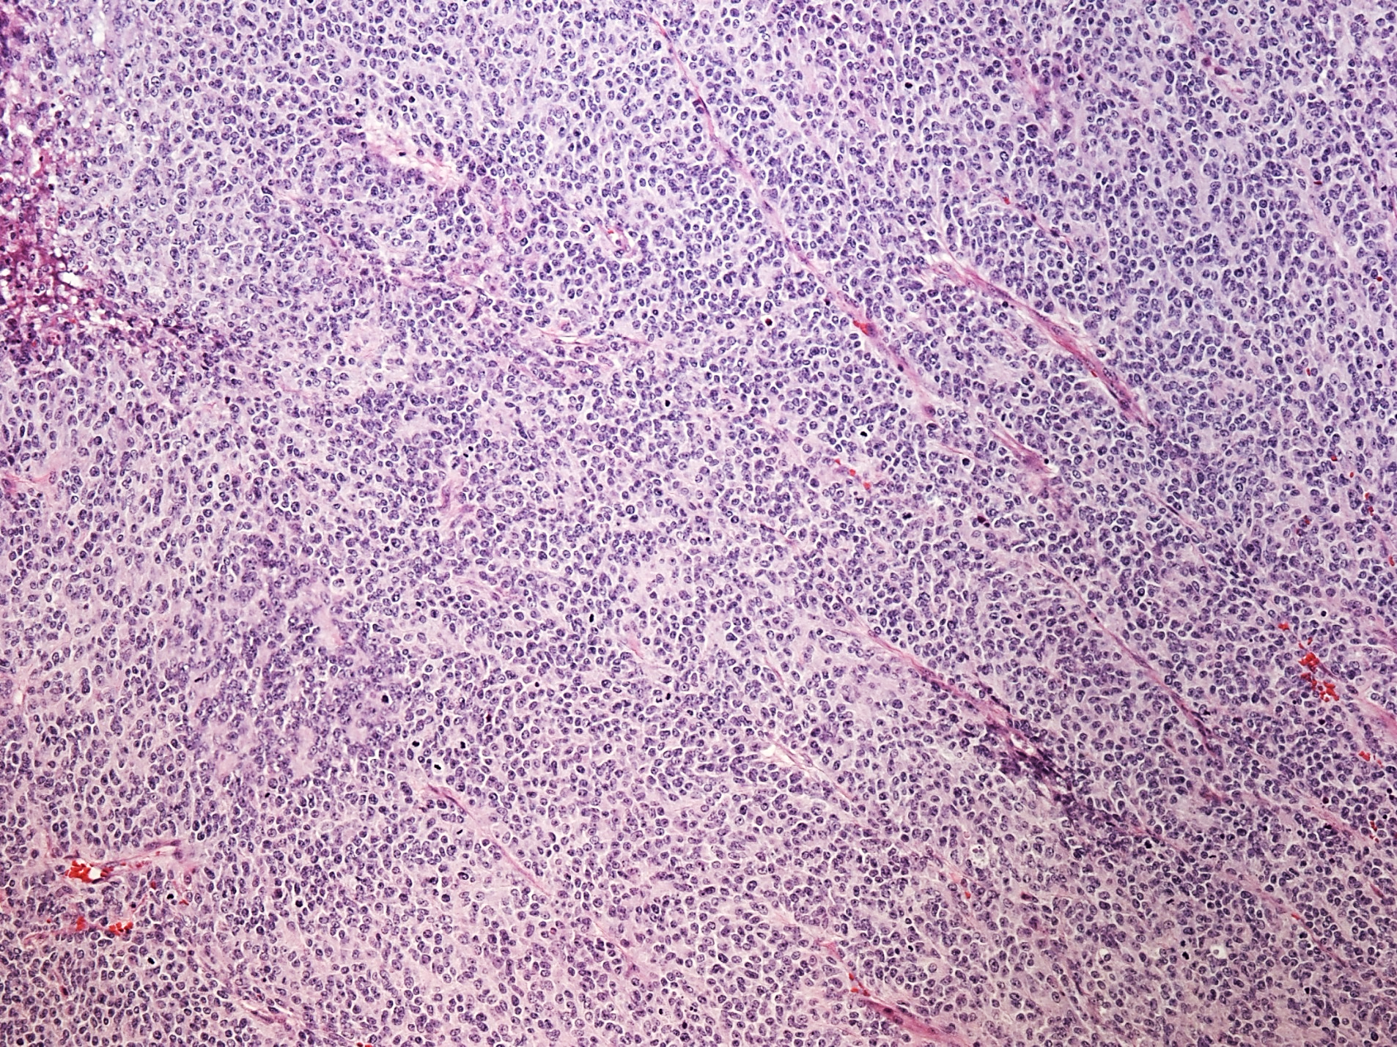
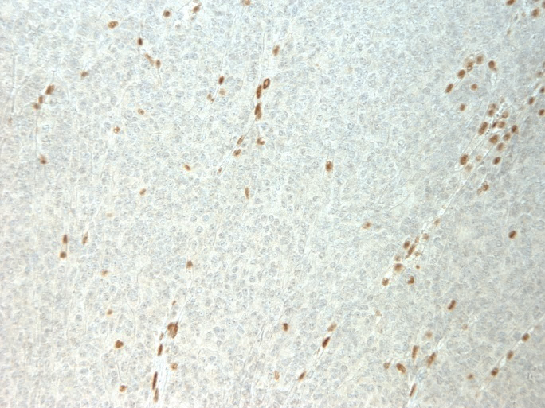
Hepatoblastoma Pathology
Diagnosis
Epithelial Subtype
Epithelial (fetal + embryonal) (85-90%)
Pure Fetal Histology (7-10%)
Excellent outcome
Stage I can be cured with surgery only
Small Cell Undifferentiated Histology (5%)
Very poor prognosis
Associated with low AFP (< 100 ng/mL)
Associated with 22q11 aberrations (hSNF5/INI1 gene) (=Malignant Rhabdoid Tumor)
Negative INI1 immunostaining
Small Cell Subtype
Loss of INI-1 expression

Slide 57
Liver Tumors and Alpha-Fetoprotein
Diagnosis
Elevated in
> 90% of HBL
60-70% of HCC
Differential diagnosis with
Germ cell tumors (liver primary)
Pancreatoblastoma
Low or Normal in fibrolamellar variant of HCC
In hepatoblastoma low AFP (< 100 ng/ml) is associated with worse prognosis and with SCU histology
Also mildly elevated in
Infantile hemangioendothelioma
Mesenchymal hamartoma

Slide 58
Hepatoblastoma Staging
Diagnosis
Surgical Criteria:
Surgical resection is the mainstay of therapy and required for cure
Staging based on surgical criteria (currently used by COG and German Cooperative Group)
I: Complete resection
II: Microscopic margins
III: Gross residual or nodal involvement
IV: Metastatic disease
Radiographic Criteria:
SIOPEL: Preoperative chemotherapy for all patients
Staging based on radiographic criteria: PRETreatment EXTent of Disease (PRETEXT)

Slide 59
PRETEXT Staging
Diagnosis
PRETEXT I: Three contiguous sectors free
PRETEXT II: Two contiguous sectors free
PRETEXT III: One contiguous sector free
PRETEXT IV: All four sectors involved

Slide 60
Treatment of Hepatoblastoma Principles of Therapy
Management and Treatment
Risk-adapted therapy based on stage and pathology
Surgical resection is the mainstay of curative therapy
Only 20-30% of patients have resectable disease at presentation
Surgery only is curative > 90% of Pure Fetal HBL
Hepatoblastoma is a very chemosensitive disease
Cisplatin-based therapy
Chemotherapy increases proportion of patients achieving complete resection
Used in neoadjuvant and adjuvant settings based on risk assignment
Radiation therapy IS NOT indicated in the upfront treatment of HB

Slide 61
Treatment of Hepatoblastoma Chemotherapy
Management and Treatment
Cisplatin-based regimens
COG: Cisplatin + 5-FU + Vincristine (C5V) +/- DOX (C5VD)
SIOPEL: Cisplatin alone or with Doxorubicin (PLADO)
Other agents (Irinotecan, Carboplatin, Etoposide) may be used for high-risk/metastatic patients
Neoadjuvant vs. Adjuvant
COG: Surgery when feasible, followed by chemotherapy
SIOPEL: Always preoperative chemotherapy
AHEP1531 (PHITT Trial): Consensus COG/SIOPEL approach

Slide 62
Treatment of Hepatoblastoma
Management and Treatment
Risk Group | Definition | Treatment | Outcome
Low-Risk | Stage I and II non-SCU | Upfront surgery Adjuvant chemotherapy (2-4 cycles of CDDP-based therapy) | 90%+ survival PFH curable with surgery only
Intermediate Risk | Stage I and II SCU | Upfront surgery Adjuvant chemotherapy (4 cycles of CDDP-based therapy) | 70-90% survival
 | Stage III | Early transplant evaluation Preoperative chemotherapy (2-4 cycles of CDDP-based therapy) Surgery Postoperative chemotherapy (2-4 cycles of CDDP-based therapy)
High Risk | Stage IV All patients with AFP < 100 | Early transplant evaluation Preoperative chemotherapy (2-4 cycles of high-risk CDDP-based therapy) Surgery (primary and mets) Postoperative chemotherapy (2-4 cycles of high-risk CDDP-based therapy) | 40-60% survival

Slide 63
Treatment of Hepatoblastoma Liver Transplant
Management and Treatment
Needed for approximately 10% of patients
Early referral to liver transplant program
Unifocal or multifocal PRETEXT 4
Unifocal, centrally-located tumors involving main hilar structures or main hepatic veins
Factors contributing to improved survival
Complete resection as soon as possible after induction therapy (4 cycles), avoiding excessive pre-transplant chemotherapy
Good response to chemotherapy
Lung metastases are not a contraindication if resectable

Slide 64
Hepatocellular Carcinoma General Concepts
Basic Science and Pathophysiology
Epidemiology and Risk Factors
HCC: Liver tumor of adolescents
95% of liver malignancies in > 15 year olds
Median age 12 years
Histology: Two broad categories
HCC in the context of underlying liver disease
De novo HCC
Conventional HCC
Fibrolamellar HCC
HCC with elements of HB (transitional liver cell tumor or hepatocellular neoplasm otherwise no specified)
Biology
Biological background similar to adult HCC: cycle of damage and repair
Multiple chromosomal imbalances
Activation of WNT/CTNNB1, EPHB2, and TGFB1/MTOR signaling pathways
Increased expression of angiogenesis pathway factors
DNAJB1-PRKACA fusion in Fibrolamellar HCC

Slide 65
Hepatocellular Carcinoma Risk Factors
Epidemiology and Risk Factors
Risk Factors | Hepatoblastoma | Hepatocellular Carcinoma
Congenital Abnormalities | Familial polyposis Gardner Syndrome Beckwith-Wiedemann Sdr. Hemihypertrophy Glycogen storage diseases | Hereditary Tyrosenemia Biliary cirrhosis Glycogen storage diseases α-1 antitrypsin deficiency Hemochromatosis
Environment Factors | Fetal alcohol syndrome Prematurity and low birth weight Oral Contraceptives Oral Gonadotropins Parental exposure to metal, petroleum products, paint | Hepatitis B & C Alcohol consumption Anabolic steroids Aflatoxin Carcinogens (pesticides, vinyl chloride, Thorotrast)

Slide 66
Hepatocellular Carcinoma General Concepts
Management and Treatment
Median Age 12 years
Fibrolamelar variant 20-25%
More protracted clinical presentation
Lower (to normal) AFP (90% < 20 ng/mL)
Aggressive behavior
Metastases in 30%
Extrahepatic extension or vascular invasion in 40%
Multifocality 50-60%
30% associated with liver cirrhosis
Response to chemotherapy (CDDP/DOX) < 50%
Resectability:
Complete resection 30%
Chemoembolization may be used
Candidates for transplant in absence of extrahepatic disease
Outcome
5 yr OS: 28%
5 yr EFS 17-19%
Katzenstein et al. J Clin Oncol 2002;20:2789-97
Czauderna et al. J Clin Oncol 2002;20:2798-2804

Slide 67
Long Term Effects
Management and Treatment
Chemotherapy
Hearing loss
Therapy-related AML
Cardiotoxicity
Renal toxicity
Surgery
Post-transplant immunosuppression
Colon carcinoma in APC+ patients
Surveillance guidelines
Annual sigmoidoscopy from age 13-15
Prophylactic colectomy between 16 and 20 years
Three yearly upper GI from age 30 years (5-10% risk small bowel carcinoma)

Slide 68
Retinoblastoma
Hepatoblastoma
Germ Cell Tumors

Slide 69
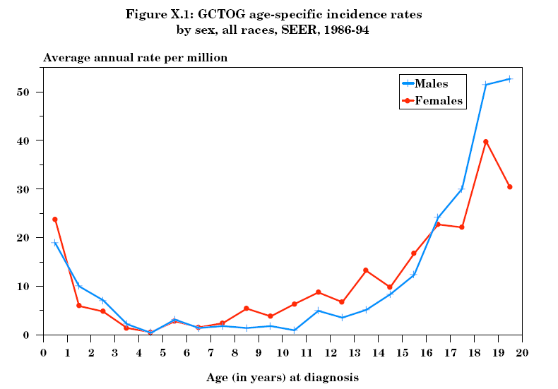
Pediatric Germ Cell Tumors
Epidemiology and Risk Factors
Annual Incidence:
3.9 cases per million children (0-15y)
1.5 cases / million at gonadal sites
2.4 cases / million at extragonadal sites
~3% of all pediatric cancers
Bimodal age distribution
Peak < 3 years
Extragonadal
Testicular tumors
Peak: adolescence
Gonadal tumors
Ries LAG, Smith MA, Gurney JG, Linet M, Tamra T, Young JL, Bunin GR (eds).
Cancer Incidence and Survival among Children and Adolescents: United States SEER Program 1975-1995, National Cancer Institute, SEER Program. NIH Pub.No.99-4649. Bethesda,MD,1999.

Slide 70
Pediatric Germ Cell Tumors Histology
Basic Science and Pathophysiology
Diagnosis
Seminomatous (germinomatous) GCT:
Seminoma (testes)
Dysgerminoma (ovary)
Germinoma (extra-gonadal)
Non-seminomatous (non-germinomatous) GCTs:
Embryonal Carcinoma: Undifferentiated cells that histologically resemble embryonic cells from the blastocyst
Yolk Sac Tumor: Most common malignant GCT in young children; components of embryonic and extraembryonic endoderm
Choriocarcinoma: Very rare, represents trophoblastic differentiation
Teratoma: disordered mixture of differentiated cell types from all three somatic cell layers. If a component acquires neuronal differentiation: immature teratoma

Slide 71
Pediatric Germ Cell Tumors Classification
Basic Science and Pathophysiology
Type I
Children < 4 years
Usually present as teratoma, yolk sac tumor, or mixtures of the two
Type II
Puberty through young adulthood
Full range of germinomatous and non-germinomatous histologies
Often associated with a presumptive precursor lesion known as germ cell neoplasia in situ (GNCIS, usually seen in normal tissue adjacent to tumor)

Slide 72
Pediatric Germ Cell Tumors Biology
Basic Science and Pathophysiology
Origin
Arise from primordial cells involved in gametogenesis at different stages of development (Type I vs. Type II)
Aberrant caudad or cephalad migration of germ cells leads to midline extragonadal tumors.
Molecular Genetics
Type I
Gain of 1q, 11q, 20q, and 22
Loss of 1p, 6q, and 16q
Partial loss of genomic imprinting
Type II
Amplification of chromosome 12 (usually through creation of isochromosome 12p)
Amplification of X chromosome
Loss of genomic imprinting
Type I and II exhibit distinct gene expression profiles
Distinct miRNA landscape from normal gonad (serum miRNA levels under evaluation as tumor markers)

Slide 73
Pediatric Germ Cell Tumors Risk Factors
Epidemiology and Risk Factors
Genetic syndromes
Klinefelter Syndrome (47XXY)
Gonadal Dysgenesis
Swyer Syndrome (47XY)
Turner Syndrome (47XO)
Anatomic
Crypto-orchidism
Genitourinary anomalies
Hernia, hydrocele

Slide 74
Pediatric Germ Cell Tumors Clinical Presentation
Diagnosis
Presentation:
Ovarian: abdominal pain, palpable abdominal/adnexal mass
Consider ovarian sex cord-stromal tumor if
Precocious puberty: Granulosa Cell Tumor (young children)
Amenorrhea and/or virilization: Sertoli-Leydig Tumor (adolescents)
Testicular: Irregular, non-tender mass
Extragonadal tumors:
Sacrococcygeal: Constipation, urinary retention
Mediastinal: Chest pain, respiratory distress
Diagnosis:
CT/MRI primary
Metastatic work-up: Bone scan, Chest CT

Slide 75
Pediatric Germ Cell Tumors Clinical Presentation
Diagnosis
Age:
Girls → ovarian tumors after age 3
Boys → testicular tumors before age 4 or after age 13
Extragonadal tumors:
Sacro-coccyx before age 4
Mediastinum after age 9
80% stage III/IV
Site:
Gonadal: 41% vs. Extragonadal: 59%.
Children < 15 → Extragonadal > Gonadal
Children ≥ 15 → Gonadal > Extragonadal

Slide 76
Pediatric Germ Cell Tumors Histology and Tumor Markers
Diagnosis
Histology | Serum AFP | Serum B-HCG
Yolk sac tumor | ++++ | -
Choriocarcinoma | - | ++++
Embryonal carcinoma | +/- | +/-
Germinoma | - | -
Teratoma | - | -
Immature teratoma | +/- | -
AFP: Developmental changes in < 12 months
Dysgerminomas: May have elevated PLAP

Slide 77
Pediatric Germ Cell Tumors Tumor Marker Kinetics
Diagnosis
Alpha-Fetoprotein
Normal values
Newborn > 40,000 ng/mL (> 100,000 in preterms)
Adult levels (<10) reached by 8-12 months
t ½ = 5-7 days (important for monitoring response to therapy)
But: wide variability in t ½ in the first year of life
Difficulties in interpreting absolute levels and decay during infancy
Elevation in levels of AFP suggests active disease, BUT
Infants may have slow rise in AFP after completing chemotherapy
Abrupt increase in AFP may occur after initiation of therapy (tumor lysis)
Spurious persistence of elevated AFP may occur in alterations of liver function (viral hepatitis, cholestasis secondary to anesthesia, exposure to phenytoin or MTX
Other malignancies may also cause elevation of AFP (hepatoblastoma, pancreatoblastoma)
Beta-HCG
Normal values < 5 IU/mL
t ½ = 24-36 hours
Elevation of levels of B-HCG suggest active disease, BUT
Iatrogenic hypogonadism may cause elevation of LH, which has immunologic cross-reactivity with B-HCG
Other malignancies may also cause elevation of B-HCG (multiple myeloma and other adult-type malignancies)

Slide 78
Pediatric Germ Cell Tumors Staging
Diagnosis
Stage | Description
I | Complete resection with normalization of tumor markers within expected half-life.
II | Microscopic residual disease: persistent marker elevation; lymph nodes < 2 cms
III | Gross residual disease: lymph nodes > 2 cms (or > 1 - < 2 cm that fail to resolve within 4-6 weeks); no extra-abdominal or visceral metastases
IV | Distant metastases

Slide 79
Pediatric Germ Cell Tumors Staging of Testicular Tumors
Diagnosis
Inguinal incision and radical orchiectomy with high ligation of cord structures
Assessment of retroperitoneal lymph nodes by CT (short axis diameter)
LN < 1 cm: Negative
LN 1 to <2 cm: Indeterminate → if stage I, f-u in 4-6 weeks, remain stage I if < 1 cm, if stable or increased, consider biopsy or upstage to stage III.
LN > 2 cm: Metastatic disease
In case of scrotal orchiectomy
May remain stage I if negative margins and appropriate decline of tumor markers
Proximal cord structures should be resected and upstage if +
If scrotal biopsy was performed
Scrotum is contaminated → stage II
Hemiscrotectomy is not required
Completion orchiectomy should be performed

Slide 80
Pediatric Germ Cell Tumors Staging of Ovarian Tumors
Diagnosis
Ovarian GCT are usually large and always friable (risk of intraoperative spill)
Required components of surgical staging:
Cytological assessment of peritoneal fluid
Inspection of and biopsy of any abnormal appearing peritoneal surfaces, lymph nodes, omentum, contralateral ovary
Removal of the primary tumor without violation of the tumor capsule in situ
Failure to document inspection and confirmation of normal appearance of omentum, peritoneal surfaces, lymph nodes, and opposite ovary precludes eligibility for surgery only approaches

Slide 81
Pediatric Germ Cell Tumors Treatment
Management and Treatment
Stage I gonadal tumors
Surgery and observation are indicated in the setting of normalization of tumor markers
Tumor markers are followed monthly to monitor normalization and anticipate recurrence
If markers fail to normalize → stage II
30% to 50% of patients may recur, but salvage rates are high and survival is > 95%
All others
Chemotherapy + surgery
Risk-adapted regimens and intensification under evaluation
Radiation therapy IS NOT indicated in upfront management of malignant GCT

Slide 82
Pediatric Germ Cell Tumors Treatment
Management and Treatment
Risk-Group | Stages | Treatment | Outcome (OS)
Low | Stage I immature teratoma Stage I testicular (ovarian?) | Surgery only | > 95%*
Intermediate | Stages II-IV gonadal Stages I-II extragonadal | Surgery + Chemotherapy | > 90%
High | Stages III-IV extragonadal | Surgery + Chemotherapy | 70-75%

Slide 83
Pediatric Germ Cell Tumors Treatment
Management and Treatment
Platinum-containing regimens
PEb: Cisplatin + Etoposide + Bleomycin
Adult regimen for adolescents: Weekly bleomycin (BEP)
CEb: Carboplatin + Etoposide + Bleomycin
Used in UK with similar results to PEB
AGCT1531 trial: Randomization Cisplatin vs. Carboplatin
VIP: Etoposide + Ifosfamide + Cisplatin
Consider for mediastinal primaries
Lower postoperative complication rates (vs. BLEO-containing regimen)
Standard approach
Stage (I)-II: 4 cycles
Stages III-IV: 4 cycles, followed by surgery
Role of postoperative chemotherapy (2 cycles) for residual active disease unclear, currently not recommended

Slide 84
Pediatric Germ Cell Tumors Treatment – Proposed New Risk Assignment
Management and Treatment
Risk | Age | Location | COG Stage | OS%
Low | < 11 | Testis Ovary Extragonadal | I I I | 100 96 93
Intermediate | < 11 < 11 ≥ 11 ≥ 11 < 11 < 11 ≥ 11 < 11 < 11 | Testis Testis Testis Testis Ovary Ovary Ovary Extragonadal Extragonadal | II/III IV II/III IV* II/III IV II/III II/III IV | 99 96 93 83 97 92 85 91 79
Poor | ≥ 11 ≥ 11 ≥ 11 ≥ 11 | Testis Extragonadal Ovary Extragonadal | IV* III IV IV | 83 61 60 40
*Further risk assignment by IGCCC
Frazier et al. J Clin Oncol 2015; 33:195-201.

Slide 85
Pediatric Germ Cell Tumors Treatment – Proposed New Risk Assignment
Management and Treatment
Patients with stage I GCT represent a low-risk group
Patients with stage II-IV gonadal GCT appear to be an intermediate risk group
However, post-puberal patients with gonadal tumors have a higher risk of failure
Patients with advanced extragonadal tumors represent the highest-risk group
Older age (post-puberal) is the factor most predictive for outcome in these patients
There is a significant interaction between age and primary site.
Young patients – sacrococcygeal (better prognosis)
Older patients – mediastinal (worse prognosis)

Slide 86
Pediatric Germ Cell Tumors Treatment – Proposed New Risk Assignment
Management and Treatment
Risk | Age | Location | COG Stage | OS%
Low | < 11 | Testis Ovary Extragonadal | I I I | 100 96 93
Intermediate | < 11 < 11 ≥ 11 ≥ 11 < 11 < 11 ≥ 11 < 11 < 11 | Testis Testis Testis Testis Ovary Ovary Ovary Extragonadal Extragonadal | II/III IV II/III IV* II/III IV II/III II/III IV | 99 96 93 83 97 92 85 91 79
Poor | ≥ 11 ≥ 11 ≥ 11 ≥ 11 | Testis Extragonadal Ovary Extragonadal | IV* III IV IV | 83 61 60 40
New COG Trials
AGCT1531 Age 0-50 Observation
AGCT1531 < 11 years: CEb vs. PEb ≥ 11 years: BEC vs. BEP
AGCT1532 Age ≥ 11 BEP vs. Accelerated BEP
*Further risk assignment by IGCCC
Frazier et al. J Clin Oncol 2015; 33:195-201.

Slide 87
Pediatric Germ Cell Tumors Treatment of Relapsed Disease
Management and Treatment
The patient with GCT in first relapse after platinum-based chemotherapy still has the opportunity for curative treatment
Taxane-based regimens (taxol, ifosfamide +/- cisplatin)
High-dose chemotherapy may be effective for a group of patients
Randomized clinical trial currently ongoing (AO31101)
Tandem (or triplet) transplant may be superior to single transplant
Risk-adapted approaches can guide the decision between standard and high-dose chemotherapy regimens
Patients whose characteristics at diagnosis may anticipate the need for high-dose chemotherapy
Mediastinal primary
Advanced choriocarcinoma
Brain metastases
Poor response/progression to frontline therapy

Slide 88
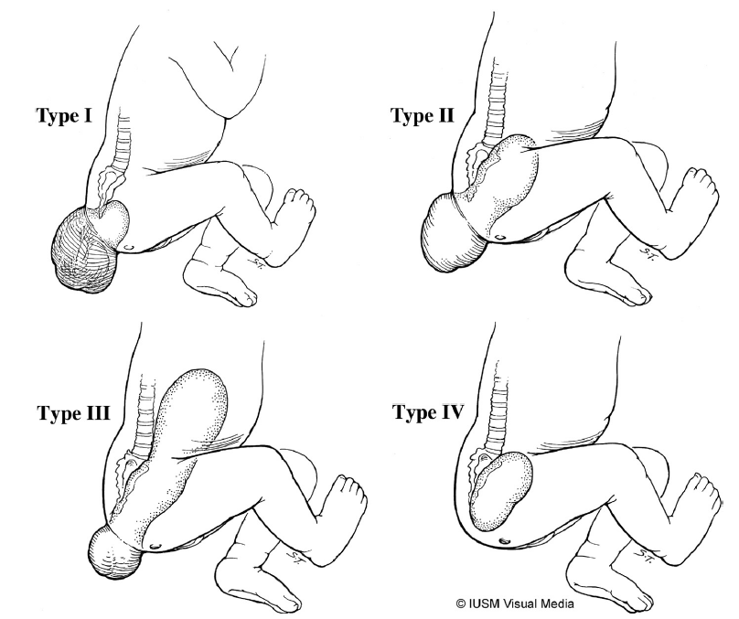
Sacrococcygeal GCT
1:35,000 live births
Two distinct clinical patterns:
Large, predominantly external, detected prenatally or at delivery → rarely malignant (< 10%) or stage I
Older infants, young children, less apparent → high rate of malignancy (60-90%), stages III-IV
Abdominal pain, constipation, bladder dysfunction, neuropathy
Large pelvic mass, lungs, bone mets
Pathology
Teratoma – Immature Teratoma – YST
Treatment
Stage I: Surgery alone (+ coccyx)
Stages II – IV: Surgery + Chemotherapy
Prognosis: Excellent (survival > 90%)
Type I: 46.7%
Type II: 34.7%
Type III: 8.8%
Type IV: 9.8%
Reprinted from Seminars in Pediatric Surgery, 21/1, Rescorla FJ, Pediatric Germ Cell Tumors, 51-60, 2012, with permission from Elsevier

Slide 89
Ovarian Sex-Cord Tumors
Typically present in the first two to three decades of life
Account for approximately 5% of ovarian malignancies in 15-24 y
Clinical presentation
Symptoms of adnexal mass: Abdominal pain, distension, torsion
Signs of hormonal production
Hirsutism and virilization
Menstrual changes
Precocious puberty
Family history of possible tumor predisposition
Physical examination (cues)
Precocious puberty, delayed menarche, secondary amenorrhea, virilization
Hyper-pigmented macules (Peutz-Jegher syndrome)
Thyroid nodules (DICER1 syndrome)

Slide 90
Ovarian Sex-Cord Tumors
Pathology
Histologic subtypes
Adult granulosa cell tumor
Juvenile granulosa cell tumor
Sertoli-Leydig cell tumor
Sex-cord tumor with annular tubules
Gynandroblastomas and other (mixed forms)
JGCT (65%) and SLCT (20%) are the most common subtypes in children
Approximately half of patients with SLCT and gynandroblastoma have a germline mutation of DICER1

Slide 91
Ovarian Sex-Cord Tumors Molecular Pathology
Gene | Tumor Subtype | Syndrome to Consider
DICER1 | Sertoli-Leydig cell tumor Gynandroblastoma | DICER1 syndrome Pleuropulmonary blastoma, eRMS of uterine cervix, renal tumors, thyroid nodules and carcinoma, nasal chondromesenchymal hamartoma, ciliary body medulloepithelioma, pineoblastoma, and pituitary blastoma
STK11 | Sex cord tumor with annular tubules | Peutz-Jegher syndrome
IGH1 and IGH2 | Juvenile granulosa cell tumor | Ollier disease (enchondromatosis) and Mafucci syndrome (enchondromatosis + hemangiomas)
FOXL2 | Adult granulosa cell tumor | -

Slide 92
Ovarian Sex-Cord Tumors Management
Evaluation
Laboratory: Inhibin (inhibin B more predictive than inhibin A), estradiol, testosterone, AFP (SLCT)
Imaging: US, CT/MRI
Family history, genetic testing and counseling
Treatment
Surgery: fertility-sparing surgery whenever possible
Adjuvant treatment is stage-dependent
FIGO Ia (Ib): Surgery alone and observation
FIGO Ic (surgical spill, tumor rupture, positive fluid) and higher: Adjuvant chemotherapy
BEP, carboplatin/paclitaxel

Slide 93
Long Term Effects
Chemotherapy
Hearing loss
Neuropathy
Therapy-related AML
Cardiotoxicity
Renal toxicity
Pulmonary toxicity
Bladder and bowel dysfunction in SCT

Slide 94
Questions?
carlos.rodriguez-galindo@stjude.org

Slide 95
Supplemental Slides

Slide 96
Retinoblastoma
Differential Diagnosis

Slide 97
Coats Disease
Inflammatory process of unknown etiology
Usually 2-5 years of age
Unilateral
Telangiectatic vessels
Protein and cholesterol-rich subretinal exudate

Slide 98
Persistent Fetal Vasculature (Persistent Hyperplastic Primary Vitreous)
Unilateral microphthalmia
Elongated ciliary processes
No calcifications (common in RB)
Can present with cataracts (extremely rare in RB)

Slide 99
Persistent Fetal Vasculature (PHPV)

Slide 100
Medulloepithelioma
Tumor of the ciliary pigment epithelium
First decade of life
Mass in contact with the iris
Cysts within the tumor
Iris neovascularization

Slide 101
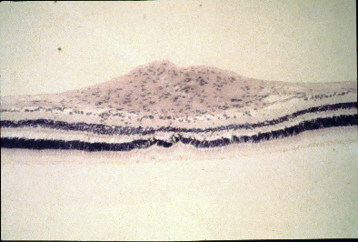
Retinal Astrocytic Hamartoma
Solitary or multiple and may progress over time
Increasingly calcified
Mulberry appearance
Tuberous sclerosis
Neurofibromatosis
Benign proliferation of astrocytes

