Slide 1


Slide 2
Disclosure Slide: Mignon Loh, MD
Speaker’s Bureau: None
Consultant without compensation over past two years: Novartis, Incyte, Abbvie, Pfizer
Honoraria over past two years: None
Stock ownership: None
Most therapies used in childhood ALL are off-label; therefore, any therapeutic recommendations made may include off-label use of drugs
Copyright © 2019 by ASPHO

Slide 3

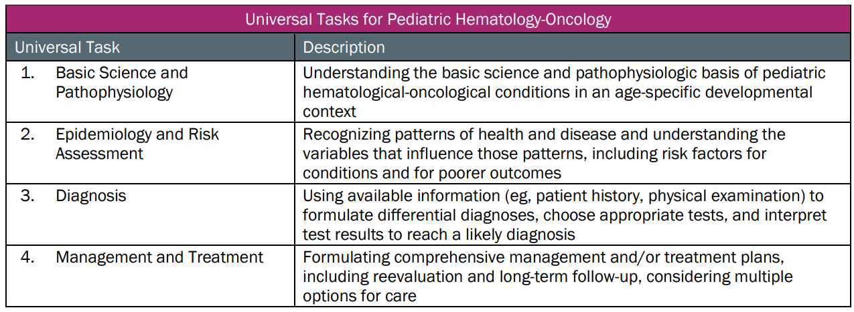
This talk will follow the topical structure suggested by the ABP:
Copyright © 2019 by ASPHO

Slide 4
Acute Lymphoblastic Leukemia (ALL)
Basic Science and Pathophysiology
Epidemiology and Risk Assessment
Diagnosis and Prognostic Features
Management and Treatment
Copyright © 2019 by ASPHO

Slide 5
ALL: Basic Science and Pathophysiology
Basic Science and Pathophysiology
Epidemiology and Risk Assessment
Diagnosis and Prognostic Features
Management and Treatment
Copyright © 2019 by ASPHO

Slide 6
Acute lymphoblastic leukemia (ALL) is a heterogeneous disease
B-lineage and T-lineage
Arrested development with abnormal proliferation
Sentinel somatic mutations arise with secondary events leading to full transformation
  KMTAr arise in utero (Ford, Nature 1993)
  1% of infants are born with ETV6/RUNX1 detectable on cord blood
    Only 1/100 of ETV6/RUNX1 positive infants develop ALL (Mori, PNAS, 2002)
  Also some evidence that some hyperdiploid ALL arise in utero (Bateman, Leukemia 2015)
Copyright © 2019 by ASPHO

Slide 7
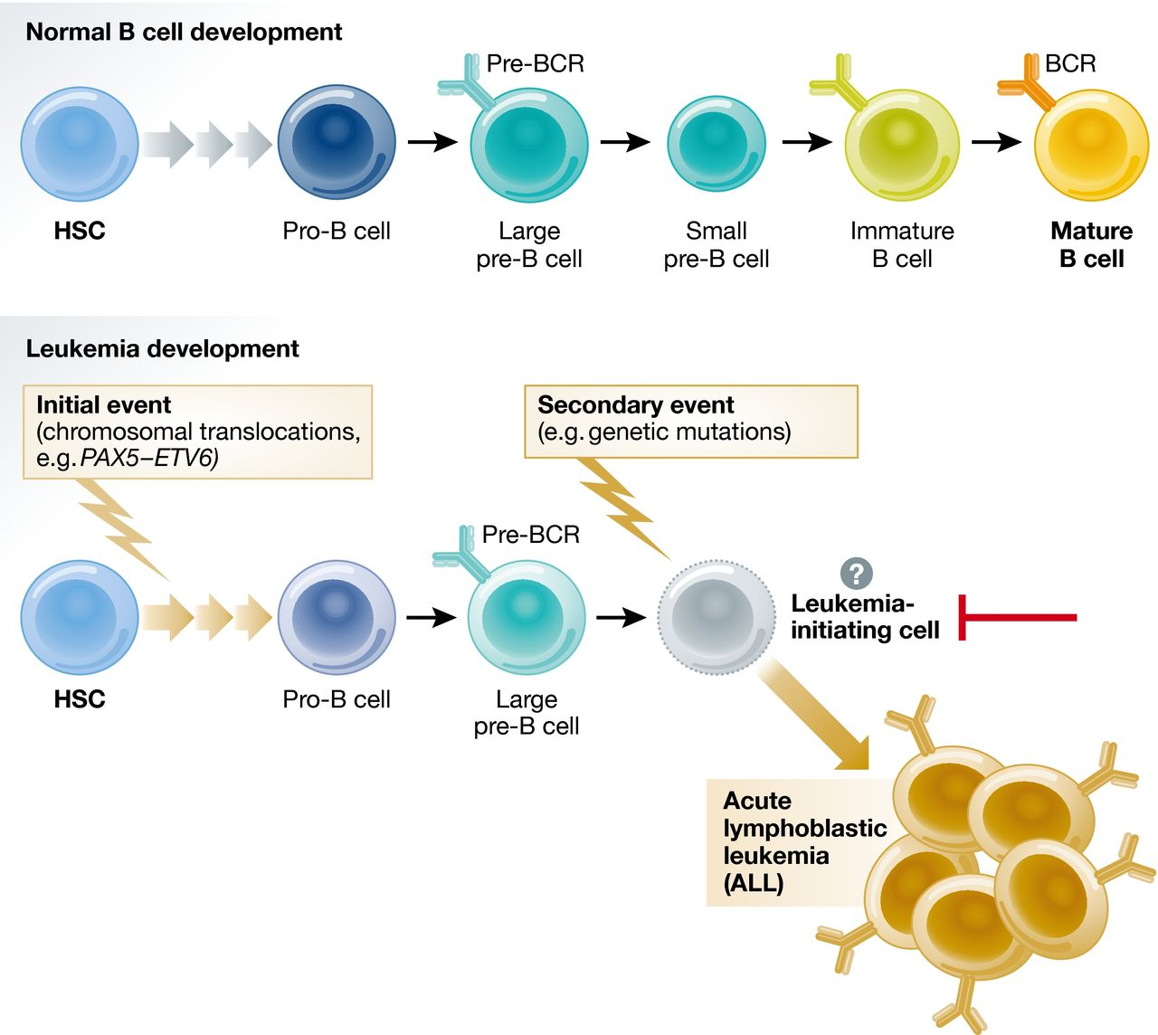

Developmental arrest as the first step in leukemogenesis
A. Alsadeq, and H. Jumaa
EMBO J. 2017;embj.201796686
Copyright © 2019 by ASPHO
Notes:
Developmental arrest as the first step in leukemogenesis During normal B‐cell generation, hematopoietic stem cells (HSC) give rise to progenitors that pass through steps of lineage commitment and differentiation to eventually become mature B cells. Chromosomal translocations that result in fusion proteins such as PAX5‐ETV6 block B‐cell differentiation and lead to a distinct population of early B cells with limited survival capacity under normal conditions. The occurrence of secondary mutations affecting tumor suppressors or oncogenes enhances proliferation or survival and initiates BCP‐ALL.
Copyright license obtained by M. Loh: 4459530952196, the Embo Journal on Oct 31, 2018

Slide 8
Children with ALL: Host and ALL Tumor Genomes
Host genome
Inherited from parents
polymorphisms (SNPs) and copy number variation (CNVs)
ALL blast genome
Somatic changes
Translocations, aneuploidy, copy number alterations, point mutations, etc.
Courtesy of J. Yang
Copyright © 2019 by ASPHO
Notes:
Get permission from Jun

Slide 9
HOST SENTINEL SECONDARY
C. Darwin, 1868
ARID5B
IKZF1
CDKN2A
CEBPE
PIP4K2A-BM1
GATA3
PAX5
TP53
TP63
ETV6-RUNX1
BCR-ABL1
TCF3-PBX1
KMT2Ar
Ph-like
CRLF2R
EBF-PDGFRB
etc.
PAX5
IKZF1
EBF1
CDKN2A
TP53
JAK
RAS
ERG
NT5C2
Reprinted from The Lancet, Vol. 62, Bhojwani, D, et al, Biology of Childhood Acute Lymphoblastic Leukemia, Pages 47-60, Copyright (2015), with permission from Elsevier.
Copyright © 2019 by ASPHO
Notes:
Need copyright

Slide 10
Epidemiology of Hematologic Malignancies
Basic Science and Pathophysiology
Epidemiology and Risk Assessment
Diagnosis
Management and Treatment
Copyright © 2019 by ASPHO

Slide 11
ALL and AML remain the most common leukemias in children and adolescents
ALL
  80% of cases among those <14.99 yrs old
  56% of leukemias among 15-19.99 yrs old
  Peak incidence 2-4 years (industrialized countries)
AML
  15% of cases among those <14.99 yrs old
  31% of leukemias among 15-19.99 yrs old
  No peak incidence
E. Ward CaCancerjournal (2014), taken from SEER data
Copyright © 2019 by ASPHO

Slide 12
Childhood leukemia is common and occurs most frequently in younger children
Originally published by the National Cancer Institute, https://seer.cancer.gov/statfacts/html/childleuk.html
Copyright © 2019 by ASPHO

Slide 13
Rates of ALL and AML differ by age:
SEER Incidence rates 2011-2015
Leukemia | < 1 | 1-4 | 5-9 | 10-14 | 15-19
Overall | 51.8 | 93.8 | 44.9 | 35.3 | 35.7
ALL | 20.9 | 78.5 | 36.7 | 23.1 | 18.5
AML | 18.8 | 10.8 | 5.0 | 7.6 | 9.9
Rates are per 1,000,000 and are age-adjusted to the 2000 US Std Population
https://seer.cancer.gov/csr/1975_2015/results_merged/sect_29_childhood_cancer_iccc.pdf#search=childhood%20cancer
Copyright © 2019 by ASPHO

Slide 14
ALL and AML remain the most common leukemias in children and adolescents and differ in incidence by race
Originally published by the National Cancer Institute, https://seer.cancer.gov/statfacts/html/childleuk.html
Copyright © 2019 by ASPHO

Slide 15
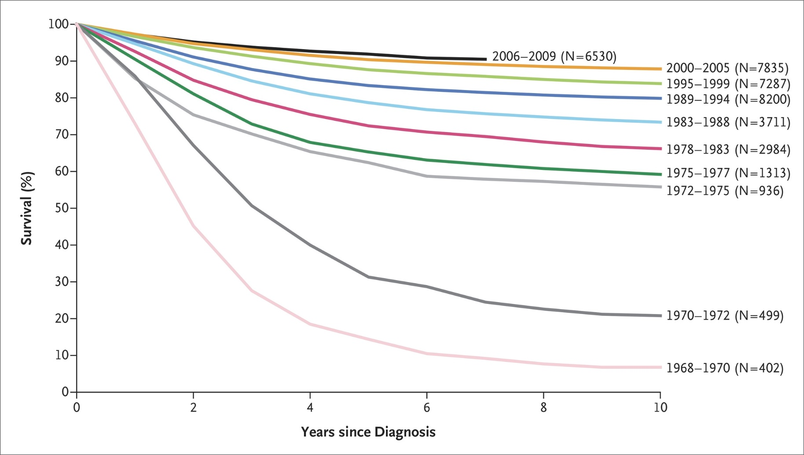
Improved Survival in Childhood ALL
CCG/COG Trials 1968-2009 (n=39,697)
From The New England Journal of Medicine, Hunger, S, Mullighan, C, , Acute Lymphoblastic Leukemia in Children, Volume 373, Copyright © (2015) Massachusetts Medical Society. Reprinted with permission from Massachusetts Medical Society
Copyright © 2019 by ASPHO
Notes:
Slide showing the tremendous improvements in ALL outcomes over the past 4 decades. Overall Survival among Children with Acute Lymphoblastic Leukemia (ALL) Who Were Enrolled in Children’s Cancer Group and Children’s Oncology Group Clinical Trials, 1968–2009
Need copyright license

Slide 16
Overall ALL Survival: Age/Gender
Patient Group | 5 yr OS% 2000-05 | 5 yr OS% 2006-09 | P Value
< 1 yr | 53.5 +/- 4.1% (n=159) | 43.0 +/- 14.5% (n=51) | 0.246
1-9.99 yrs | 93.9 +/- 0.3% (n=6079) | 95.2 +/- 0.4% (n=4954) | 0.005
10+ yrs | 81.1 +/- 1.1% (n=1528) | 83.0 +/- 1.5% (n=1525) | 0.408
16+ yrs | 78.2 +/- 2.5% (n=365) | 76.8 +/- 3.3% (n=427) | 0.359
Male | 89.9 +/- 0.5% (n=4327) | 91.5 +/- 0.7% (n=3633) | 0.0356
Female | 91.2 +/- 0.5% (n=3439) | 92.7 +/- 0.7% (n=2897) | 0.078
Hunger, Devidas, SIOP 2013
Copyright © 2019 by ASPHO

Slide 17
Overall Survival: Narrowing the Racial Gap
Race | 5 yr OS 1990-05 vs. 2006-09
White | 85.4% vs. 92.5%
African Americans | 74.9% vs. 90.5%
ALL survival disparities have narrowed between African Americans vs. Whites
62% Decrease in Death Rates for African Americans 1990-94 vs. 2006-09
Copyright © 2019 by ASPHO

Slide 18
Survival Improvements Over Twenty Years: T-ALL vs. B-ALL
Patient Group | 5 yr OS% 1990-94 | 5 yr OS% 2006-09
B-ALL | 84.9 +/- 0.5 (n=5068) | 92.2 +/- 0.5% (n=6078)
T-ALL | 70.7 +/- 1.7% (n=748) | 90.6 +/- 2.7% (n=449)
90% 3-yr EFS for T-ALL in UKALL 2003 (Vora, ASH 2008), which uses the COG (Capizzi MTX + ASNase) augmented BFM backbone
Improved survival for T-ALL likely helps to explain the improved survival for African Americans over past 20 years
Copyright © 2019 by ASPHO
Hunger et al, JCO 2012; SIOP 2013

Slide 19
Survival is excellent for ALL, less so for AML
Improved treatment
  CNS recognized as sanctuary site that needed special prophylaxis in 1970s
  Intensified therapies for identified risk groups with higher rates of relapse
Improved supportive care
https://seer.cancer.gov/csr/1975_2015/results_merged/sect_29_childhood_cancer_iccc.pdf#search=childhood%20cancer
Copyright © 2019 by ASPHO
Notes:
?copyright license

Slide 20
ALL: Known Predisposition Syndromes
Down Syndrome
Constitutional Robertsonian translocation
Ataxia telangiectasia (ATM) (T-ALL and NHL)
Nijmegen breakage syndrome (NBS1)
Bloom Syndrome
Constitutional mismatch repair deficiencies
Rasopathies (NF1, Noonan Syndrome)
Klinefelter Syndrome
Li-Fraumeni (hypodiploid ALL)
Reviewed in C.P. Kratz, European J. Med Gen., 2016 and S. Izraeli, Blood 2014
Copyright © 2019 by ASPHO

Slide 21
ALL and Down Syndrome (DS)
Children with DS have 20x increased risk of leukemia
  Risk period limited to 1st 3 decades of life
  Although relative risk of AML is higher than ALL, DS-ALL is more common than DS-AML except in first year of life
3% of children with B-precursor ALL have DS
  Almost no DS children have T-ALL or infant ALL (<1 yr old)
Decreased rate of common sentinel genetic lesions (Maloney KW et al, Blood 2010)
  MLL translocation or t(9;22) very rare
  ETV6-RUNX1 (TEL-AML1): 2.5% DS-ALL vs. 24% non DS-ALL
  Trisomy 4+10: 7.7% DS-ALL vs. 24% non DS-ALL
  Frequently overexpress CRLF2 (60%) and has accompanying JAK and IL7R mutations)
Overall outcome of DS-ALL inferior to non-DS ALL, but equivalent if limit analysis to cases lacking common sentinel genetic lesions (Maloney KW et al, Blood 2010)
Increased risk of toxic death in DS-ALL
Copyright © 2019 by ASPHO
Reviewed in S. Izraeli, Blood 2014

Slide 22
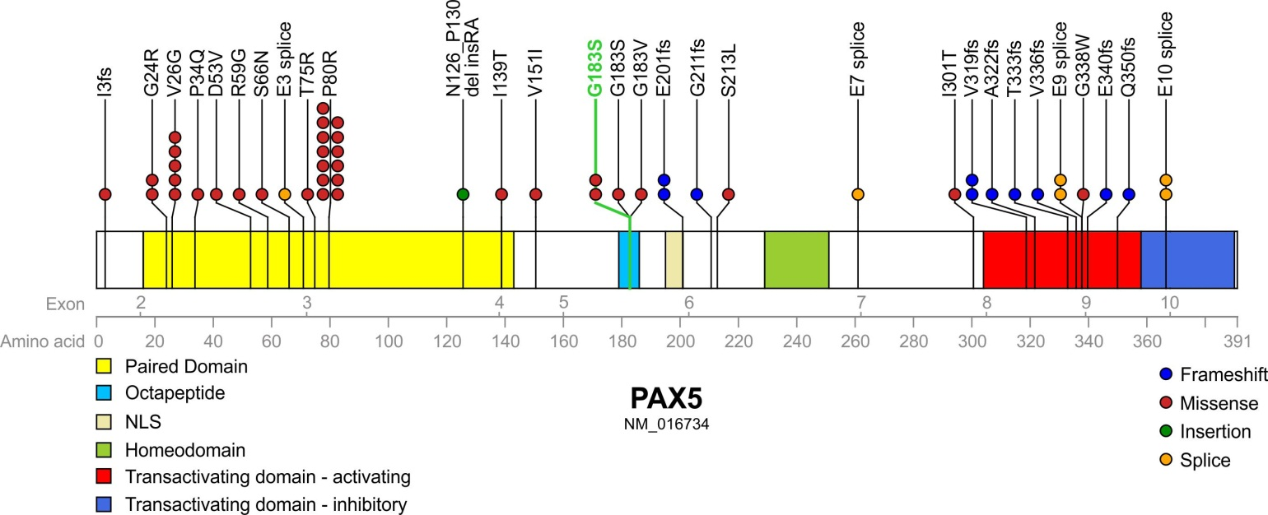
ALL: Recently Described Germline Mutations in Families
PAX5 G183S mutations in familial ALL
TP53 mutation in hypodiploid and familial ALL
ETV6 mutation in hyperdiploid and familial ALL
Multiple additional germline mutations in hypodiploid and B-ALL
  XRCC1, TP53INP1, FANCA, MLL3, ROS1, SH2B3 (LNK)*
4.6% (27/588) childhood leukemia patients have deleterious germline mutations**
  Shah, Nat Genet 2013;
  Holmfeldt, Nat Genet 2013;
  Powell Ped Blood Cancer 2013;
  *Perez-Garcia Blood 2013;
  **Zhang NEJM 2016
Courtesy of J. Yang
Reprinted by permission from Springer Nature: Nature Genetics, A recurrent germline PAX5 mutation confers
susceptibility to pre-B cell acute lymphoblastic leukemia, , Shah, S, et al (2013), Sep 8, 2013.
Copyright © 2019 by ASPHO
Notes:
Get permission from Jun Yang

Slide 23
ALL: Concordance Between Identical Twins
Concordance rates are close to 100% for leukemia occurring in infants <12 mos. old
Concordance rates are 10% to 15% for typical childhood B-cell precursor ALL occurring after infancy
Concordance is primarily due to prenatal acquisition of early (initiating) chromosome translocations or other genetic lesions and transplacental transfer of leukemia or preleukemia cells to other twin
  Primarily KMT2A translocations in infants
Copyright © 2019 by ASPHO

Slide 24
Diagnosis of Acute Lymphoblastic Leukemia
Basic Science and Pathophysiology
Epidemiology and Risk Assessment
Diagnosis and Prognostic Features
Management and Treatment
Copyright © 2019 by ASPHO

Slide 25
ALL: Common Clinical Features at Diagnosis
Bone pain due to expansion of marrow cavity
  Manifested as general irritability in young children
  Refusal to walk
Decreased energy, pallor, loss of appetite
Adenopathy +/- hepatosplenomegaly
Thymic expansion: mediastinal masses in T-ALL
  Shortness of breath, dyspnea, unable to lie flat
  High risk of Tumor Lysis Syndrome
  Abnormal INR
CNS leukemia: Headache, neck pain, seizures, cranial nerve palsies
  Consider ophthalmology consult to assess retinal involvement
Testicular involvement (always exam testes in boys!)
  Painless, enlarged, usually “rock hard” testes—needs biopsy
Copyright © 2019 by ASPHO

Slide 26
Clinical Complications Related to Abnormal Hematopoiesis in Acute Leukemia
Hematologic abnormalities are due to replacement of normal BM leading to signs/symptoms of BM failure
  White blood count may be low, normal or high
  Decreased absolute neutrophil # and function: infection
  Risk of tumor lysis syndrome with high WBC (>50k) or T-cell ALL
  Hyperleukocytosis (WBC >250-500k) may be associated with CNS and pulmonary symptoms
    Risk of CNS/pulmonary complications much lower than in AML
    Controversy over role of leukopheresis in ALL
  Decreased platelets: bleeding, bruising and petechiae
  Decreased red blood cells: pallor and fatigue
Copyright © 2019 by ASPHO

Slide 27
General work up of a child with acute leukemia
Chest X-Ray to rule out mediastinal mass (?safe for anesthesia?)
Bone marrow aspirate
  Morphology, flow cytometry, cytogenetics/FISH, molecular studies
Bone marrow biopsy
  Strongly recommend to pursue at diagnosis unless peripheral blood is clearly leukemia
Lumbar puncture by most experience clinician
  Support abnormal coagulation studies and thrombocytopenia per best institutional practices
Copyright © 2019 by ASPHO

Slide 28
Clinical and Laboratory Findings that Influence Prognosis
Baseline characteristics
    Age and WBC collectively define NCI risk group
    Presence/absence of extramedullary disease influences prognosis and dictates need for specific therapies
    Sex, race, ethnicity important but not used for treatment stratification
    ALL genotype strongly influences prognosis, treatment stratification and sometimes use of targeted therapies; e.g. TKI treatment for Ph+ ALL
T-cell ALL outcome is not predicted by NCI Risk Group
Response to therapy is the strongest prognostic factor
Copyright © 2019 by ASPHO

Slide 29
NCI/Rome Risk Groups in Childhood ALL
Applies only to B-lineage ALL! WBC or Age is not prognostic in T-cell ALL!
Standard risk (~65% patients)
  Age 1.00-9.99 years
  Initial white blood count <50,000/microliter
  EFS ~90%
High risk (~35% patients)
  Age <1 yr or 10+ yrs OR WBC ≥50,000/ml
  Current 5 year EFS 75-80% for non-infants
    Achieved with more intensive therapy
  Outcome still poor for infants < 1 year old
    ~3% of patients; generally treated on infant specific trials
Copyright © 2019 by ASPHO

Slide 30
ALL: Risk-Adapted Therapy
High-risk subgroups fare poorly with less intensive therapies that have high cure rates in lower risk subgroups
Outcome of high-risk subgroups can be improved with more intensive therapy that may not be needed for LR subgroups
Prognostic factors disappear as therapy improves; e.g. t(1;19)
Copyright © 2019 by ASPHO

Slide 31
Flow Cytometric Features: B-Precursor ALL
80-85% of ALL cases are B-precursor
CD45 positive (distinguishes lymphoid from myeloid)
Almost all cases are CD19+, CD22+, CD79a+
Most cases are CD10+ (cALLA+), TdT+ and HLA-DR+
  About half of MLL-R ALL lack CD10 expression
Early B-lineage ALLs are cIg-negative
Pre-B ALL is cIg+, sIg-neg
Co-expression of myeloid antigens is common (CD13/33)
  This does NOT make it ALAL or MPAL!
Copyright © 2019 by ASPHO

Slide 32
Clinical and Laboratory Features: T-Cell ALL
~15% of ALL cases are T-ALLs
Associated with high WBC and mediastinal masses
  Increased risk of tumor lysis syndrome
Express cytoplasmic CD3 (cCD3+); most sCD3+ and TdT+
Often express CD2, 4, 7, 8
CD10 expression is variable; most are HLA-DR negative
ETP phenotype
  cCD3+, CD7+, weak CD5 (< 75% positive or 1 log dimmer than mature T cells), CD1a-, CD8-, (CD117+, CD34, HLA-DR, CD13, CD33, CD11b, of which one or more are positive on at least 25% lymphobblasts)
T-cell ALL slower to clear MRD by end induction
Copyright © 2019 by ASPHO
Notes:
1. CD1a and CD8 negative (<5%)
2. Positive for one or more immature/myeloid antigens including: CD34, CD13, CD33, CD117, HLA-DR, etc. (>25%)
3. CD5 weak defined as either < 75% positive OR 1 log dimmer than mature T cells.
The cCD3 and CD7 are not really part of the ETP definition but used largely identify lineage as T for further subclassification, particularly cCD3.

Slide 33
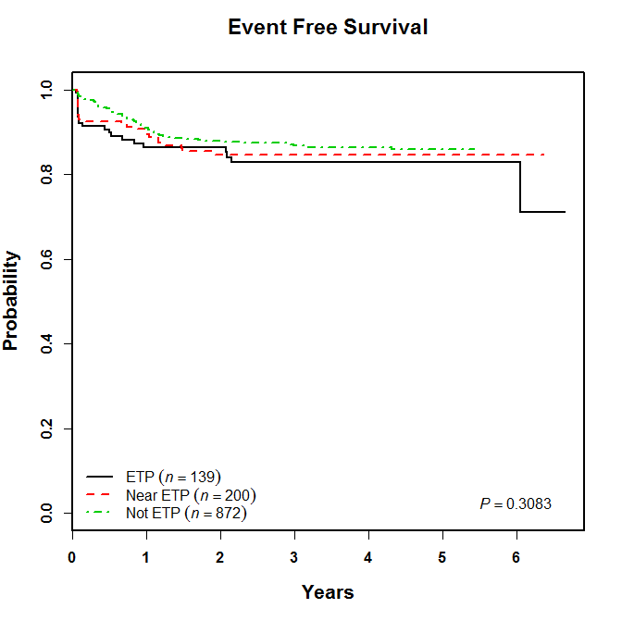
AALL0434 - Event-Free Survival for ETP is Excellent
Reprinted from The Lancet, Vol. 10, Coustan-Smith et al, Early T-cell precursor leukaemia: a subtype of very high-risk acute lymphoblastic leukaemia, Pages 147-156, Copyright (2009), with permission from Elsevier.
Copyright © 2019 by ASPHO

Slide 34
Clinical and laboratory features: Mixed Phenotype Acute Leukemia (MPAL) (aka ALAL)
Biphenotypic leukemia: Myeloid and lymphoid features present on the same cell
  Dual expression of MPO and B or T cell features
  Biology follow predictors from pure B and T cell ALL subtypes
    T-Myeloid MPAL overlaps with ETP ALL
    B-Myeloid MPAL has a high incidence of ZNf384-driven leukemia
Bilineal leukemia: Distinct populations of lymphoid and myeloid blasts (very poor prognosis)
Collective data supports initiating therapy with ALL for MPAL
Genetics demonstrate diverse lesions
O. Hrusak, Blood , 2018 (19); 132; 264-276
M. Maruffic, Leukemia epub 2018
T. Alexander, Nature 2018 (562)373-379
Copyright © 2019 by ASPHO

Slide 35
Sentinel Translocations in B-lineage ALL
Cytogenetics | Molecular | Incidence | Outcome | Comments
t(12;21)(p13;q22) (cryptic) | ETV6-RUNX1 (aka TEL-AML1) | 25% Most common | Excellent | Less common in pts >15 yr
t(1;19)(q23;p13) | TCF3-PBX1 (aka E2A-PBX1) | 5% (25% of pre-B ALL) | Neutral with modern therapy | Poor outcome in older studies; higher incidence CNS disease and CNS relapse
t(v;11)(v;q23) t(11;v)(q23;v) | MLL-rearranged >50 partners | 3% | Poor, but less significant than in past | 75% of infants <1 yr have MLL-R
t(9;22)(q34;q11) | BCR-ABL1 | ~4% | Poor with chemo alone | Rate increases w/ age Treat with TKI
t(8;14)(q24;q32); t(2;8)(p11;q24); t(8;22)(q24;q11) | Myc fused to IgH, Igl or Igk | Rare | Treat like Burkitt NHL | Burkitt Leukemia
Copyright © 2019 by ASPHO

Slide 36
B-lineage cytogenetic subsets differ by NCI RG-AALL03B1
Copyright © 2019 by ASPHO

Slide 37
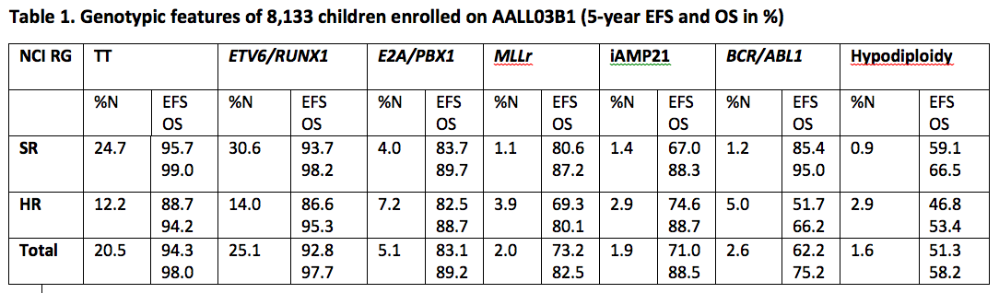
Outcomes are Highly Correlated with NCI RG and Genotype
Loh, ASH 2016
Copyright © 2019 by ASPHO

Slide 38
Philadelphia Chromosome-like (Ph-like) ALL
Ph-like ALL comprises 15-20% of high-risk B-ALL occurring in children/adolescents and 20-40% of B-ALL in adults
  Defined by an activated kinase gene expression signature similar to that of BCR-ABL1-rearranged (Ph+) ALL
  Driven by various often cytogenetically-cryptic genetic alterations that activate constitutive kinase signaling
  Frequently associated with deletions of IKZF1 and other lymphoid transcription factors (overlap with IKZF1^{plus} subtype)
Patients with Ph-like ALL often present with WBC >50,000 and have high rates of end-induction minimal residual disease (MRD) and relapse with conventional chemotherapy
Addition of tyrosine kinase inhibitors (TKIs) to chemotherapy may improve event-free and overall survival
Copyright © 2019 by ASPHO

Slide 39
Spectrum of Kinase Alterations in Ph-like ALL
>70 different fusions involving 19 kinase, cytokine, or cytokine receptor genes
Sequence mutation or structural alterations in CRLF2, IL7R, FLT3, SH2B3, RAS
Kinase | TKIs | Number of partners
ABL1 | dasatinib/imatinib | 13
ABL2 | dasatinib/imatinib | 3
CSF1R | dasatinib/imatinib | 3
PDGFRB | dasatinib/imatinib | 8
CRLF2 | ruxolitinib | 2
JAK2 | ruxolitinib | 21
EPOR | ruxolitinib | 4
Others | various | many n=1
Relative frequency of Ph-like ALL
alterations across age spectrum
50% with CRLF2 rearrangements +/- JAK2 or JAK1 point mutations
15-20% with JAK2 or EPOR rearrangements
10-15% with ‘ABL class’ alterations (ABL1, ABL2, CSF1R, PDGFRB rearrangements)
Courtesy of S. Tasian
Copyright © 2019 by ASPHO

Slide 40
Spectrum of Kinase Alterations in Ph-like ALL
>70 different fusions involving 19 kinase, cytokine, or cytokine receptor genes
Sequence mutation or structural alterations in CRLF2, IL7R, FLT3, SH2B3, RAS
Kinase | TKIs | Number of partners
ABL1 | dasatinib/imatinib | 13
ABL2 | dasatinib/imatinib | 3
CSF1R | dasatinib/imatinib | 3
PDGFRB | dasatinib/imatinib | 8
CRLF2 | ruxolitinib | 2
JAK2 | ruxolitinib | 21
EPOR | ruxolitinib | 4
Others | various | many n=1
Relative frequency of Ph-like ALL
alterations across age spectrum
All Ph-like ALL is associated with constitutive activation of kinase signaling.
Courtesy of S. Tasian
Copyright © 2019 by ASPHO

Slide 41
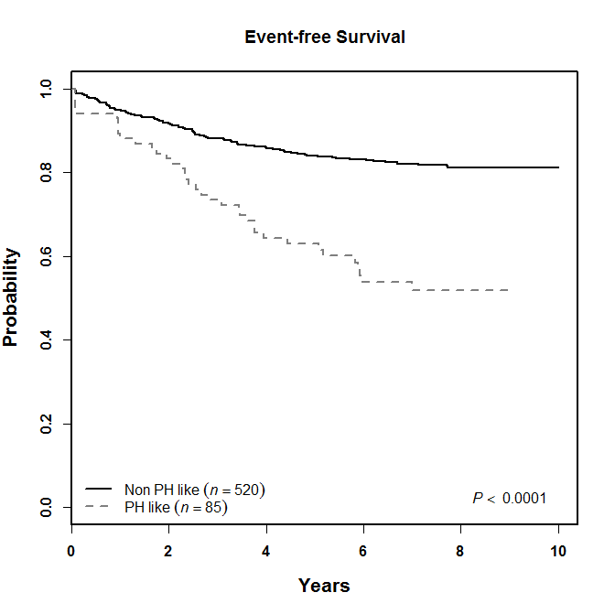
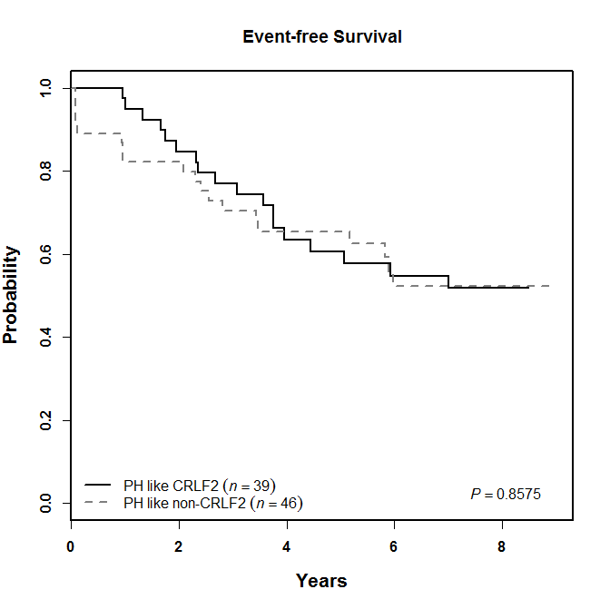
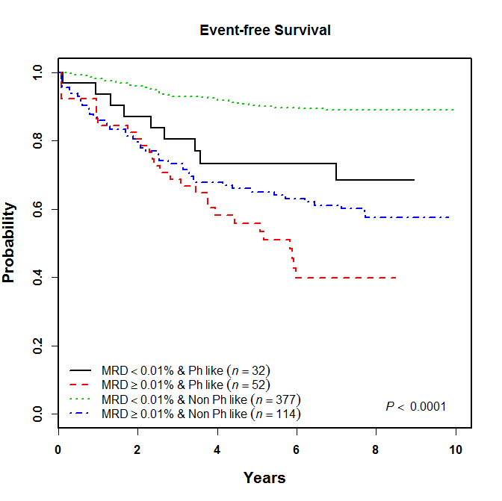
Poor Clinical Outcomes of Children with Ph-like ALL
Children with Ph-like ALL have high rates of relapse and inferior outcomes when treated with conventional chemotherapy
5 year EFS
non-Ph-like
94.7%
73.0%
CRLF2-R
non-CRLF2-R
65.0%
Probability EFS
Ph-like
~65% 3y EFS
in Ph-like ALL
55.0%
Years
Years
Years
Years
COG AALL0232
>60% of children with Ph-like ALL have EOI MRD ≥0.01%
Copyright © 2019 by ASPHO

Slide 42
Can we build on the success of TKI + chemo in Ph+ ALL?
COG AALL0031
*Chemotherapy + imatinib
7-year EFS 71.7% vs. 21.4% historical controls
* 3-year EFS 84.7% +/-7%
Reprinted by permission from Springer Nature: Leukemia, Long-term follow-up of imatinib in pediatric Philadelphia chromosome-positive acute lymphoblastic leukemia: Children's Oncology Group Study AALL0031, Schultz, K R, et al, Jan 20, 2014
Copyright © 2019 by ASPHO

Slide 43
Current Clinical Trials for Patients with Ph-like ALL
Ph-like alterations | TKI | Disease status | Ages | Clinical trial
ABL class | dasatinib | newly-diagnosed | 1-30 years | NCT01406756 (COG AALL1131)
ABL class | dasatinib | newly-diagnosed | 1-18 years | NCT03117751 (SJCRH Total XVII)
ABL class | dasatinib | relapsed | ≥10 years | NCT02420717 (MDACC)
CRLF2/JAK pathway | ruxolitinib | newly-diagnosed | 1-21 years | NCT02723994 (COG AALL1521)
CRLF2/JAK pathway | ruxolitinib | newly-diagnosed | 1-18 years | NCT03117751 (SJCRH Total XVII)
CRLF2/JAK pathway | ruxolitinib | relapsed | ≥10 years | NCT02420717 (MDACC)
Courtesy of S. Tasian
Copyright © 2019 by ASPHO

Slide 44
Infant ALL
The presence of a KTM2A-R in infants less than 12 months of age is the most important prognostic factor
  EFS for infants with KMT2A-R ranges from 37-49% versus 69-95% for non KMT2A-R infants
Generally presents with high WBC, involvement of etramedullary sites (chloromas, CNS disease, skull based disease—low threshold for imaging)
  CD10 negative, usually expresses some myeloid antigens
Risk classification
  Age (KMT2A-R nearly always present in infants with ALL < 100 days old)
  KMT2A-R status
Pathogenesis
  High expression of FLT3
  Global hypermethylation
  Abnormal Histone modification
Intensive multi agent therapy
E. Guest, Curr. Opin. Peds, 2017
Copyright © 2019 by ASPHO

Slide 45
T cell ALL
Neither age nor white blood count are prognostic
End induction MRD is not prognostic
  Many T cell ALL cases are positive at end induction
End consolidation MRD appears to be most prognostic
Presentation
  Always need to rule out mediastinal involvement, which can affect airway
  Can present with a coagulopathy, so correct INR
  Higher rate of tumor lysis syndrome
Copyright © 2019 by ASPHO

Slide 46
Acute Lymphoblastic Leukemia
Basic Science and Pathophysiology
Epidemiology and Risk Assessment
Diagnosis
Management and Treatment
Copyright © 2019 by ASPHO

Slide 47
Initial management of ALL therapy
Stabilize patient
Assess for tumor lysis risk
  T cell ALL higher risk than B-lineage: local dosing recommendations re allopurinol versus rasburicase
  High white blood count higher risk than lower white blood count
Rare to need to invoke plasmapheresis (some cases of infants with exceedingly high white blood cell counts)
Initiate chemotherapy after enrolling on appropriate biology and clinical trials, if available.
Copyright © 2019 by ASPHO

Slide 48
CCG 106: BFM Therapy is Superior to CCG Therapy for HR-ALL [Gaynon PS et al JCO 11:2234, 1993]
CCG 106 enrolled patients from 1983-87
7-Year EFS + S
Reg A (BFM): 63% + 72%
Reg B (NYII): 61% + 72%
Reg C (CCG): 40% + 56%
Regimen B had increased morbidity compared to A
Regimen A, with DI phase based on BFM 76, was adapted as standard CCG therapy for HR ALL
Reprinted with permission. © (1993) American Society of Clinical
Oncology. All rights reserved. Gaynon, P S, et al: J Clin Oncol, Nov 1, 1993
Copyright © 2019 by ASPHO

Slide 49
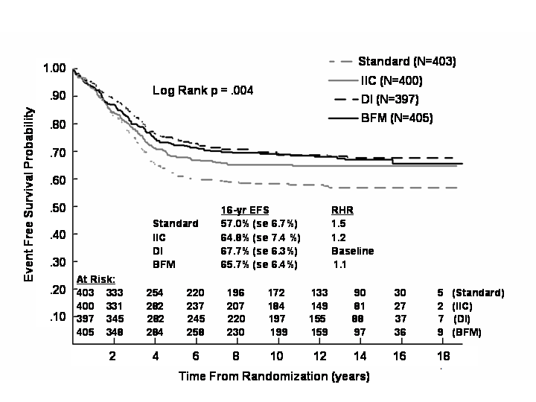
CCG 105: Long Term Outcome [1983-1989]
Tested components of BFM therapy by randomizing IR pts to std CCG therapy +/- BFM intensifications:
  Std CCG
  IIC: BFM protocol Ia + Ib
  DI: Added DI (protocol IIa + IIb to std)
  BFM: Used protocol I and II
DI improved outcome
No added advantage to Ia (4 drug induction), or Ib (intensive consolidation) for IR pts if DI given
Based on these results, all subsequent CCG trials included DI, but SR trials did not have Ia (4-drug induction) or Ib (intensive consolidation)
Tubergen DG et al J Clin Oncol 11:527-37, 1993
Hunger SP et al Pediatr Blood Cancer 2005 45:876-80, 2005
Copyright © 2019 by ASPHO

Slide 50
Principles of Treatment for Different Risk Groups of ALL (COG Approach)
Standard Risk ALL
  4-week 3-drug (Dex) induction
  4-week oral consolidation with intensive IT
  8-week Int Maint (IM) with Capizzi IV MTX w/o rescue
  8-week DI phase with standard re-consolidation
  2nd Capizzi IM (sometimes)
  Maint with q 4 week steroid/VCR pulses
High Risk ALL (and T-ALL)
  4-week 4-drug (Pred28 or Dex14) induction
  8-week intensive IV consolidation with intensive IT
  8-week Int Maint with HD MTX or Capizzi IV MTX + ASNase
  8-week DI phase with intensive re-consolidation
  2nd Capizzi IM (sometimes)
  Maint with q 4 week steroid/VCR pulses
Copyright © 2019 by ASPHO

Slide 51
General Overview of COG Based ALL therapy
Esc IV-
MTX*
mBFM DI^
Esc IV-
MTX*
3 drug
induction
Cons.
Maintenance
Standard
Risk
3 drug
induction
maBFM DI &
Cons.
HD-MTX
#Capizzi-MTX
Maintenance
High
Risk
*Esc IV MTX does not contain Asp
^mBFM includes Asp only on day 4
&ma (modified hemi-augmented)BFM includes additional Vcr, Asp on day 43 and Vcr on day 50
#Capizzi-MTX includes Asp on day 2 and 22
Copyright © 2019 by ASPHO

Slide 52
ALL: Measures of Early Treatment Response
BFM: PB (absolute blast count) response to 7 days of steroids + 1 dose IT MTX (prophase or prephase)
  Good (PGR): <1000 blasts/ml in PB [90% of pts with EFS 80%]
  Poor (PPR): >1000 blasts/ml in PB [10% of pts with EFS 30%]
CCG: day 8 (HR) or day 15 (SR) BM response
    M1: <5% blasts, M2: 5-25% blasts, M3: >25% blasts
    Outcome: M1> M2 > M3
COG: day 8 PB MRD and day 29 BM MRD
Bone marrow MRD at day 29 is the most significant predictor of outcome
Copyright © 2019 by ASPHO

Slide 53
Minimal Residual Disease (MRD)
Morphologic assessment is a crude, but accurate and reproducible way to identify patients likely to have good or bad outcomes
MRD is the presence of cells following chemotherapy below the level of morphologic detection
  Techniques to assess MRD should achieve a sensitivity of at least 1/10,000 (0.01%)
  End of induction MRD using flow cytometry is most powerfule predictor of outcome
More sensitive measures should be a more accurate way to identify groups for risk-adapted therapy and will be tested
MRD response is most powerful prognostic factor
  Day 8/15 BM morphology not significant in context of MRD
Copyright © 2019 by ASPHO

Slide 54
MRD: Technologies
Detection of leukemia associated phenotypes via flow cytometry
  Applicable in almost all cases
  Fast, relatively inexpensive
  Less sensitive than molecular methods
PCR amplification of antigen receptor loci (Ig or TCR)
  Applicable to ~85-90% of cases
  Laborious and expensive (10x flow), but very sensitive
  Now using next generation sequencing (NGS) (evolving)
Parallel studies of flow and PCR show very similar results at 1/10,000
PCR of translocation-derived fusion transcripts
  Controversial in pediatric ALL
Copyright © 2019 by ASPHO

Slide 55
End Induction BM MRD via FCM is Highly Prognostic:
COG P9900
1.0
88±1%
51% of events are in the MRD negative group
0.8
5 yr EFS
59±5%
0.6
MRD threshold for 2nd generation COG ALL trials
Event-free survival probability
43±5%
0.4
P
<
0.0001
MRD threshold in 1st generation COG ALL trials
0.2
1: Day 28 <0.01% (n=1588)
2: Day 28 0.01-0.1% (n=175)
3: Day 28 >0.1% (n=208)
0.0
0
1
2
3
4
5
6
Years
Copyright © 2019 by ASPHO
Republished with permission of American Society of Hematology, from Blood, Borowitz M et al., 111, 2008,
5477-5485; permission conveyed through Copyright Clearance Center, Inc.

Slide 56
Ig/TCR Rearrangements are Unique Clonotypic Markers and MRD Targets (NGS)
Unique marker of each B cell and its clonal progeny
Copyright © 2019 by ASPHO
Courtesy of S. Hunger

Slide 57
Prevention of CNS Leukemia Dramatically Improved ALL Outcome
1960s: chemotherapy induced remissions in most patients, but very high rate of early CNS relapses
  50-75% had CNS relapse within 6-12 months
Most chemo agents have poor CNS penetration and prophylactic CNS treatment is essential
  Dramatic increase in cure rates in early 70s with universal use of cranial (cXRT) or craniospinal irradiation (csXRT)
CNS disease definitions
  CNS1 (0-5 white cells/chamber, 0 blasts, no clinical signs of CNS leukemia)
  CNS2 (< 5 white blood cells/chamber, presence of blasts) or negative by Steinherz-Bleyer algorithm if traumatic tap
  CNS3 (> 5 white blood cells/ul chamber, presence of blasts), signs of clinical leukemia, positive by Steinherz-Bleyer algorithm if traumatic tap
Copyright © 2019 by ASPHO

Slide 58
ALL: Prophylactic Treatment of the CNS
Greatly decreased use of cXRT over time; some groups use only for CNS3 or not at all (SJCRH, DCOG, MRC, CoALL)
  Other groups still use cXRT for some patient subsets (COG, DFCI, BFM, others)
    Typically includes all CNS3
  Current prophylactic dose usually 1200 cGy cXRT
  Current treatment dose (CNS3) usually 1800 cGy cXRT, includes posterior halves of globes of eyes
    Many groups treat with HR backbone therapy (including HDM)
  Spinal irradiation rarely used any more
CNS2
  Most groups treat with extra IT during induction which abrogate poor prognosis
Copyright © 2019 by ASPHO

Slide 59
CNS-Directed Therapy: Acute Complications
Intrathecal chemotherapy
  Arachnoiditis (headache, nausea, vomiting, meningismus)
  Seizures (occur in 1-2%, particularly with repeats ITs)
  Transient stroke-like symptoms
    Typically occur 7-11 days post IT
  Rare occurrence of subacute encephalopathy, myelopathy, and weakness/paraplegia linked to IT MTX
Irradiation
  Somnolence syndrome 5-7 weeks post cXRT
Administration of high dose IV MTX after cXRT is associated with increased CNS toxicity
  Give High Dose MTX first!
Copyright © 2019 by ASPHO

Slide 60
CNS-Directed Therapy: Late Complications
Changes on neuroimaging studies
  Cortical atrophy, necrotizing leukocencephalopathy, subacute leukocencephalopathy, mineralizing leukocencephalopathy (HD MTX may increase risk; uncertain)
    Calcifications may be most significant finding
Impaired intellectual function and school performance
  Linked to dose and age at time of cXRT (younger is worse)
Development of secondary brain tumors (10+ yrs post XRT)
  Meningioma (15-20 yrs post XRT) highly curable; others not
Neuroendocrine changes
  Impaired growth and GH responses; much lower risk if <2400 cGy
Increased risk of obesity
Copyright © 2019 by ASPHO

Slide 61
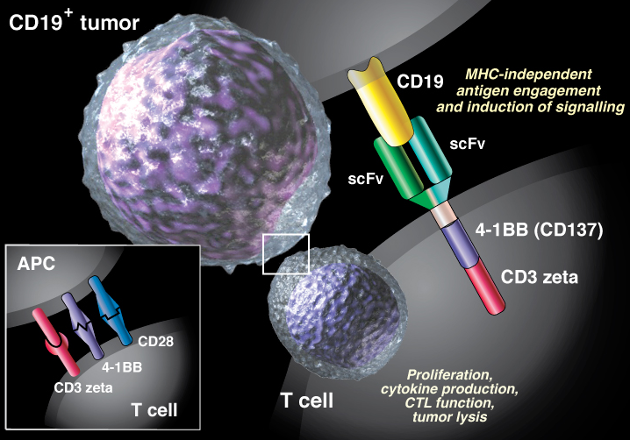
New Immunotherapies for ALL
Blinatumomab
Inotuzumab
CTL-019/CART
Hematology Am Soc Hematol Educ Program. 2018 Nov 30;
2018(1):16-24. doi: 10.1182/asheducation-2018.1.16.
Clinicaloptions.com
Reprinted by permission from Dove Medical Press Ltd., Thomas, X, Profile
of inotuzumab ozogamicin and its potential in the treatment of acute
lymphoblastic leukemia, April 2014 Vol. 2014: 4 1-8.
.
Copyright © 2019 by ASPHO

Slide 62
Promising New Immunotherapies for B-ALL
Immune Therapy | Mechanism of Action | Patient Population Studied | Outcome
Inotuzumab | CD22-directed humanized moAB conjugated to calicheamicin | Adults with CD22+ R/R B-ALL | 80.7% CR/CRi
Blinatumomab | Bispecific T cell receptor engager (BiTE) that redirects CD3+ T cells to CD19+ blasts | Adults with R/R Ph- B-ALL Children with R/R B-ALL | 39% CR 39% CR
CAR T cells | T cells transduced ex-vivo with chimeric anti-CD19 receptor | Children with CD19+ R/R B-ALL | 83% CR/CRi
Kantarjian et al. N Engl J Med. 2016;375:740-753, Maury S et al. N Engl J Med. 2016;375:1044-1053,
Topp M et al. EHA. 2016;149, von Stackelberg A et al. Blood. 2016;128:222, Grupp SA et al. Blood.
2016;128:221
Courtesy, S. Tasian
Copyright © 2019 by ASPHO

Slide 63
Immune Toxicities
Immunotherapies have toxicities distinct from chemotherapy
  Collaboration between oncology and ICU teams important
Several toxicities shared amongst immunotherapies
  Cytokine release syndrome
    Associated with higher disease burden
  Neurologic side effects
Sinusoidal obstruction syndrome (associated with inotuzumab)
  Elevated risk in the post-inotuzumab HSCT setting
  Higher rates in children compared to adults*
Toxicities related to mechanism of action
Toxicity management could impact efficacy
*D. Bhojwani, Leukemia, 2018
Copyright © 2019 by ASPHO

Slide 64
Cytokine Release Syndrome (CRS)
Severe CRS correlates with disease burden
  Patients in morphologic remission likely to be at lower risk of severe CRS
  Severity scales with disease burden
  Treatment includes supportive care, pressors, and tociluzumab when indicated
Disease Burden
BM Blasts (%)
Fever
Myalgias
Nausea/Vomiting
Hypotension
Respiratory insufficiency
Renal insufficiency
Coagulopathy
p<0.01
Severe CRS
Copyright © 2019 by ASPHO
Maude et al., ASPHO/EHA 2015, data as of 4/26/15

Slide 65

Neurotoxicity after CAR-T
CAR-T cell Related Encephalopathy Syndrome (CRES)
Similar neurotoxicity seen with Blinatumomab (CD19 BiTE)
Seen with multiple CD19 CAR T cell products used in multiple diseases
Seen with CD22 CAR T cell products in ALL patients
Seen in preclinical models of anti-GD2 CAR T cells for NBL
Headache
Dysgraphia
Tremor
Delirium
Anxiety
Seizure
Coma
Cerebral Edema
Death
Gust, et. al. Cancer Discovery 2017;
Mackall, et. al., Cancer Discovery 2018
Courtesy, D. Teachey
Copyright © 2019 by ASPHO

Slide 66
Prognostic Factors Following ALL Relapse
Site of relapse
  Bone marrow worse than extramedullary
Time to relapse
  Earlier much worse than later
Age at initial diagnosis
  Very poor outcome for teenagers that relapse
Immunophenotypic and genetic features
  BM relapse of T-ALL has very poor outcome
Copyright © 2019 by ASPHO

Slide 67
ALL Bone Marrow Relapse: Prognostic Importance of Time to Relapse
Time to relapse | Isolated BM relapse 5-yr OS (n) | Combined BM relapse 5-yr OS (n)
0-17 mos. | 11.5% (412) | 11.6% (86)
18-35 mos. | 18.4% (324) | 39.8% (54)
36+ mos. | 43.5% (387) | 60.3% (124)
All | 24.1% (1123) | 39.4% (264)
Nguyen et al, Leukemia 22:2142-50, 2008
Copyright © 2019 by ASPHO

Slide 68
ALL: CNS and Testicular Relapse
CNS relapse
Time to relapse is a strong predictor of outcome (<18 mos < 18-36 mos < 36+ months
  Effective systemic therapy is critical as the biggest risk is subsequent BM relapse
About 2% of boys will have an isolated testicular relapse
  104/5374 boys treated on CCG trials 1988-2002 (Nguyen et al, Leukemia 2008)
Standard treatment includes intensive systemic therapy plus 2400 cGy bilateral testicular irradiation
  Risk of contralateral testicular relapse high without irradiation
  Leads to sterility and need for hormone replacement
  Other studies suggest orchiectomy can obviate need for testicular XRT, or that those that have a complete response to induction chemotherapy may not need irradiation
Copyright © 2019 by ASPHO

Slide 69
Relapsed ALL: Role of Allogeneic Stem Cell Transplantation (SCT)
Outcomes now equivalent for matched sib and unrelated donor SCT; use same indications for both
  No role of autologous SCT in ALL
SCT indicated for ALL with early (<3 yrs) 1st marrow relapse
  This may also be evolving but is current standard of care
Increasing use of SCT for late marrow relapse with high MRD at end of 1st course of reinduction therapy
Some believe (disagreement) that SCT indicated for early CNS relapse (<18 mos)
SCT indicated for any ALL with 2nd relapse, or any T-ALL BM relapse
Copyright © 2019 by ASPHO

Slide 70
Relapsed ALL: Role of CAR-T cells in a rapidly evolving field
Genetically engineered receptors the pair an anti-CD19 single chain Fv domain to intracellular T cell signaling domains that result in redirection of the T lymphocytes to recognize B ALL cells that express CD19.
Different co-stimulatory domains provide different half lives for length of therapy—4-1BB last longer than CD28
  Role of transplant is uncertain after infusion
When using CTL-019 (with 4-1BB), CR rate for relapsed/Refractory ALL was 90% with a 6 month EFS of 78% (95% CI 51-88%) and an OS of 78% (95% CI 65-95%)
Durable remissions were seen as far as 24 months out.
Maude, NEJM 2018
Copyright © 2019 by ASPHO

Slide 71
Survivorship Issues for Leukemia Survivors
ALL Survivors are at risk for
  Osteonecrosis
  Cardiac toxicity
  Obesity
  Neurocognitive Impairment
  Growth hormone deficiency (if treated with cranial radiation)
  Insulin resistance
  Muscle weakness
  Peripheral neuropathy
  Reviewed in Ness, Exp. Rev. Heme, 2011, 4:2, 185-197
http://www.survivorshipguidelines.org/pdf/2018/COG_LTFU_Guidelines_v5.pdf
Copyright © 2019 by ASPHO

Slide 72
Good luck!
Copyright © 2019 by ASPHO

