Slide 1
Inherited Bleeding Disorders
Guy Young, MD
Children’s Hospital Los Angeles, University of Southern California Keck School of Medicine

Slide 2
Lecture Outline
Hemophilia
von Willebrand disease
Rare bleeding disorders

Slide 3
Hemophilia Outline
Hemophilia history
General characteristics
Diagnosis
Treatment
Inhibitors

Slide 4
Talmud—2nd Century
“If she circumcised her first son and he died and a second one also died, she must not circumcise the third son”
R. Judah, the Patriarch, redactor of the Mishnah

Slide 5
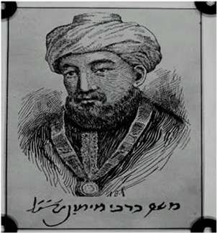
Refinement of Talmud Language—12th Century
Moses Maimonedes was a physician and religious scholar who refined the teachings of the Talmud as follows:
“If a woman had her first son circumcised and he died as a result of the circumcision, which enfeebled his strength, and she similarly had her second [son] circumcised and he died as a result of the circumcision - whether [the latter child] was from her first husband or her second husband - the third son may not be circumcised at the proper time [on the eighth day of life]…”²
He understood the genetics—that hemophilia was X-linked
1. Rosner F. Ann Intern Med 1965;372:1135-1204.
2. Mishneh Torah, Hilkhot Milah. 1:18.

Slide 6
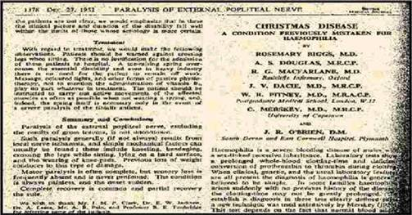
First description of FIX deficiency
Biggs R, et al. Br Med J. Dec. 27, 1952;1378.

Slide 7
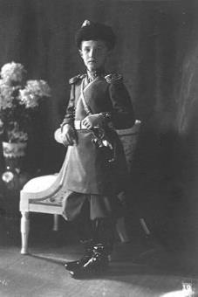
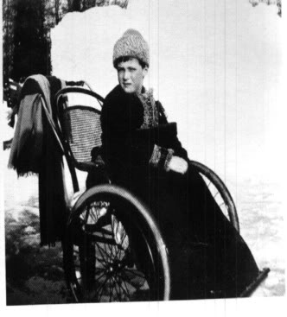
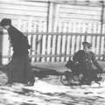
The Most Famous Hemophiliac
Flexed knee due to bleed
Significant bruising

Slide 8
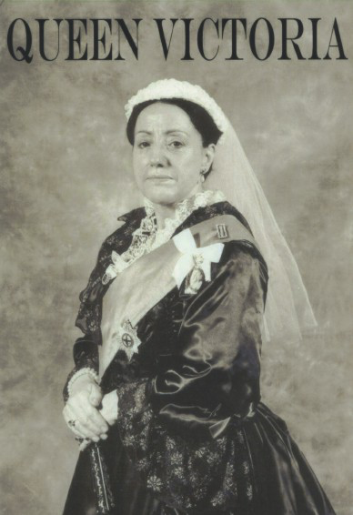

Slide 9
Hemophilia Outline
Hemophilia history
General characteristics
Diagnosis
Treatment
Inhibitors

Slide 10
Hemophilia
Hemophilia is the term used to describe deficiencies of factors VIII and IX
Also known as hemophilia A and B
Deficiencies of factors VIII and IX are inherited in an X-linked recessive pattern
Heterozygous females (i.e. carriers) can be symptomatic
Historically called symptomatic carriers but now referred to by their level of factor as mild (most often) or moderate (very rare) hemophilia

Slide 11
Molecular Basis of Hemophilia A
Severe hemophilia A
40% to 50%: Intron 22 inversion in factor VIII gene
50%: Specific point mutations in exons or at splice junctions in factor VIII gene
5%: Deletions of varying size
5%: Intron 1 inversion
Mild and moderate hemophilia A
Point mutations in the factor VIII coding sequence
Differences in the location and nature of point mutation accounts for variations in severity
Notes:
Know the molecular basis for hemophilia.

Slide 12
Miller et al. Haemophilia 2012: 18:375-382.

Slide 13
Miller et al. Haemophilia 2012: 18:375-382.

Slide 14
Miller et al. Haemophilia 2012: 18:375-382.

Slide 15
Molecular Basis of Hemophilia B
Factor IX gene deletions of varying sizes and point mutations
Correlation of type of mutation with severity
Small and large deletions—associated with severe hemophilia B
Missense mutations—common in mild and moderate disease
Notes:
Know the molecular basis for hemophilia.

Slide 16
Miller et al. Haemophilia 2012: 18:375-382.

Slide 17
Miller et al. Haemophilia 2012: 18:375-382.

Slide 18
Miller et al. Haemophilia 2012: 18:375-382.

Slide 19
Clinical and Laboratory Manifestations
 | Severe | Moderate | Mild
Factor level | <1% | 1-5% | 5-40%
Age at presentation | Birth-3 years* | 2-10 years* | 5->21 years*
Presentation | Family history (pre- or postnatal screening) Neonatal bleeding (circ, heel sticks) Bruising (<1 year) Vaccine-related bleed Mucosal bleed Joint bleed | Family history (pre- or post natal screening) Neonatal bleeding (less likely than severe) Vaccine-related bleed Mucosal bleed Joint bleed | Post-traumatic bleed Post-surgical bleed
Risk for inhibitor development | ~25% in FVIII ~5% in FIX | ~1-2% | Very rare
Risk for hemophilic arthropathy | Universal without prophylaxis | Very common without prophylaxis | Rare
*Age at presentation is highly variable—these are approximations of ages that questions will likely cite

Slide 20
Typical Bleeding Locations by Age
Age | Site | Frequency
Neonatal | Post-circumcision Heel sticks Intracranial | Common in severe (less so in other types) Common in severe (less so in other types) Uncommon (~1-5% in severe)
4 weeks-1 year | Bruising Post-vaccination Joint (elbow, knee, ankle) Intracranial | All severe, most moderate, less in mild Occasional in severe (less so in other types) Infrequent in severe, rare in other types Rare (1% or less)
1 year -5 years | Joint (elbow, knee, ankle) Muscle Mucosal | Nearly all severe patients will have a joint/muscle bleed, very common in moderate and rare in mild Universal in all types with trauma
5-13 years | Joint (elbow, knee, ankle) Muscle Post-trauma | All severe and most moderates will have joint/muscle bleeds All types will have post-traumatic bleeding
13-21 years | Joint (elbow, knee, ankle) Muscle Post-trauma | All severe and most moderates will have joint/muscle bleeds All types will have post-traumatic bleeding

Slide 21
Unusual Bruising

Slide 22
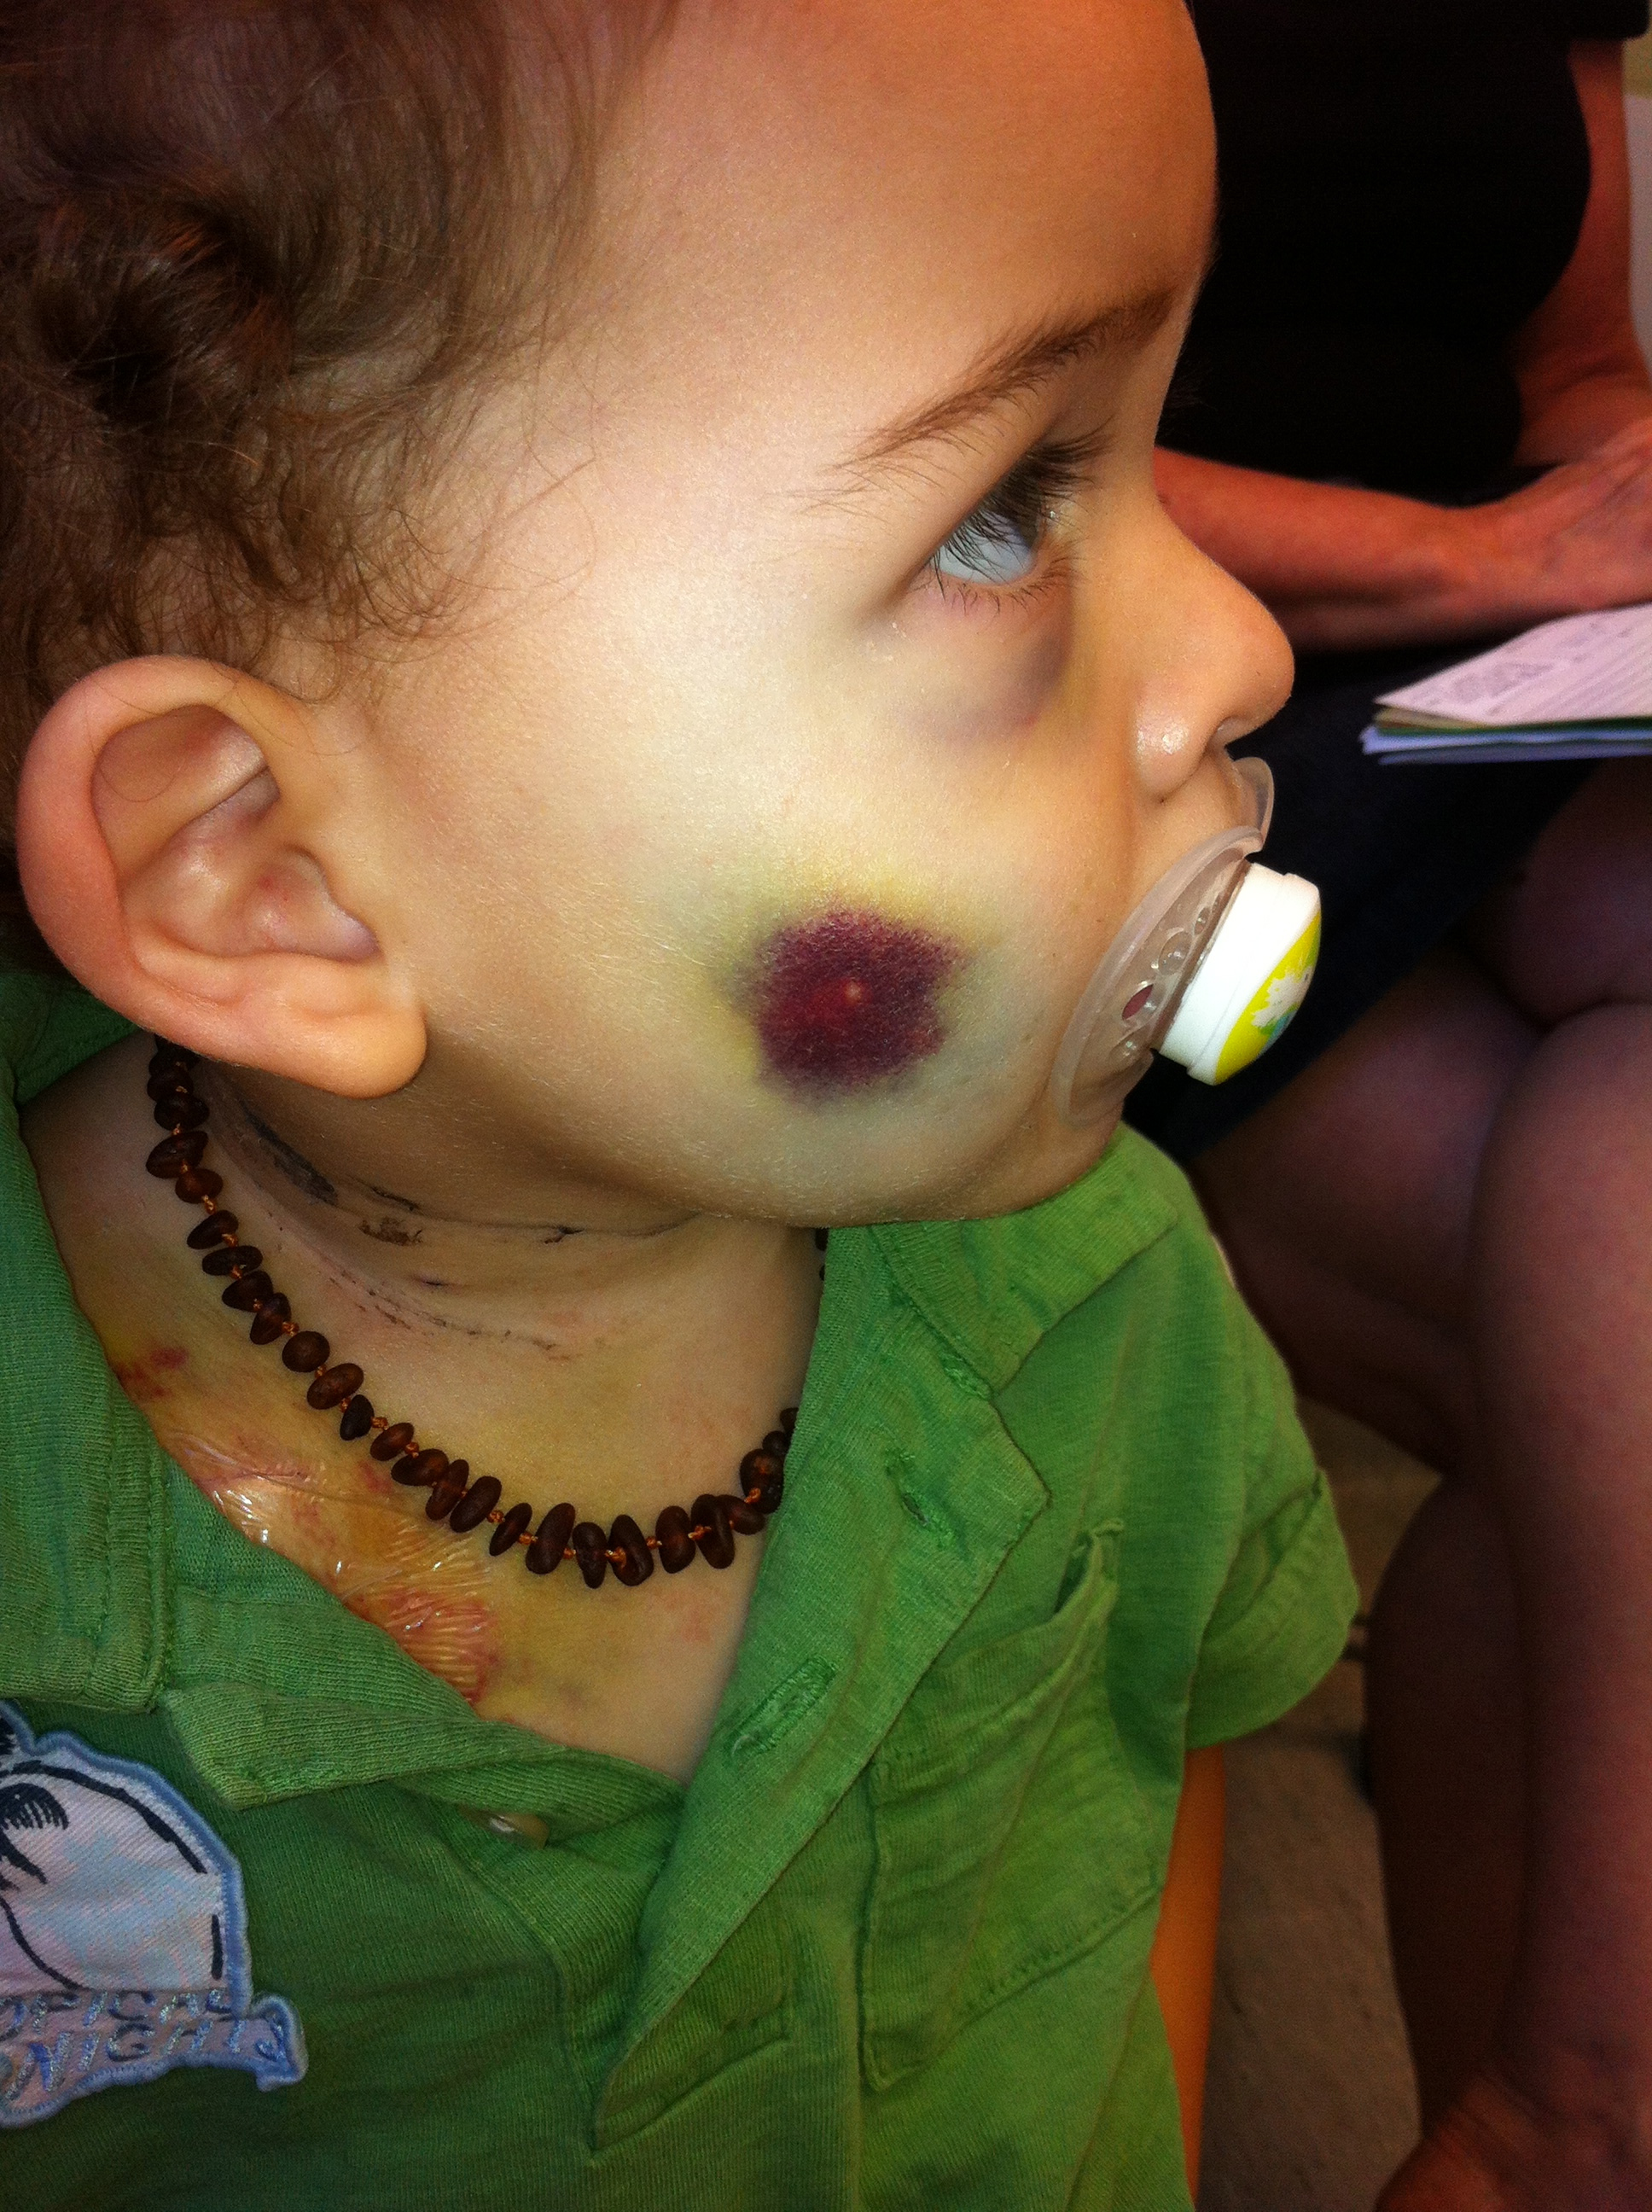

Slide 23
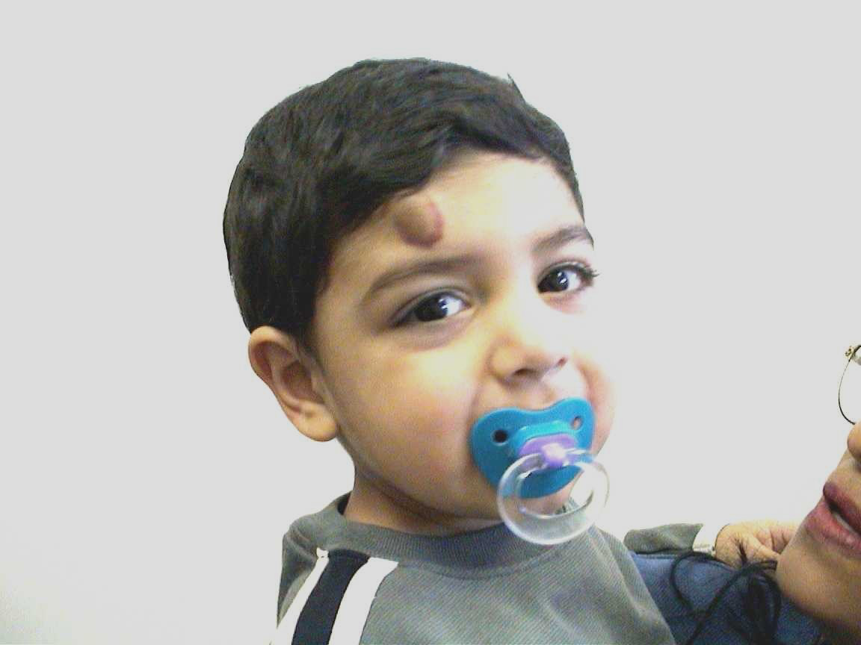
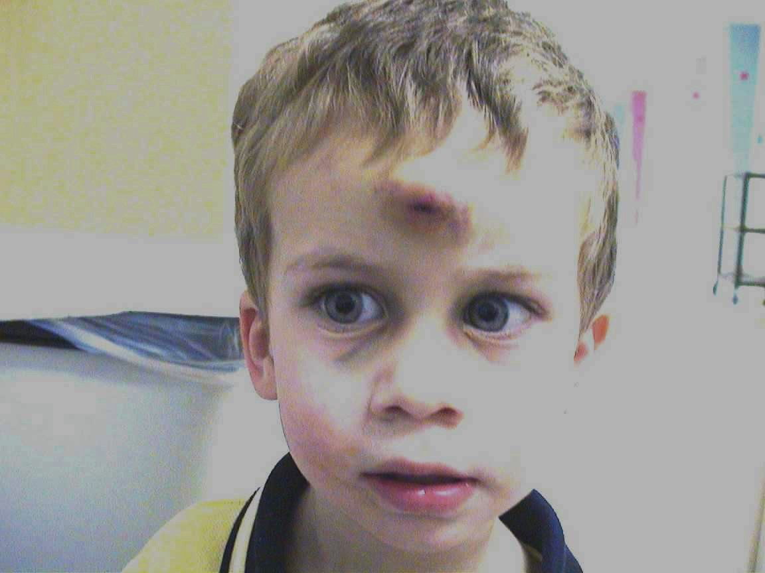

Slide 24
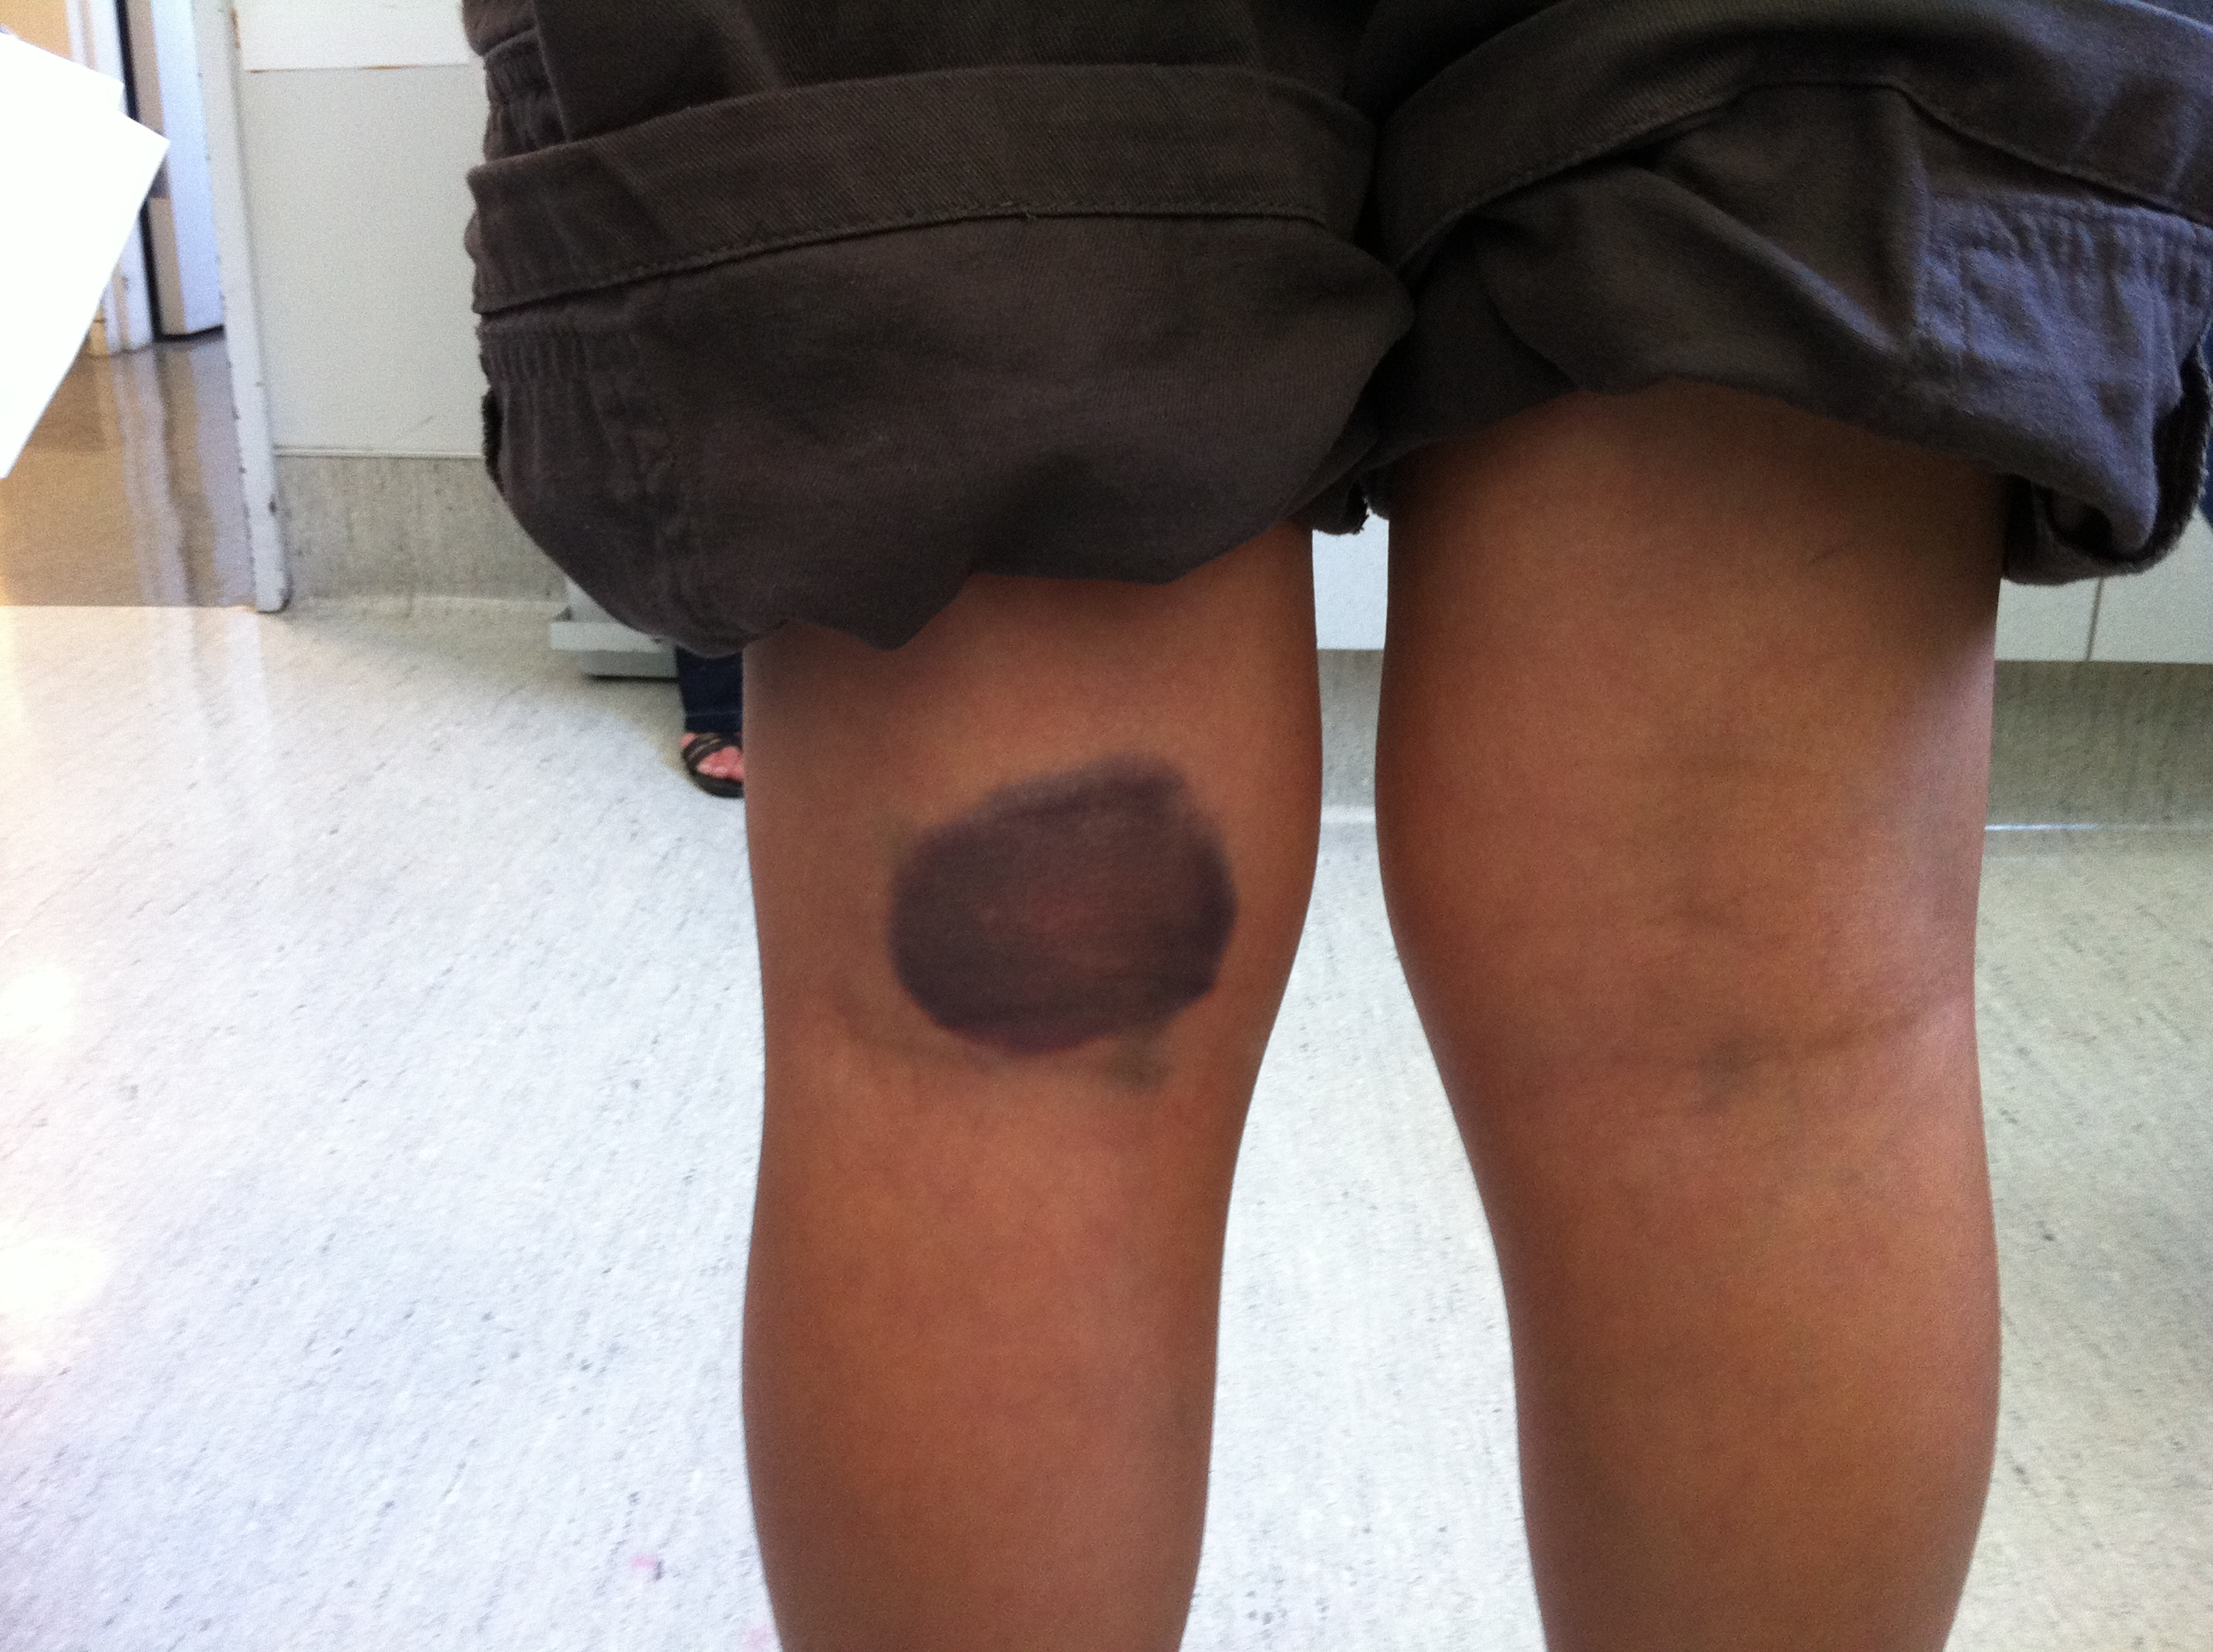

Slide 25
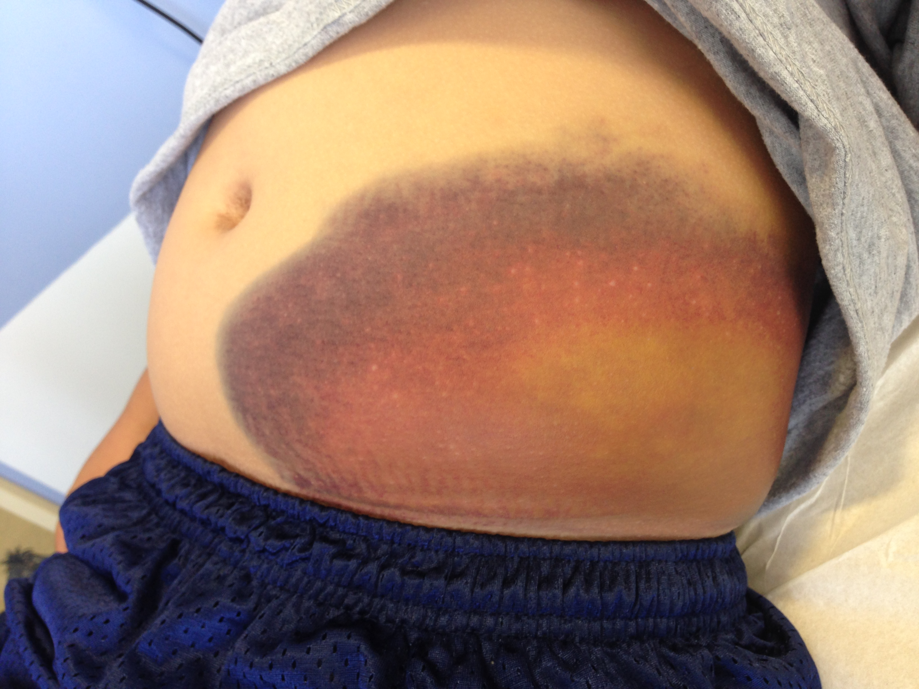

Slide 26
Post-vaccination Bleeding

Slide 27
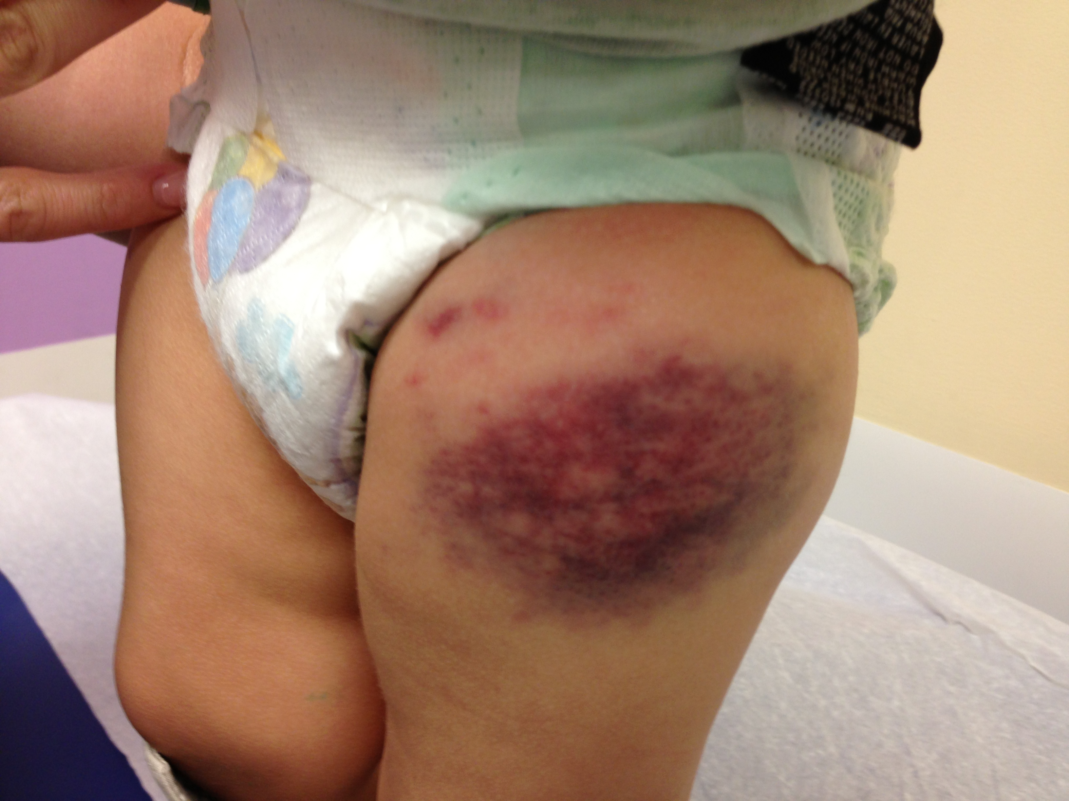

Slide 28
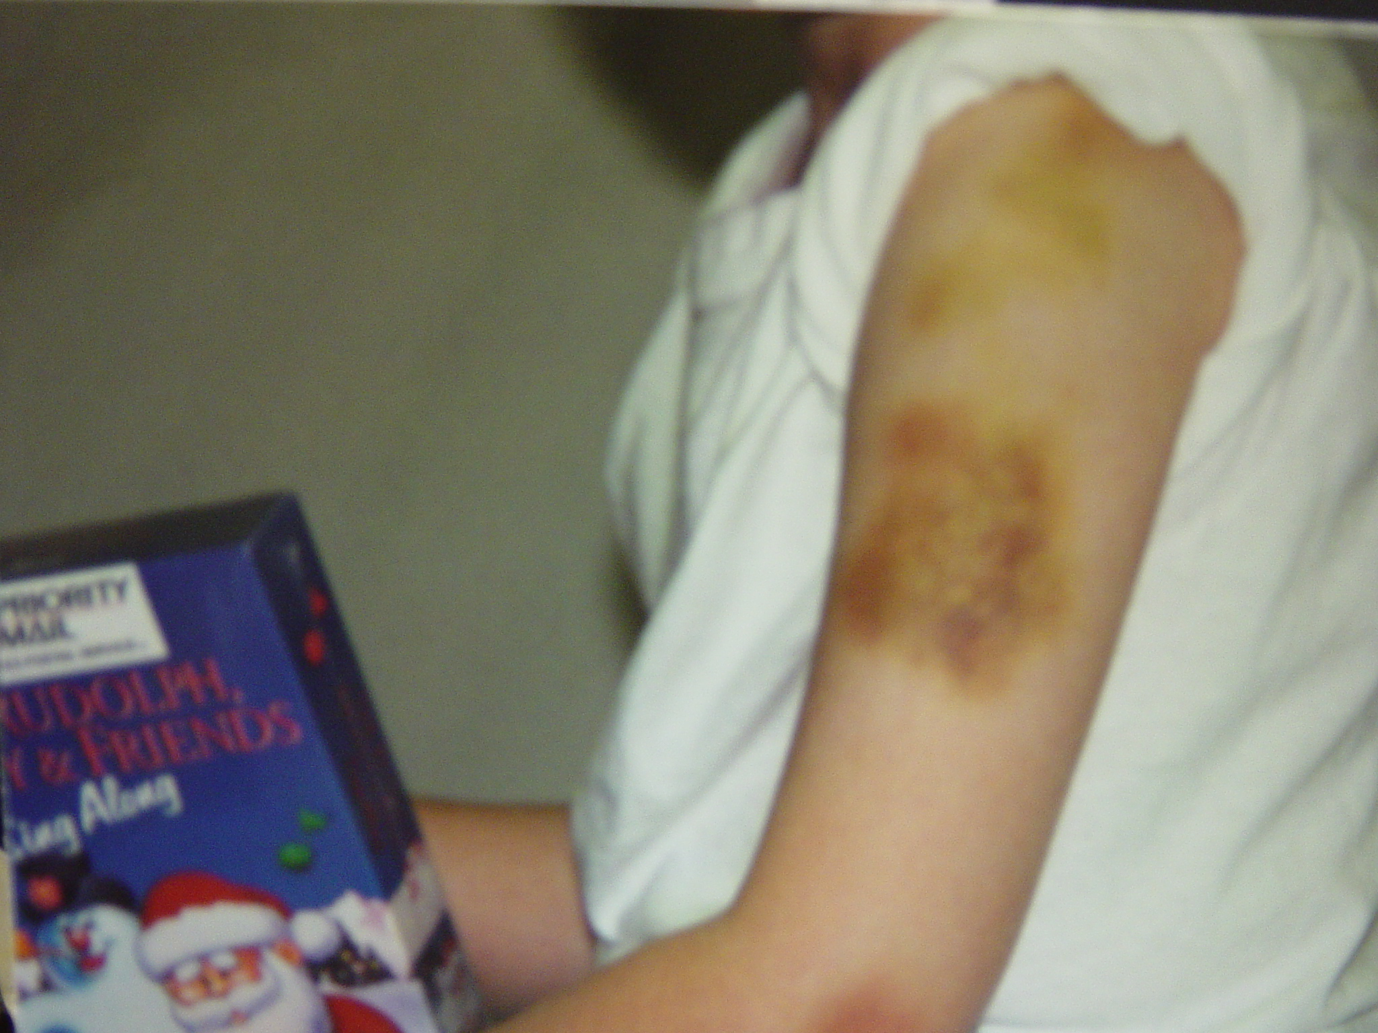

Slide 29
Joint Bleeding

Slide 30
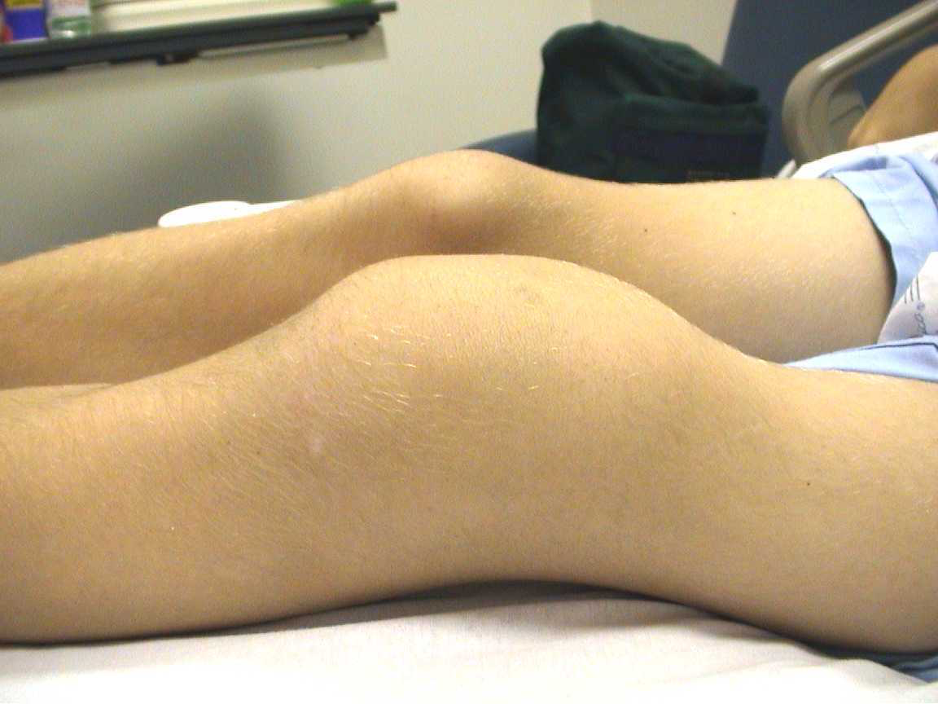
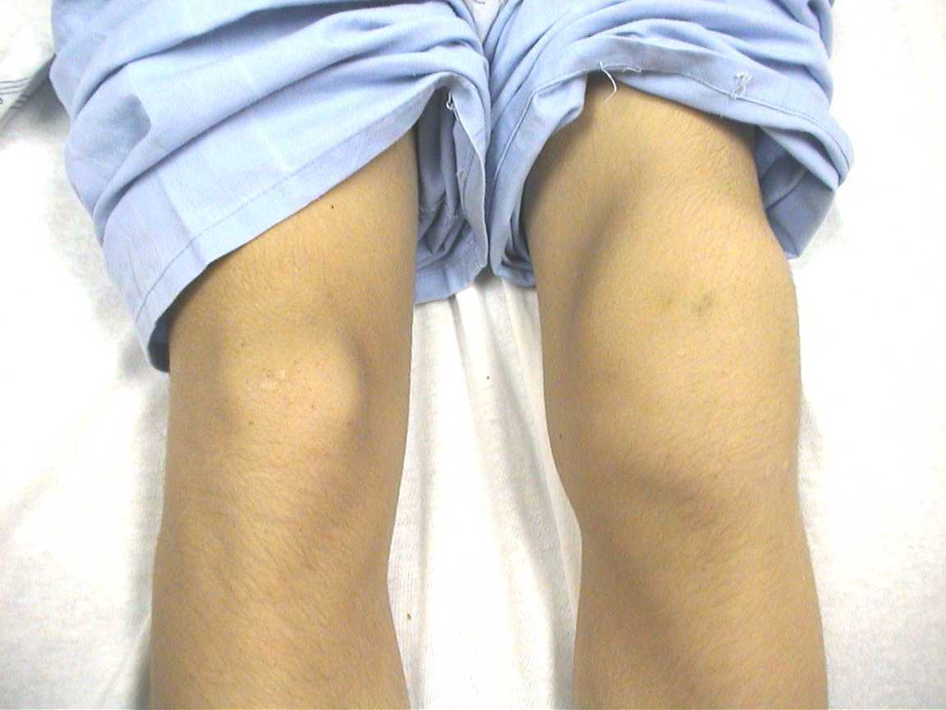

Slide 31
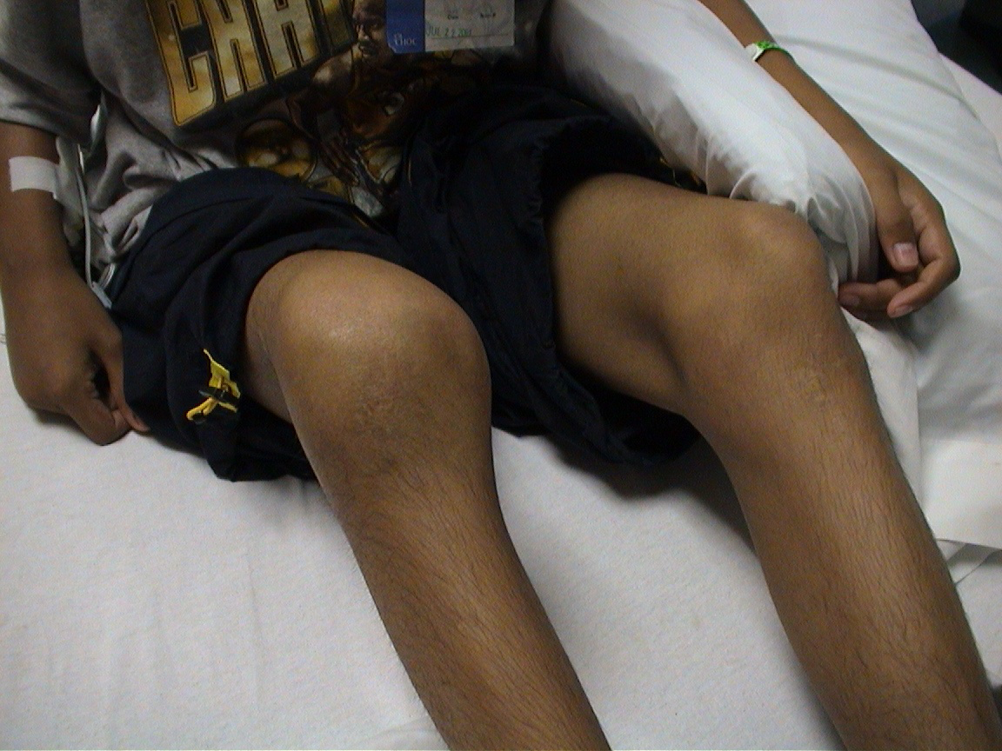

Slide 32
Muscle Bleed

Slide 33
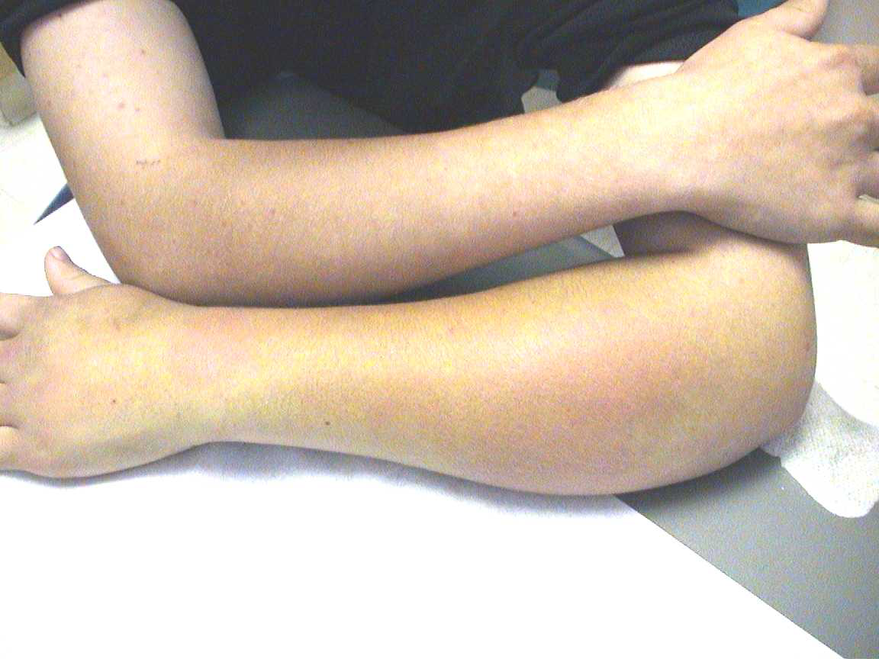

Slide 34
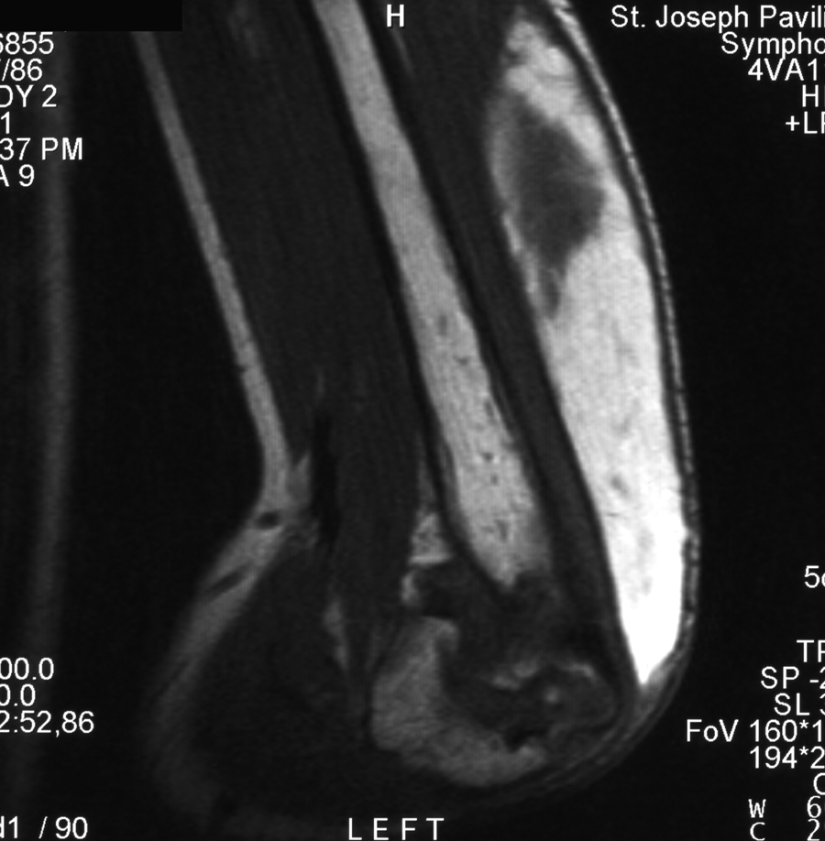
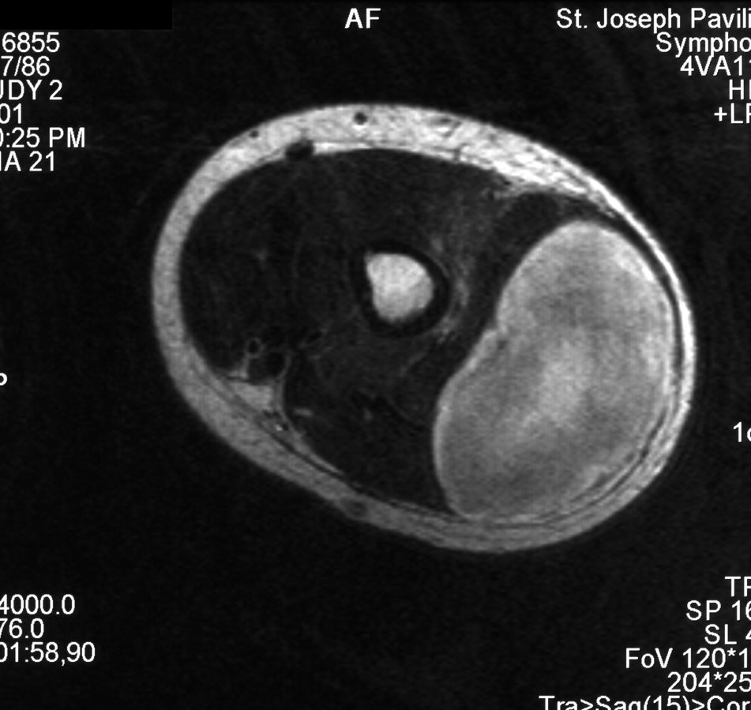

Slide 35
Mucus Membrane Bleeding

Slide 36
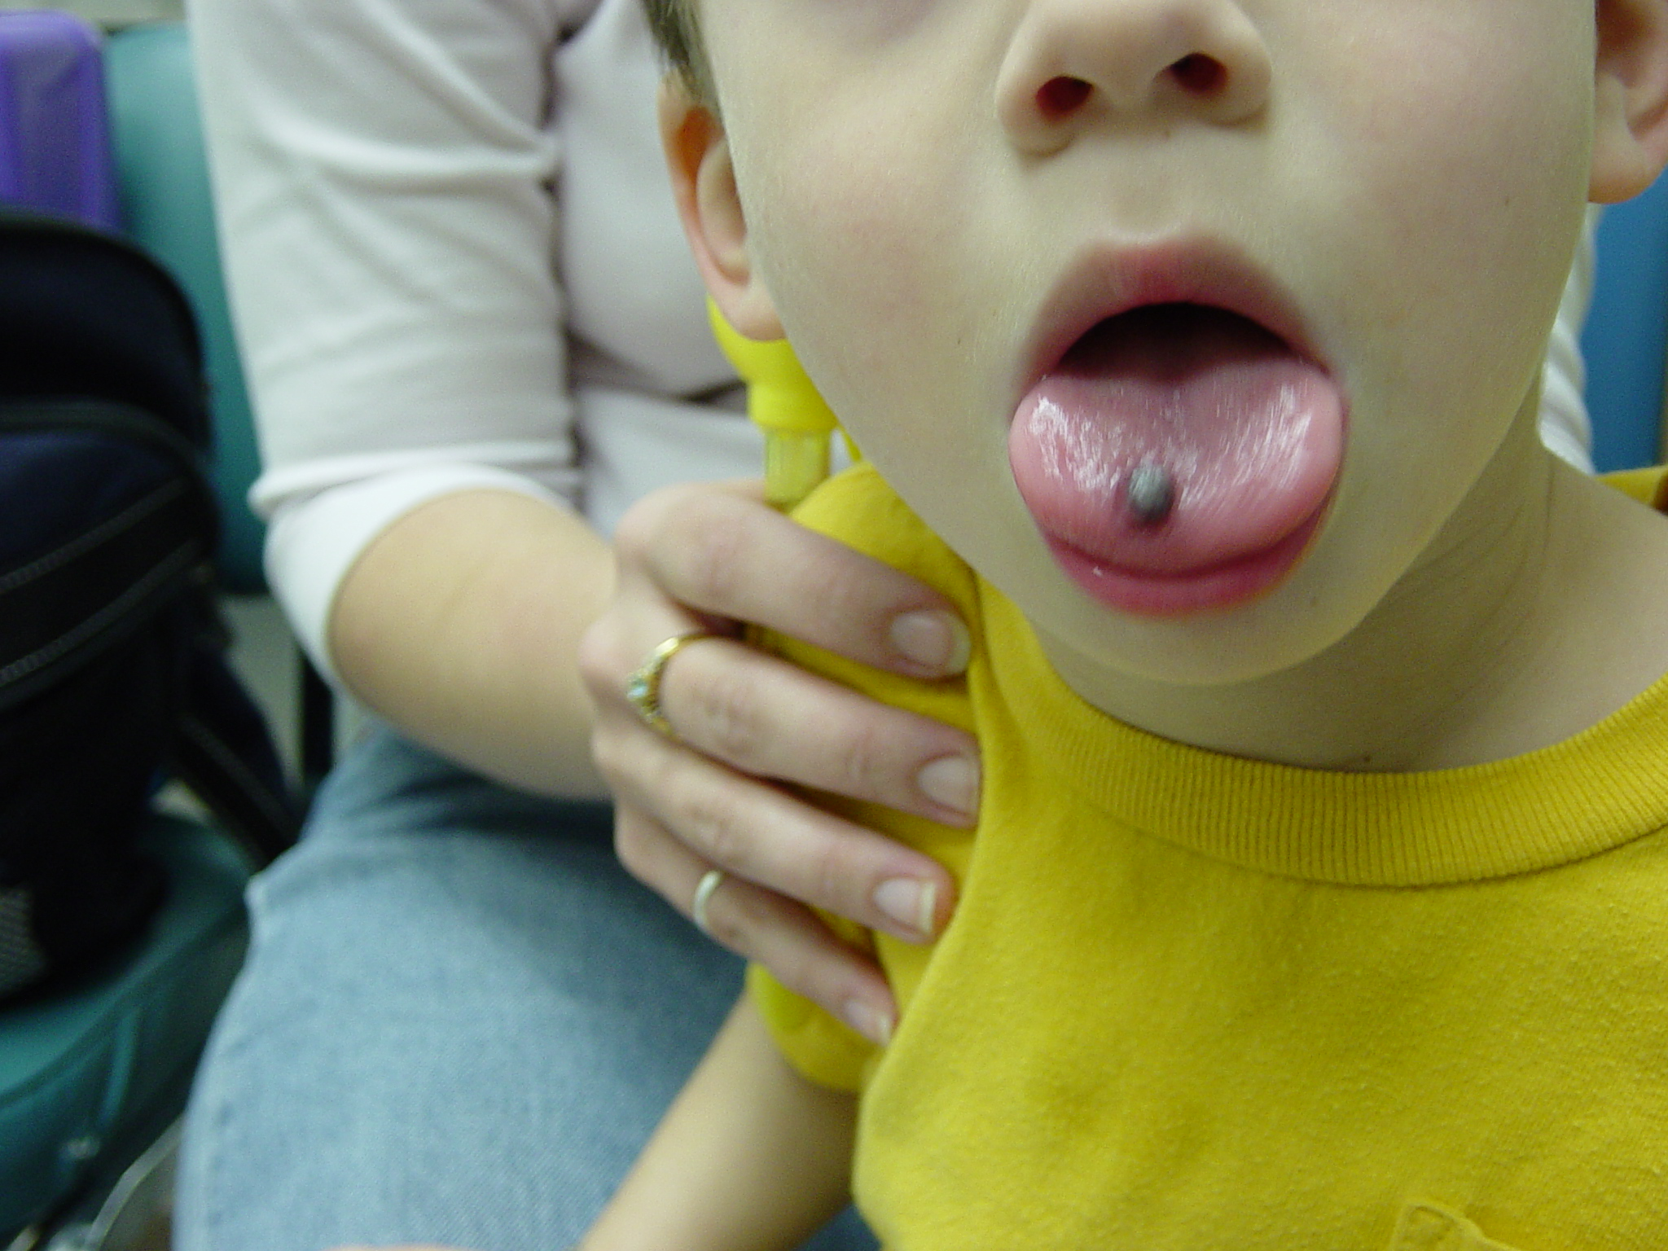

Slide 37
Post-traumatic Bleeding

Slide 38
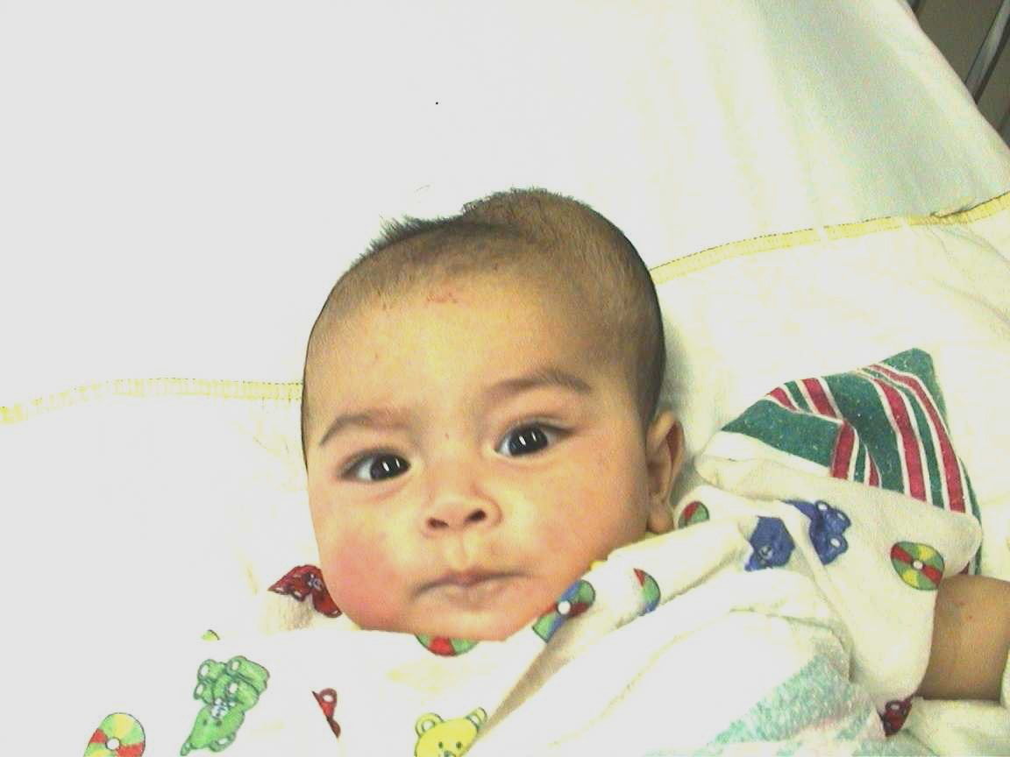

Slide 39
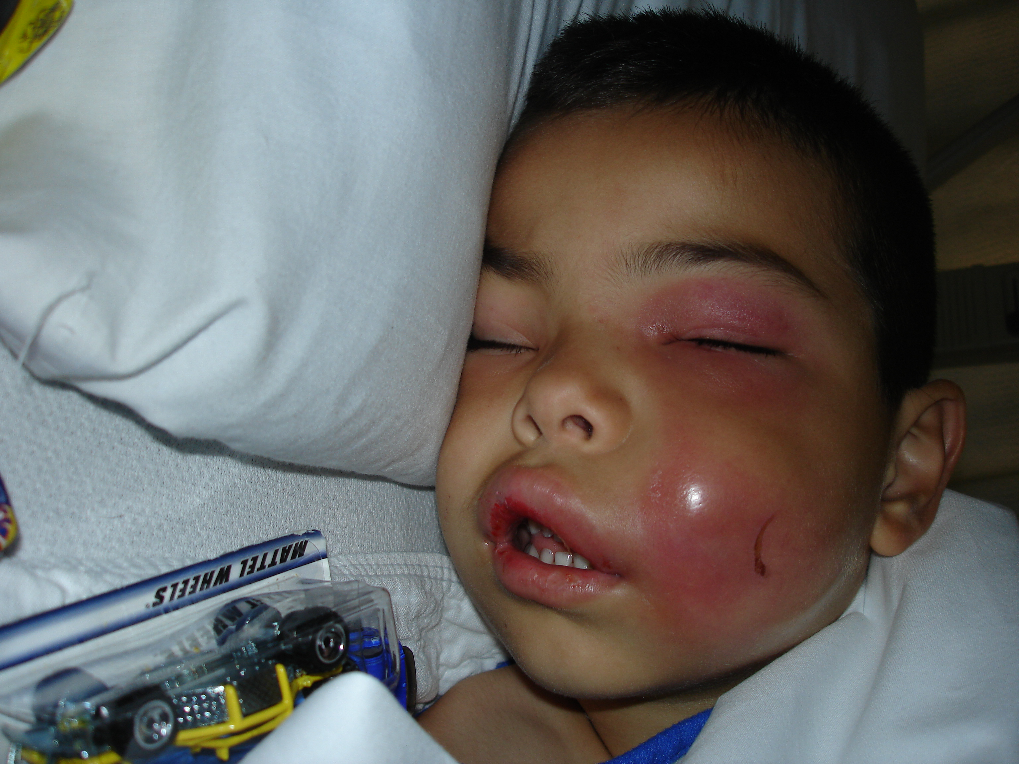

Slide 40
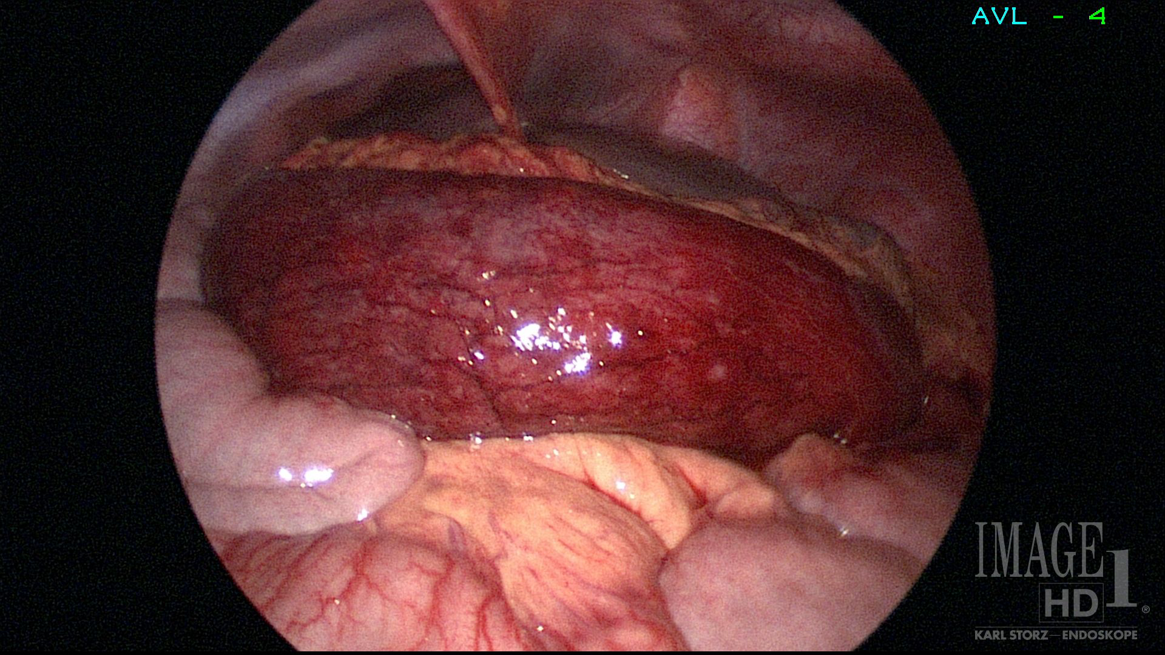

Slide 41
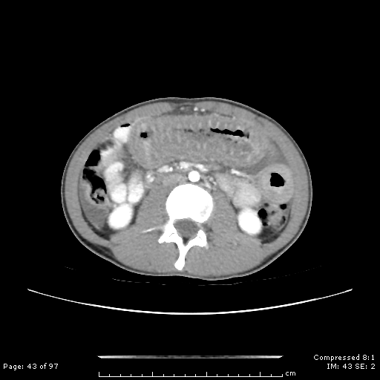

Slide 42
Intracranial Bleeding

Slide 43
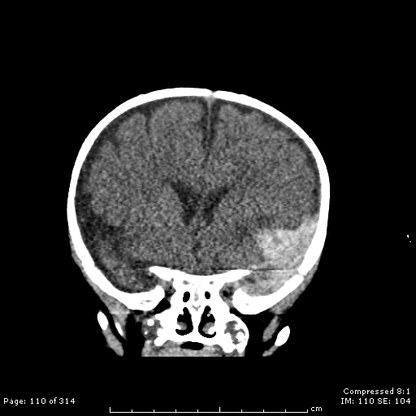

Slide 44
Retroperitoneal hemorrhage
A common type of internal hemorrhage usually resulting from bleeding in the iliopsoas muscle
Symptoms
Pain in flank, groin or rarely thigh (referred pain)
Pain exacerbated and localized to RLQ by extending leg (stretching the muscle)
Difficulty walking
Typically walk hunched over to relax the iliopsoas

Slide 46
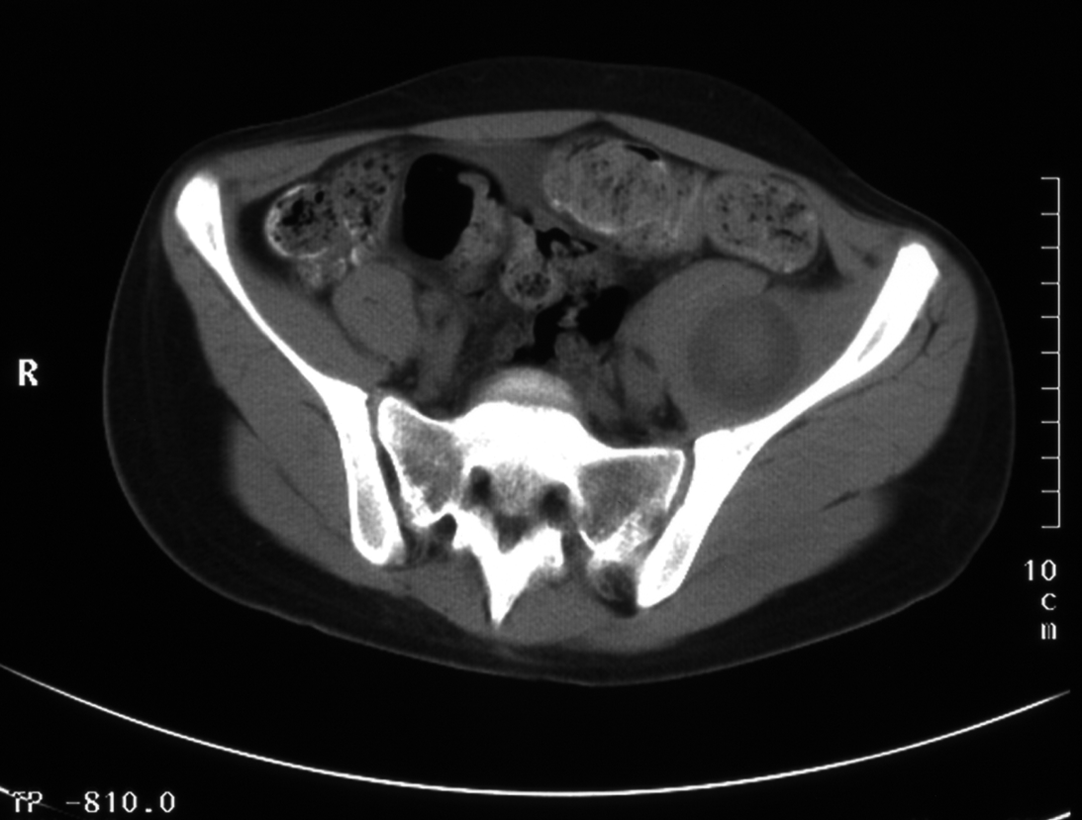

Slide 47
Hemophilia Outline
Hemophilia history
General characteristics
Diagnosis
Treatment
Inhibitors

Slide 48
Laboratory Diagnosis
Screening assays
PTT is almost always prolonged
Some mild hemophilia patients will have a normal PTT
Selected genotypes are known to cause this due to the way the FVIII/FIX interacts with phospholipids in the reagents
Factor assays
Measure specific factor activity levels
Clot-based assays using PTT as base assay
Genetic assays
Genotyping to determine specific molecular defect

Slide 49
Prenatal diagnosis
Prenatal diagnosis can be performed using fetal DNA
Amniocentesis
Percutaneous umbilical blood sampling
Chorionic villous sampling
Testing is easiest if the genetic defect in the family is already known
Factor levels are not reliable enough for prenatal testing
FIX levels are physiologically low in fetuses
FVIII levels can be falsely elevated

Slide 50
Carrier testing
Heterozygous women (carriers) can be symptomatic due to Lyonization (non-random X-chromosome inactivation)
Factor levels fall in the mild hemophilia range
Can be diagnosed with factor levels, but…
Must rule out von Willebrand disease to be sure
Most reliable way to diagnose carriers is through genotyping
First, find molecular defect in index case

Slide 51
Hemophilia Outline
Hemophilia history
General characteristics
Diagnosis
Treatment
Inhibitors

Slide 52
Treatment Issues
General approach
On-demand (episodic) vs. prophylaxis
Medications
Factor replacement
Desmopressin (DDAVP)
Antifibrinolytic therapy
Special situations
Surgery
Dental procedures
Hematuria

Slide 53
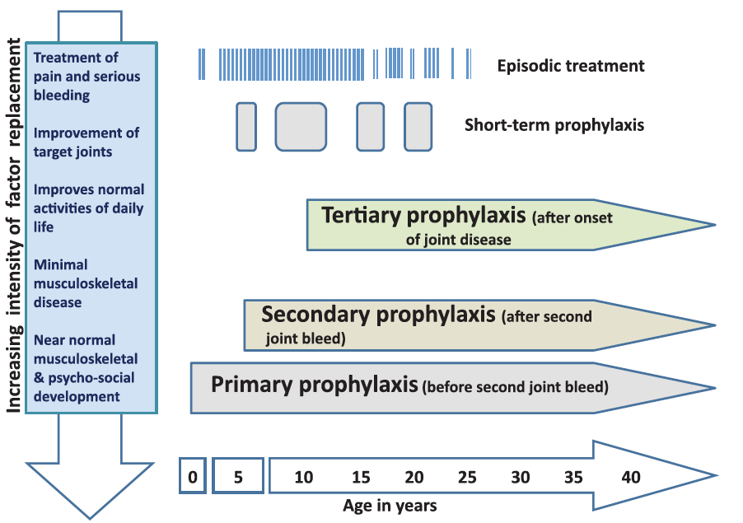
Reproduced with permission from Srivastava A, Brewer AK, Mauser-Bunschoten EP, Key NS, Kitchen S, Llinas A, Ludlam CA, Mahlangu JN, Mulder K, Poon MC, Street A; Treatment Guidelines Working Group on Behalf of The World Federation Of Hemophilia. Guidelines for the management of hemophilia. Haemophilia. 2013 Jan;19(1):e1-47. doi: 10.1111/j.1365-2516.2012.02909.x. © 2013, John Wiley & Sons, Inc.

Slide 54
Prophylaxis
Prophylaxis implies the regular administration of factor replacement therapy in order to prevent bleeding and its complications
Primary prophylaxis
Initiation of factor prior to any joint bleeding (or after 1-2 joint bleeds before any obvious joint disease)
Secondary prophylaxis
Initiation of factor replacement after the onset of joint disease in order to prevent further bleeding

Slide 55
Indications for prophylaxis
Does not differ with FVIII or FIX deficiency
Generally used in severe hemophilia to prevent hemophilic arthropathy
In US, severe hemophilia patients should start prophylaxis no later than after 2 joint bleeds
Can be started prior to any joint bleeds
Moderate hemophilia patients who bleed frequently should also be on prophylaxis

Slide 56
Prophylaxis dosing
Factor VIII
25-40 IU/kg/dose 3x per week or qod
Some centers start with weekly dosing and escalate with bleeds
FIX
50-100 IU/kg/dose 2x per week
Some center start with weekly dosing and escalate

Slide 57
New Factor Therapies
New, longer-acting factor therapies have become available
Won’t be on the Boards
You can ask me about them later if interested

Slide 58
On-demand (episodic) therapy
Appropriate for mild and most moderate hemophilia patients
Treat bleeding episodes only
Not preventative of bleeds or joint disease

Slide 59
Chronic Arthropathy
Patients can develop arthropathy after even one joint bleed though generally takes several bleeds in the same joint
Multiple bleeds in the same joint are referred to as a target joint
3 bleeds in 6 months
4 in a year

Slide 60
Management of Chronic Arthropathy
Goals
Improve joint mobility
Reduce pain
Achieve optimal function for activities of daily living

Slide 61
Management of Chronic Arthropathy
Medical
Initiation of secondary prophylaxis
Surgical
Synovectomy (open, arthroscopic, radioisotopic)
Other
Pain management
Physiotherapy
Casting, bracing, orthotics, walking/mobility aids
Notes:
Recognize the management approaches to chronic arthropathy in a patient with hemophilia.

Slide 62
Treatment—Factor Replacement*
Bleed Location | Treatment | Comments
Intracranial | 100% correction for at least 2 weeks | Continue treatment with prophylaxis dosing indefinitely
Retroperitoneal | 80% correction for at least a few days | Follow up with short-term prophylaxis (weeks)
Muscle | 40-60% correction | At least until can utilize muscle with no pain
Joint | 40-60% correction | Generally 1-3 doses suffices
Mucosal | 30-50% correction | Add antifibrinolytics
Subcutaneous hematomas | Observation is generally sufficient | Large hematomas in “bad” locations (buttocks) need factor
Surgery | 100% correction pre-op | Maintain trough of 50% until risk for bleeding is over
*There are no clinical trial data supporting these dosing schemes

Slide 63
Treatment—Factor Replacement
Pharmacology
Factor recovery (peak factor found in plasma immediately after a dose)
FVIII—1 IU/kg increases factor level by ~2%
FIX—1 IU/kg increases factor level by ~1%
True for all pd-FIX products
For rFIX, there are three available products and recovery is 0.7% per IU/kg (Benefix)

Slide 64
Treatment—Desmopressin (DDAVP)
Desmopressin
Increased FVIII levels in most patients with mild hemophilia by increasing circulating vWF
Not indicated in FIX deficiency
Only effective in mild hemophilia A
Generally for mucocutaneous bleeding and minor procedures (dental)
Some mild mutations are non-responsive
Must do a desmopressin challenge before prescribing
Patients less than 3 years of age can develop hyponatremia
Generally a moot point as mild hemophiliacs are not often diagnosed by this age
Some patients develop hypotension and flushing
First dose should be administered in the clinic

Slide 65
Pros/Cons of Factor VIII Therapy
Pros
Immediate rapid, reliable rise in factor level
Factor level is sustained (half-life is ~6-12 hours)
Highly effective
Safe (except risk for inhibitors)
Cons
Intravenous administration
Availability
Cost
Inhibitor development
~30% of patients will develop an inhibitor

Slide 66
Pros/Cons of Desmopressin (DDAVP)
Cons
Levels don’t peak sufficiently high for serious bleeds (joint/muscle/ICH)
Levels return to baseline in ~4 hours
Not all patients respond
Some responsive patients have hypotension/flushing abrogating its use
Pros
Routes of administration
Intranasal, IV, SC
Intranasal route very easy to do at home
Effective for mild bleeds
Generally safe (risk for hyponatremia and hypotension is low)
Relatively inexpensive

Slide 67
Pros/Cons of Factor IX Therapy
Pros
Immediate rapid, reliable rise in factor level
Factor level is sustained (half-life is ~12-18hours)
Highly effective
Safe (except risk for inhibitors)
Cons
Intravenous administration
Availability
Cost
Inhibitor development
Much less than FVIII (~5%)
FIX inhibitors often cause anaphylaxis
Cannot do ITT
Cannot use APCC

Slide 68
Surgical Management
Ensure patient does not have an inhibitor
Replace factor to 100% immediately prior to procedure
Repeat bolus doses to maintain a trough >50% until bleed risk has passed
Can use continuous infusion if many days of factor will be needed (major surgery)
Antifibrinolytic drugs can be added especially for mucus membrane surgery

Slide 69
Surgical Factor Management
FVIII
50 IU/kg immediately prior to procedure
Follow up doses
50 IU/kg q12h
Can adjust to maintain a trough >50%
Continuous infusion (~3 IU/kg/hr) to maintain a trough >50%

Slide 70
Surgical Factor Management
FIX
120-140 IU/kg of rFIX (or 100 IU/kg of pdFIX) immediately prior to procedure
Follow up doses
Same as pre-op q12-24h
Continuous infusion (~6 IU/kg/hour) to maintain a trough >50%

Slide 71
Management of Dental Extractions
Factor replacement
Correction to 80-100%
Add antifibrinolytic agent
Aminocaproic acid
Tranexamic acid
Pressure gauze
Desmopressin
Not fully reliable

Slide 72
Management of Hematuria
Factor replacement
Correct factor level to 80-100%
Hydration
1.5-2x maintenance
Antifibrinolytic agents are contraindicated
Unless you know for sure the source is the lower urinary tract
Desmopressin is not reliable enough
Glucocorticoids are often given though data is very limited

Slide 73
Therapeutic Failure of Factor Replacement Therapy
Signs
Lack of response to treatment of a bleed
Breakthrough bleeding for patients on prophylaxis
Excessive bleeding during surgery or post-operatively
Causes
Insufficient factor dose
Dosing is weight based
Development of an inhibitor
Therapeutic failure includes

Slide 74
Therapeutic Failure of Factor Replacement Therapy
Must test for inhibitor immediately
For bleeding, treat with a bypassing agent
For patients on prophylaxis, therapy should be suspended

Slide 75
Hemophilia Outline
Hemophilia history
General characteristics
Diagnosis
Treatment
Inhibitors

Slide 76
Inhibitors
An inhibitor is the term for a neutralizing antibody
Renders factor replacement less effective or ineffective
Inhibitors significantly complicate the management of hemophilia
Bleeds are more difficult to treat
Prophylaxis is not nearly as effective
Inhibitor patients have worse morbidity

Slide 77
Risk Factors for Inhibitor Development
Patient
Treatment
Severity of hemophilia
Product type?
Family history
No. of exposure days
Molecular defect
Intensity of exposure
Race
FVIII
antibody
response
Cumulative exposure
High-responding inhibitors
Low- responding inhibitors
Transient inhibitors
Notes:
Arun B, Kessler CM. Clinical manifestations and therapy of the hemophilias. In: Colman RW, Clowes AW, Hirsh J, George JN, Marder VJ, eds. Hemostasis and Thrombosis: Basic Principles and Clinical Practice. 4th ed. Philadelphia, Pa: Lippincott, Williams & Wilkins; 2000:815-824.
Kreuz W, Escuriola-Ettingshausen C, Martinez-Saguer I, Kaiml M, Kornhuber B. Epidemiology of inhibitor development in haemophilia A patients treated with virus-inactivated plasma-derived clotting factor concentrates. Vox Sang. 1999;77(suppl 1):3-8.
Oldenburg J, Brackmann H-H, Schwaab R. Risk factors for inhibitor development in hemophilia A. Haematologica. 2000;85(suppl to 10):7-14.
Oldenburg J, El-Maarri O, Schwaab R. Inhibitor development in correlation to factor VIII genotypes. Haemophilia. 2002;8(suppl 2):23-29.
Clinical Contributors to Inhibitor Development
In addition to the influence of the specific FVIII mutation underlying a patient’s FVIII deficiency (detailed on a later slide), known or potential predictors of inhibitor development include a severe hemophilia A phenotype; a family history of inhibitors; African heritage; young age at initiation of replacement therapy; number of FVIII infusions; and, possibly, an inflammatory event (eg, vaccination or infection) coincident with initial exposure to FVIII concentrate
Some of these factors are possibly expressions of underlying genetics rather than independent predictors

Slide 79
Risk Factors for Inhibitor Development
Patient
Treatment
Severity of hemophilia
Product type
Family history
No. of exposure days
Molecular defect
Intensity of exposure
Race
FVIII
antibody
response
Cumulative exposure
High-responding inhibitors
Low- responding inhibitors
Transient inhibitors
Notes:
Arun B, Kessler CM. Clinical manifestations and therapy of the hemophilias. In: Colman RW, Clowes AW, Hirsh J, George JN, Marder VJ, eds. Hemostasis and Thrombosis: Basic Principles and Clinical Practice. 4th ed. Philadelphia, Pa: Lippincott, Williams & Wilkins; 2000:815-824.
Kreuz W, Escuriola-Ettingshausen C, Martinez-Saguer I, Kaiml M, Kornhuber B. Epidemiology of inhibitor development in haemophilia A patients treated with virus-inactivated plasma-derived clotting factor concentrates. Vox Sang. 1999;77(suppl 1):3-8.
Oldenburg J, Brackmann H-H, Schwaab R. Risk factors for inhibitor development in hemophilia A. Haematologica. 2000;85(suppl to 10):7-14.
Oldenburg J, El-Maarri O, Schwaab R. Inhibitor development in correlation to factor VIII genotypes. Haemophilia. 2002;8(suppl 2):23-29.
Clinical Contributors to Inhibitor Development
In addition to the influence of the specific FVIII mutation underlying a patient’s FVIII deficiency (detailed on a later slide), known or potential predictors of inhibitor development include a severe hemophilia A phenotype; a family history of inhibitors; African heritage; young age at initiation of replacement therapy; number of FVIII infusions; and, possibly, an inflammatory event (eg, vaccination or infection) coincident with initial exposure to FVIII concentrate
Some of these factors are possibly expressions of underlying genetics rather than independent predictors

Slide 80
Risk Factors for Inhibitor Development
Higher risk for inhibitor
Family history of inhibitors
Identical twin>sibling>uncle or grandfather
Severity of hemophilia
Severe>Moderate>Mild
Molecular defect
Large deletions>Nonsense mutations>Inversions>Missense mutations
Race
African>Caucasian (Latino, Asian less clear)

Slide 81
Diagnosis of Inhibitors
Bethesda Assay

Slide 82
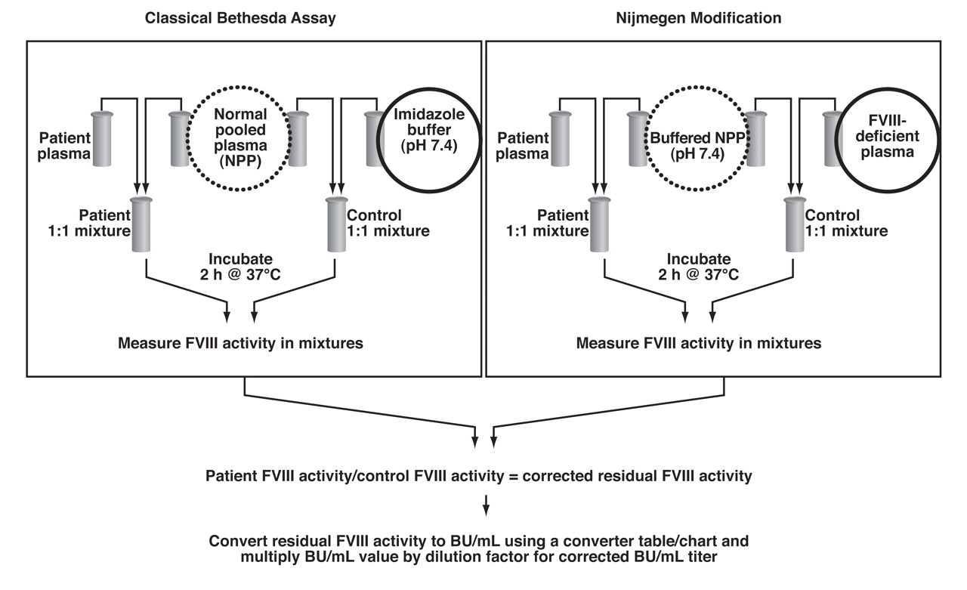
Reproduced with permission from Peerschke EI, Castellone DD, Ledford-Kraemer M, Van Cott EM, Meijer P; NASCOLA Proficiency Testing Committee. Laboratory assessment of factor VIII inhibitor titer: the North American Specialized Coagulation Laboratory Association experience. Am J Clin Pathol. 2009 Apr;131(4):552-8. doi: 10.1309/AJCPMKP94CODILWS. Copyright © 2009, Oxford University Press.

Slide 83
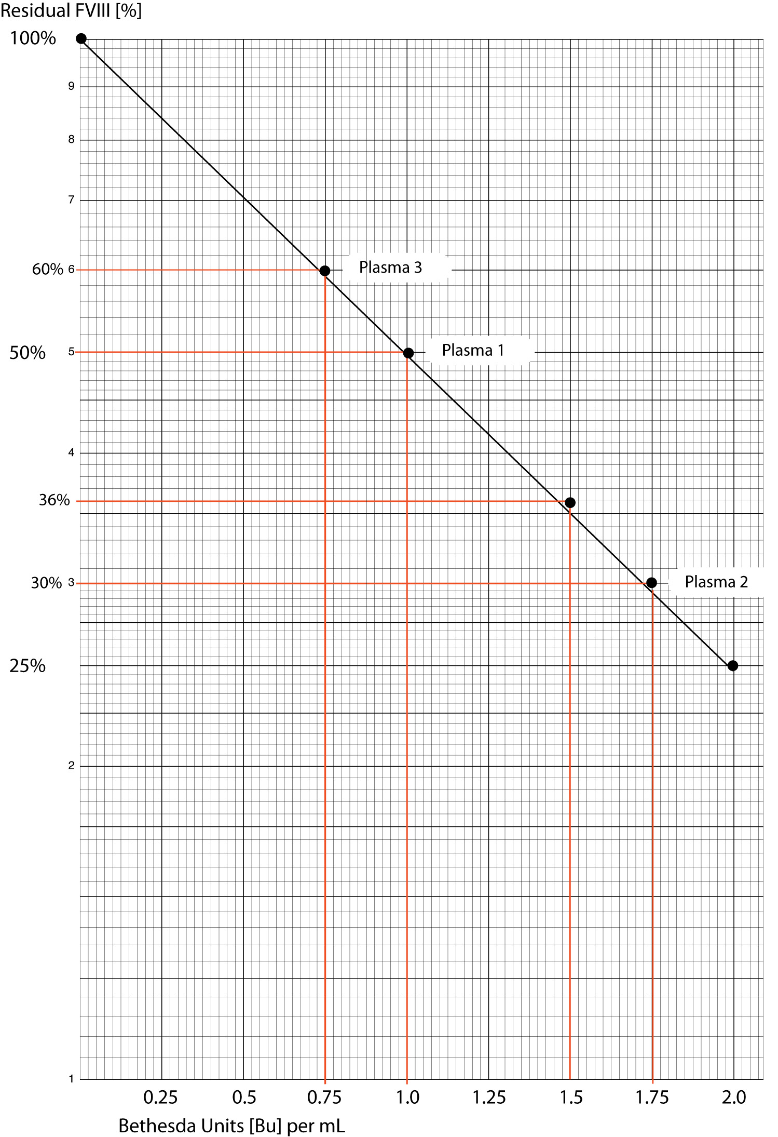

Slide 84
Transient inhibitors
As their name implies, only transient
Clinically insignificant
Only found during routine surveillance for inhibitors
No specific treatment
Continue to use standard factor replacement
Observation
Follow inhibitor titer

Slide 85
Types of inhibitors
High titer
Low titer
>5 BU
Always high responders
Rapid anamnestic response
Must use bypassing agents to treat and/or prevent bleeding
<5 BU
Low responder
No anamnestic response
Can be treated with factor replacement at higher than usual doses

Slide 86
Management of Inhibitor Patients
Eradication of the inhibitor
Immune Tolerance Therapy
Bleed management
Treatment of bleeds
Prevention of bleeds

Slide 87
Eradication of the Inhibitor
Immune Tolerance Therapy (ITT)
Regular (usually daily) infusions of FVIII (or rarely FIX) to “educate” immune system to become tolerant of factor replacement
Treatment takes 6-18 months
Tolerance is achieved when the patient has a recovery of >66% and a half-life >6 hours
Regimens include daily and qod regimens
Daily regimen associated with fewer bleeding episodes early in ITT course

Slide 88
Bleed Management
Low titer, low responder patients
Can use standard factor VIII replacement therapy but need higher doses
Simple (not validated) formula
Multiply the inhibitor titer by the IU/kg that you would give to a non-inhibitor patient
Recheck inhibitor titer to be sure it is not rising following infusion (anamnesis)

Slide 89
Bleed Management
High titer inhibitor patients
All are high responders
Cannot use standard factor VIII replacement
Must use bypassing agents
Anti-inhibitor coagulant complex [a.k.a. activated prothrombin complex concentrates (APCC)]
Recombinant activated factor VIIa (rFVIIa)

Slide 90
Management of Inhibitor Patients
rFVIIa
Activated prothrombin complex concentrate (APCC)*
Bleed treatment
90-120 mcg/kg per dose is US licensed dose
Doses are repeated q2-3h until bleed resolution
Outside US, 270 mcg/kg per dose is licensed
Surgical prophylaxis
Prophylaxis
Licensed for this use outside US
Plasma-derived mixture of factors II, VII, IX and X (some activated)
Bleed treatment
50-100 IU/kg per dose q8-12
Not to exceed 200 IU/kg/day
Surgical prophylaxis
Prophylaxis
Licensed in US and outside
75 IU/kg qod
*Generic name is Anti-inhibitor coagulant complex

Slide 91
Inhibitor Management Main Points
Know that you can treat low titer, low responder patients with regular factor
Know that you CANNOT treat high titer patients with factor replacement
Either rFVIIa or APCC can be used to treat bleeding and prevent surgical bleeding
Desmopressin is ineffective in inhibitor patients

Slide 92
Lecture Outline
Hemophilia
von Willebrand disease
Rare bleeding disorders

Slide 93
von Willebrand disease
Most common bleeding disorder
1% by lab testing
1 per 500 symptomatic (“real cases”)
Symptoms
Mostly mucocutaneous bleeding except type 3
Type 3 have mucocutaneous bleeding and hemophilia-like bleeding
Epistaxis, easy bruising, oral bleeding, post-surgical (oropharyngeal) bleeding
Menorrhagia and post-partum bleeding in females of child-bearing age

Slide 94
von Willebrand factor
vWF function
Platelet binding
Carrier molecule for FVIII
vWF is increased by physiologic stress, DDAVP, estrogen, pregnancy, and is an acute phase reactant

Slide 95
Von Willebrand factor, endothelial cells and platelets
--platelet
--circulating vWF
--endothelial cell
Normal status

Slide 96
Von Willebrand factor, endothelial cells and platelets
--platelet
--circulating vWF
-- bound vWF
--activated platelet
--endothelial cell
Injury situation
vWF binding to (“unfurling”) subendothelium

Slide 97
Von Willebrand factor, endothelial cells and platelets
--platelet
--circulating vWF
-- bound vWF
--endothelial cell
Injury situation
vWF binding “capturing” platelet via platelet gylcoprotein Ib receptor

Slide 98
Von Willebrand factor, endothelial cells and platelets
--platelet
--circulating vWF
-- bound vWF
--activated platelet
--endothelial cell
Injury situation
Platelet adhesion via vWF and platelet activation

Slide 99
von Willlebrand disease types
Divided into several types
Types below by physiologic defect
Type 1 (autosomal dominant)
Heterozygous defect with reduced production of normal vWF
Type 2A (autosomal dominant)
Multimerization defect with absent large/intermediate size multimers
Type 2B (autosomal dominant)
Gain of function mutation in VWF (too adherent to platelets so large multimers are attached to platelets and not circulating)
Type 2M (autosomal dominant)
Loss of function mutation (opposite of 2B)—vWF doesn’t bind well to platelets
Type 2N (autosomal dominant—patients are compound heterozygotes with type 1)
Loss of vWF binding function to FVIII
Type 3 (autosomal recessive)
Absence of vWF production

Slide 100
von Willebrand disease lab testing
Screening
No screening tests rule out vWD (PT is normal, PTT is only abnormal if FVIII is low, bleeding time and PFA-100 are not sufficiently sensitive)
Diagnostic tests
VWF antigen (VWF:Ag)
Immunologic test for the presence of vWF in plasma (doesn’t assess function)
Ristocetin cofactor activity (VWF:Rcof)
Platelet aggregation based test assessing vWF platelet binding function
Factor VIII activity (same assay as for hemophilia)
Assesses FVIII activity in blood and assesses vWF:FVIII binding function
vWF multimer analysis
Assesses molecular structure of vWF on an agarose gel (vWF is normally present in a variety of sizes termed high, intermediate, and low molecular weight multimers)

Slide 101
VWD classification
Type | FVIII | VWF:Ag | RCoF | RIPA | Multimers
1 | wnl/ |  |  | No increase in plt aggregation | All sizes present
2A | wnl/ |  |  | No increase in plt aggregation | Decreased large and intermediate MW multimers
2B | wnl/ |  |  | Increased plt aggregation with low dose ristocetin | Decreased large MW multimers
2M | nl | wnl/ |  | No increase in plt aggregation | All sizes present
2N |  |  |  | No increase in plt aggregation | All sizes present
3 | Absent | Absent | Absent | No increase in plt aggregation | Absent

Slide 102
type 2B
type 2A
type 1
type 3
VSD
VSD
NP
TTP
Plasma VWF Multimers
0.65% agarose
Notes:
Legend: VSD = ventricular septal defect.
NP = normal plasma.
TTP = thrombotic thrombocytopenic purpura.
Types 2A, 2B, 1, and 3 refer to subtypes of VWD.

Slide 103
VWF Levels: Influence of Blood Type
Blood Type Lower VWF:Ag Limit
Type O 35.6 U/dL (mean 74.8 U/dL)
Type A 48.0 U/dL (mean 105.9 U/dL)
Type B 56.8 U/dL (mean 116.9 U/dL)
Type AB 63.8 U/dL (mean 123.3 U/dL)
Notes:
Blood type is known to influence VWF plasma levels. The presence of the ABO blood group has a significant influence on VWF antigen assay (VWF:Ag) values; individuals with blood group O have the lowest mean VWF:Ag level (mean 74.8 U/dL), followed by group A (mean 105.9 U/dL), then group B (mean 116.9 U/dL), and finally group AB (mean 123.3 U/dL).¹⁰
Type I VWD is found more frequently in individuals with blood type O, which may be a result of decreased concentrations of structurally normal VWF on the basis of blood group rather than specific inherited abnormalities of VWF production or release.¹⁰
These ranges should be determined in each diagnostic laboratory, as there is local variation in the results of these assays on identical standards.

Slide 104
Treatment options
Increase circulating vWF
Desmopressin (DDAVP)
Releases stored vWF from Weibel-Palade bodies in endothelium
Replacement with plasma-derived vWF concentrate
Inhibit fibrinolysis
Antifibrinolytics (described in detail in general coag talk)
Hormonal therapy
Effective for menorrhagia management
Estrogen increases vWF and FVIII
Reduced blood flow to endometrium
Topical therapy
Antifibrinolytics for oral bleeding
Topical thrombin for oral or nose bleeding
Cellulose or collagen embedded gauze

Slide 105
Treatment by VWD type and Bleeding Situation
 | Type 1 | Type 2A | Type 2B, 2N, 2M | Type 3
Mild oral mucosal | DDAVP Antifibrinolytics Topical therapy | DDAVP? Antifibrinolytics Topical therapy | Antifibrinolytics Topical therapy vWF replacement | Antifibrinolytics Topical therapy vWF replacement
Menorrhagia | DDAVP Antifibrinolytics Hormonal therapy | DDAVP? Antifibrinolytics Hormonal therapy | Antifibrinolytics Hormonal therapy vWF replacement | Antifibrinolytics Hormonal therapy vWF replacement
Deep tissue Bleeding | Rare vWF replacement | Uncommon vWF replacement | Occasional vWF replacement | Common vWF replacement
Minor surgery | DDAVP Antifibrinolytics Topical therapy | DDAVP? Antifibrinolytics Topical therapy vWF replacement | vWF replacement Antifibrinolytics | vWF replacement Antifibirinolytics
Major Surgery | vWF replacement Antifibrinolytics | vWF replacement Antifibrinolytics | vWF replacement Antifibrinolytics | vWF replacement Antifibrinolytics

Slide 106
Lecture Outline
Hemophilia
von Willebrand disease
Rare bleeding disorders

Slide 107
Characteristics of factor deficiencies
Factor | Bleeding pattern | Other features
Fibrinogen (I) | Post-trauma/surgery Soft tissue | Splenic rupture Pregnancy loss
Prothrombin (II) | Similar to hemophilia? | Extremely rare
Factor V | Similar to hemophilia? | Extremely rare
Factor VII | Similar to hemophilia (mild, moderate, severe based on levels) | Intracranial hemorrhage can occur
Factor X | Intracranial hemorrhage relatively (to other deficiencies) common
Factor XI | Post-trauma/surgery Mucocutaneous | Common in Ashkenazi Jews Most patients don’t bleed
Factor XIII | Umbilical stump bleeding Intracranial hemorrhage common | Highest (relative) prevalence of causing intracranial hemorrhage

Slide 108
Characteristics of factor deficiencies
Factor | Incidence | Inheritance | Treatment
Fibrinogen (I) | 1:1 million | AR | pdFib concentrate Cryoprecipitate
Prothrombin (II) | 1:2 million | AR | PCC
Factor V | 1:1 million | AR | FFP, Platelet tx
Factor VII | 1:300,000 | AR | rFVIIa
Factor X | 1:1 million | AR | PCC
Factor XI | 1:1 million 1:10 Ashkenazi Jews (het) 1:200-400 are affected | AR | FFP pdFXI concentrate only in Israel, Europe
Factor XIII | 1:1 million | AR | pdFXIII and rFXIII concentrate cryoprecipitate
het-heterozygote, conc.-concentrate, tx-transfusion, pd-plasma-derived, r-recombinant

Slide 109
Dysfibrinogenemia
Rare inherited disorder due to a dysfunctional fibrinogen
Can cause bleeding or thrombosis
Bleeding due to dysfibrinogens with loss of proper clot forming structure
Thrombosis due to dysfibrinogens which resist fibrinolysis
Lab findings: prolonged thrombin time, abnormal ratio of fibrinogen antigen to fibrinogen function
Treatment
Bleeding
Replace fibrinogen with pd-fibrinogen concentrate or cryoprecipitate
Thrombosis
Anticoagulation

Slide 110
Prolonged thrombin time
Due to:
Absent or very low (less than 1g/L or 100mg/dL) of fibrinogen
Dysfibrinogenemia
Heparin contamination
Further evaluation
Ensure that there is no heparin contamination
Measure functional fibrinogen [clotting assay (Clauss method)]
If normal, measure fibrinogen antigen and function together to assess for dysfibrinogens
Normal antigen and reduced function is suggestive of dysfibrinogenemia
For patients on heparin, can measure the Reptilase time
Assesses fibrinogen conversion to fibrin (like thrombin time) and resistant to effects of heparin

Slide 111
Appendix—ABP Outline and Slide Number
Coagulation
Disorders of coagulation (diagnosis and therapy)
Congenital hemorrhagic disorders
Factors VIII and IX
Clinical features
Know the mode of inheritance for Factor VIII and IX deficiency (slides 5, 10)
Know that some hemophilia carriers are symptomatic (slides 10, 50)
Know the differentiating characteristics of mild, moderate, and severe hemophilia A and B (slide 19)
Recognize the clinical features of retroperitoneal hemorrhage in a patient with hemophilia (slides 44-46)
Understand the relationship between age and the sites and frequency of bleeding episodes in a hemophiliac patient (slide 20)
Know the risk factors for inhibitor development (slides 77-80)
Recognize that inhibitors may be transient (slide 84)
Know the clinical indications for the use of human recombinant activated factor VII concentrate (slides 89-90)
Understand the molecular basis for hemophilia (slides 11-18)

Slide 112
Appendix—ABP Outline and Slide Number
Coagulation
Disorders of coagulation (diagnosis and therapy)
Congenital hemorrhagic disorders
Factors VIII and IX
Laboratory diagnosis
Understand the various tests to prenatally diagnose factor VIII and IX deficiency (slides 48-49)
Understand the various tests to diagnose a carrier state for factor VIII or factor IX deficiency (slide 50)
Know the limitations of the partial thromboplastin time in diagnosing plasma concentrations of factor VIII or factor IX (slide 48 and slide 47 from general coagulation talk)
Understand the Bethesda assay using human factor VIII (slides 82-83)
Know the differentiating laboratory characteristics of mild, moderate, and severe hemophilia A and B (slide 19)

Slide 113
Appendix—ABP Outline and Slide Number
Coagulation
Disorders of coagulation (diagnosis and therapy)
Congenital hemorrhagic disorders
Factors VIII and IX
Management
Understand the optimum replacement therapy in relation to severity and location of bleeding in a patient with hemophilia (slide 62)
Know the indications for and potential complications of DDAVP in patients with hemophilia (slides 64, 66)
Know the advantages and disadvantages of specific therapies for factor VIII deficiency (slide 65)
Know the probable causes of therapeutic failure in factor VIII deficiency (slides 73-74)
Know the therapeutic approaches to a hemophiliac patient with inhibitor (slides 86-91)
Know the management of dental extractions in hemophiliac patients (slide 71)
Know the therapeutic approaches to a hemophiliac patient with hematuria (slide 72)

Slide 114
Appendix—ABP Outline and Slide Number
Coagulation
Disorders of coagulation (diagnosis and therapy)
Congenital hemorrhagic disorders
Factors VIII and IX
Management
Know the advantages and disadvantages of specific therapies for factor IX deficiency (slide 67)
Know the proper management and appropriate pre- and post-operative treatment for a patient with factor VIII or factor IX deficiency (slides 68-70)
Understand the indications for prophylaxis in factor VIII and IX deficiencies (slides 53-56)
Understand the approaches to chronic arthropathy in a patient with hemophilia (slides 59-61)
Know the diagnostic and therapeutic approaches for a patient with hemophilia (slides 47-91)
Understand the management principles of hemophilia in a neonate or young infant (slide 8)

Slide 115
Appendix—ABP Outline and Slide Number
Coagulation
Physiology of coagulation, fibrinolysis and the vessel wall
von Willebrand factor (vWF)—see section on vWD except as noted below
Know the sites of synthesis, storage, and release of vWF (slide 12 from coag general talk)
Know the platelet aggregation patterns associated with the different types of von Willebrand disease (slide 101)
Know the laboratory methods for measuring the concentrations, structure, and function of vWF (slides 100-102))
Know the interaction between vWF, platelets, and the vessel wall (slides 95-99))
Know the consequences of a deficiency of vWF on the laboratory assessment of hemostasis (slide 100-101)
Know the factors that affect the serum concentration of vWF (slide 94))
Know the half-life of vWF (slide 12 from coag general talk)

Slide 116
Appendix—ABP Outline and Slide Number
Coagulation
Disorders of coagulation (diagnosis and therapy)
Congenital hemorrhagic disorders
von Willebrand disease
Recognize the clinical features of vWD (slide 93)
Know the relationship of decreased von Willebrand antigen with von Willebrand disease (slides 100-101)
Correlate the response to DDAVP with various types of vWD (slide 13)
Know the therapeutic options for the treatment of severe vWD (slide 12-13)
Know how to diagnose and treat subtypes of vWD (slides 99-102, 104-105))
Know the inheritance pattern of vWD (slide 99)
Know the effect of blood type and other factors on von Willebrand antigen concentration (slide 103))

Slide 117
Appendix—ABP Outline and Slide Number
Coagulation
Disorders of coagulation (diagnosis and therapy)
Congenital hemorrhagic disorders
Other inherited coagulation disorders
Recognize the bleeding patterns in less common coagulation defects (slide 107)
Know the appropriate therapy for FXIII deficiency (slide 108)
Recognize the clinical features of afibrinogenemia and dysfibrinogenemia (slides 107-109)
Know how to investigate the cause of a prolonged thrombin time (slide 110)
Know the appropriate therapy for afibrinogenemia and dysfibrinogenemia (108-109)
Understand that clinical bleeding does not occur with prekallikrein deficiency, high molecular weight kininogen deficiency, or FXII deficiency (slides 14 from general coag lecture)

